Slide 1
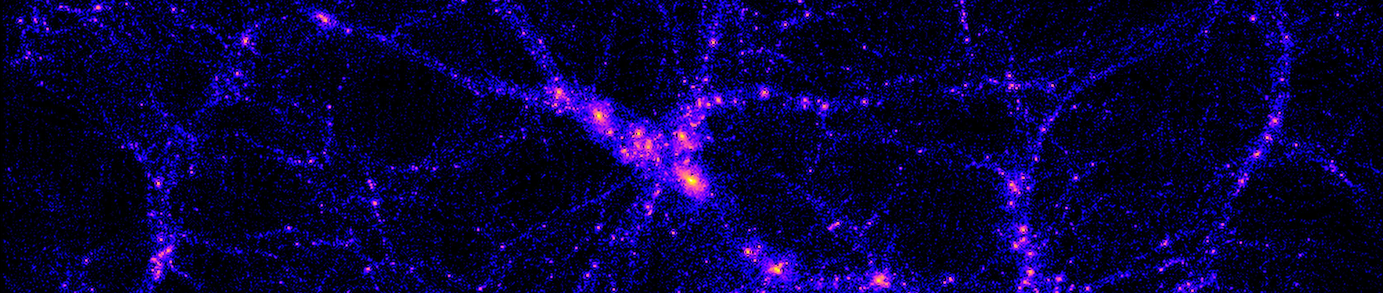
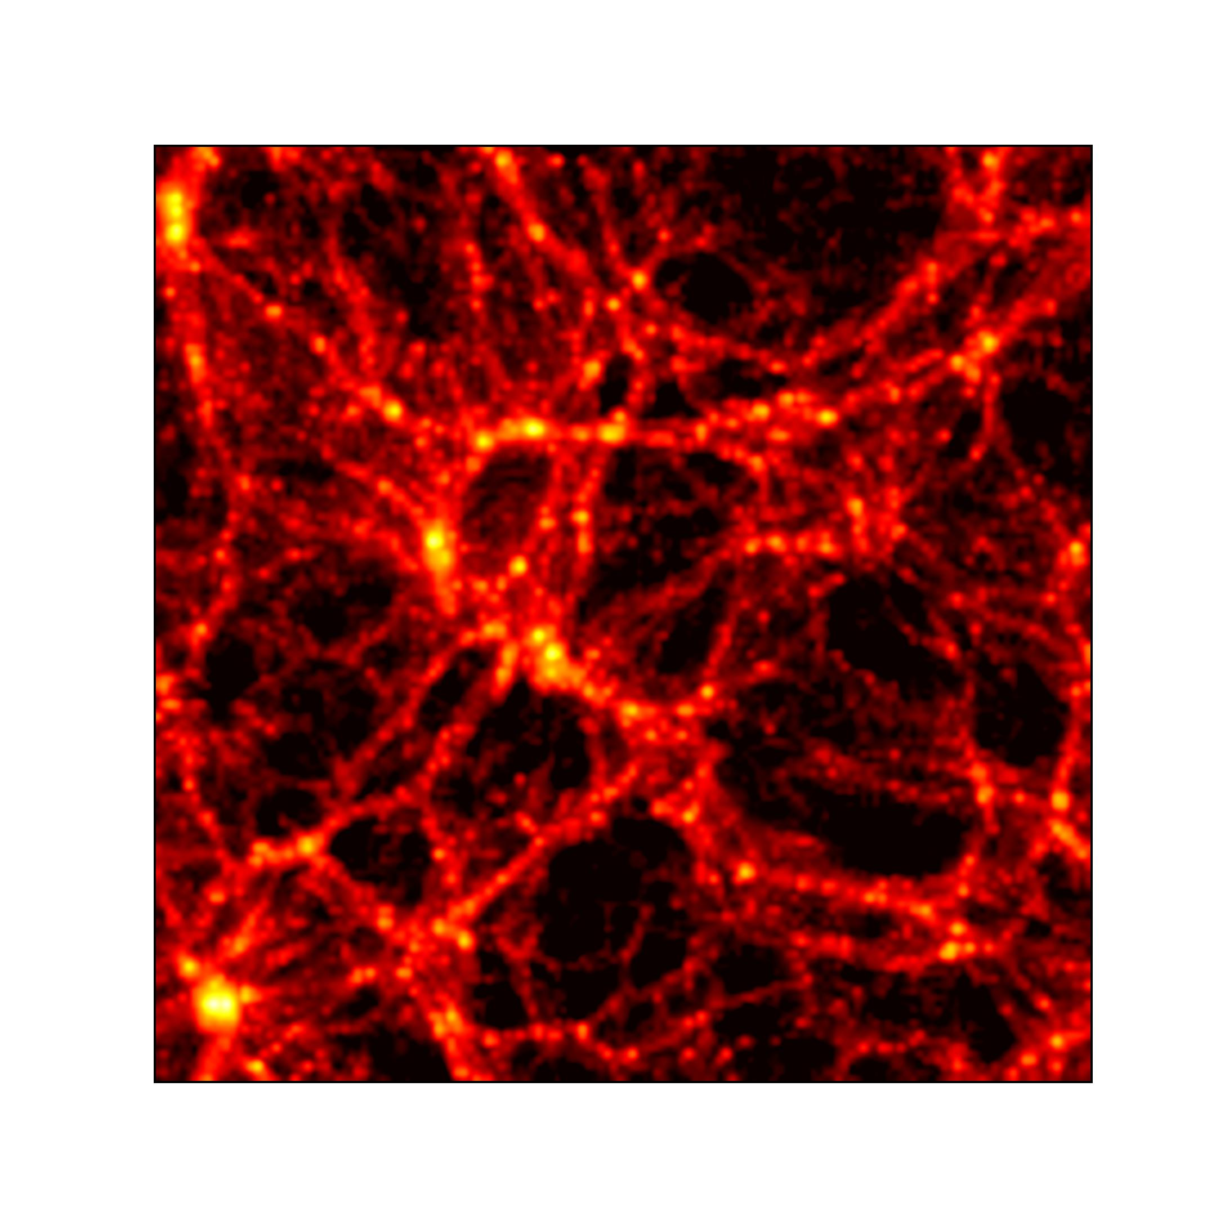
Cosmology at small scales: combining probes with baryonification
Aurel Schneider, UZH
Lecture 2 — Radiation
Notes:
With this talk, I want to give you an overview over my research activities as well as an outlook towards some future projects.
As some might remember, I was here not very long ago. Some of the talk might therefore feel familiar but I have various new things to show.
My research is about predicting nonlinear scales of cosmology. These are the scales where things get complicated to model, not only bus they are linear but also bus gas and stars and feedback matter.
This can be observed in the two first images…
Next to cosmology at small scales, I am also interested in the very high redshifts. More particularly in the epoch of cosmic dawn and redo. This is illustrated in the third picture showing the expansion of ionised bubbles in the IGM.
Finally I want to mention that I have a special interest in particle cosmology (dark matter sector). My goal is therefore to use upcoming data from Euclid and SKA in order to learn something about the nature of DM (free-streaming properties, potential interactions etc).

Slide 2
New cosmological surveys unlock small, non-linear, messy scales
Notes:
As you may know, Euclid requires a percent precision for theory predictions of the matter power spectrum.
Explain plot

Slide 3
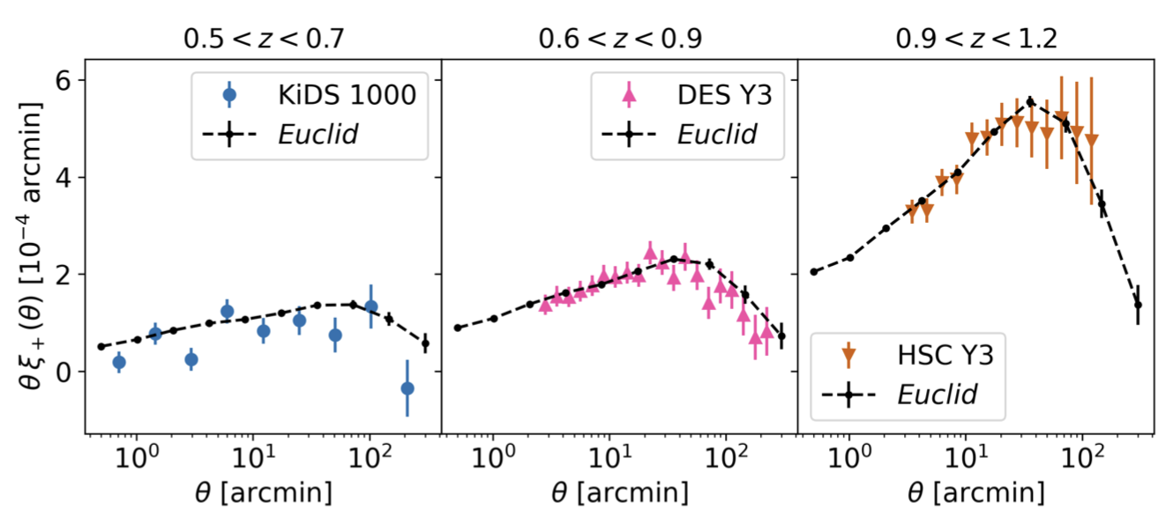
New cosmological surveys unlock small, non-linear, messy scales
    Mellier et al (2025)
    Surveys: weak lensing, galaxy clustering, SZ, X-ray, ….
Notes:
As you may know, Euclid requires a percent precision for theory predictions of the matter power spectrum.
Explain plot

Slide 4
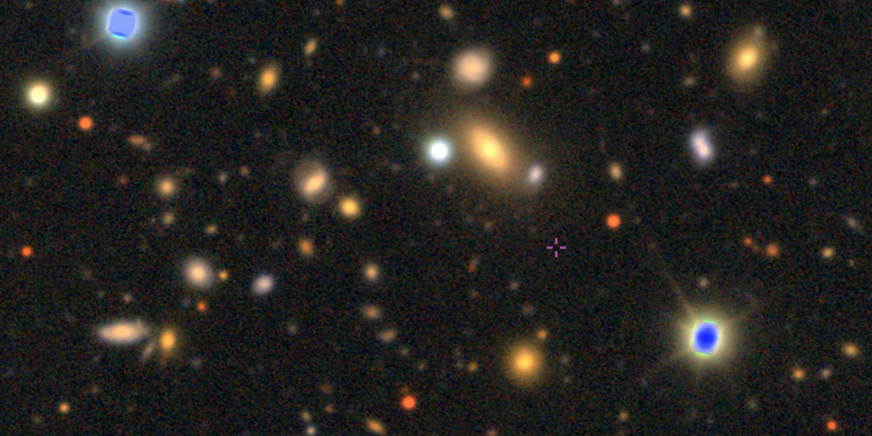
New cosmological surveys unlock small, non-linear, messy scales
sky.esa.int
DES (DR2)- Euclid (VIS)
Notes:
As you may know, Euclid requires a percent precision for theory predictions of the matter power spectrum.
Explain plot

Slide 5

New cosmological surveys unlock small, non-linear, messy scales
Planck
Notes:
As you may know, Euclid requires a percent precision for theory predictions of the matter power spectrum.
Explain plot

Slide 6
Modelling is difficult (and potentially unreliable)
Notes:
As you may know, Euclid requires a percent precision for theory predictions of the matter power spectrum.
Explain plot

Slide 7
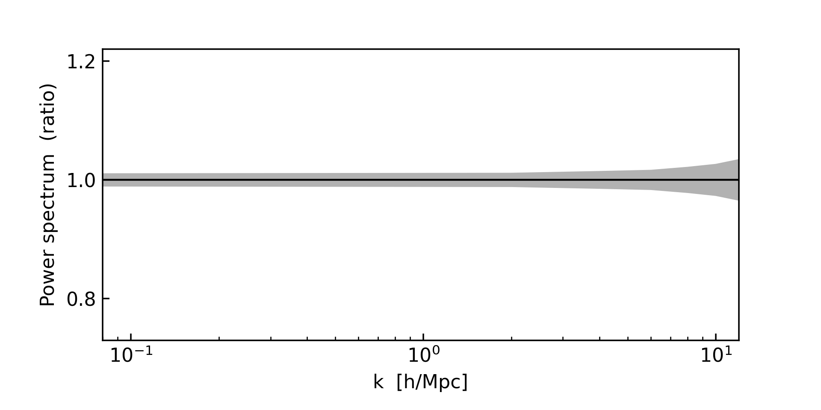
Modelling is difficult (and potentially unreliable)
    Euclid / LSST require precent precision up to k~10 h/Mpc.
Notes:
As you may know, Euclid requires a percent precision for theory predictions of the matter power spectrum.
Explain plot

Slide 8
Modelling is difficult (and potentially unreliable)
    Euclid / LSST require precent precision up to k~10 h/Mpc.
Agreement between N-body codes
(Gadget3, Gadget4, Pkdgrav3, Abacus, CUBEP3M, Ramses)
Notes:
In terms of gravity-only sims there was a lot of progress in the last ten years.
Today the differences between these codes is below 1 percent for nearly all scales.

Slide 9
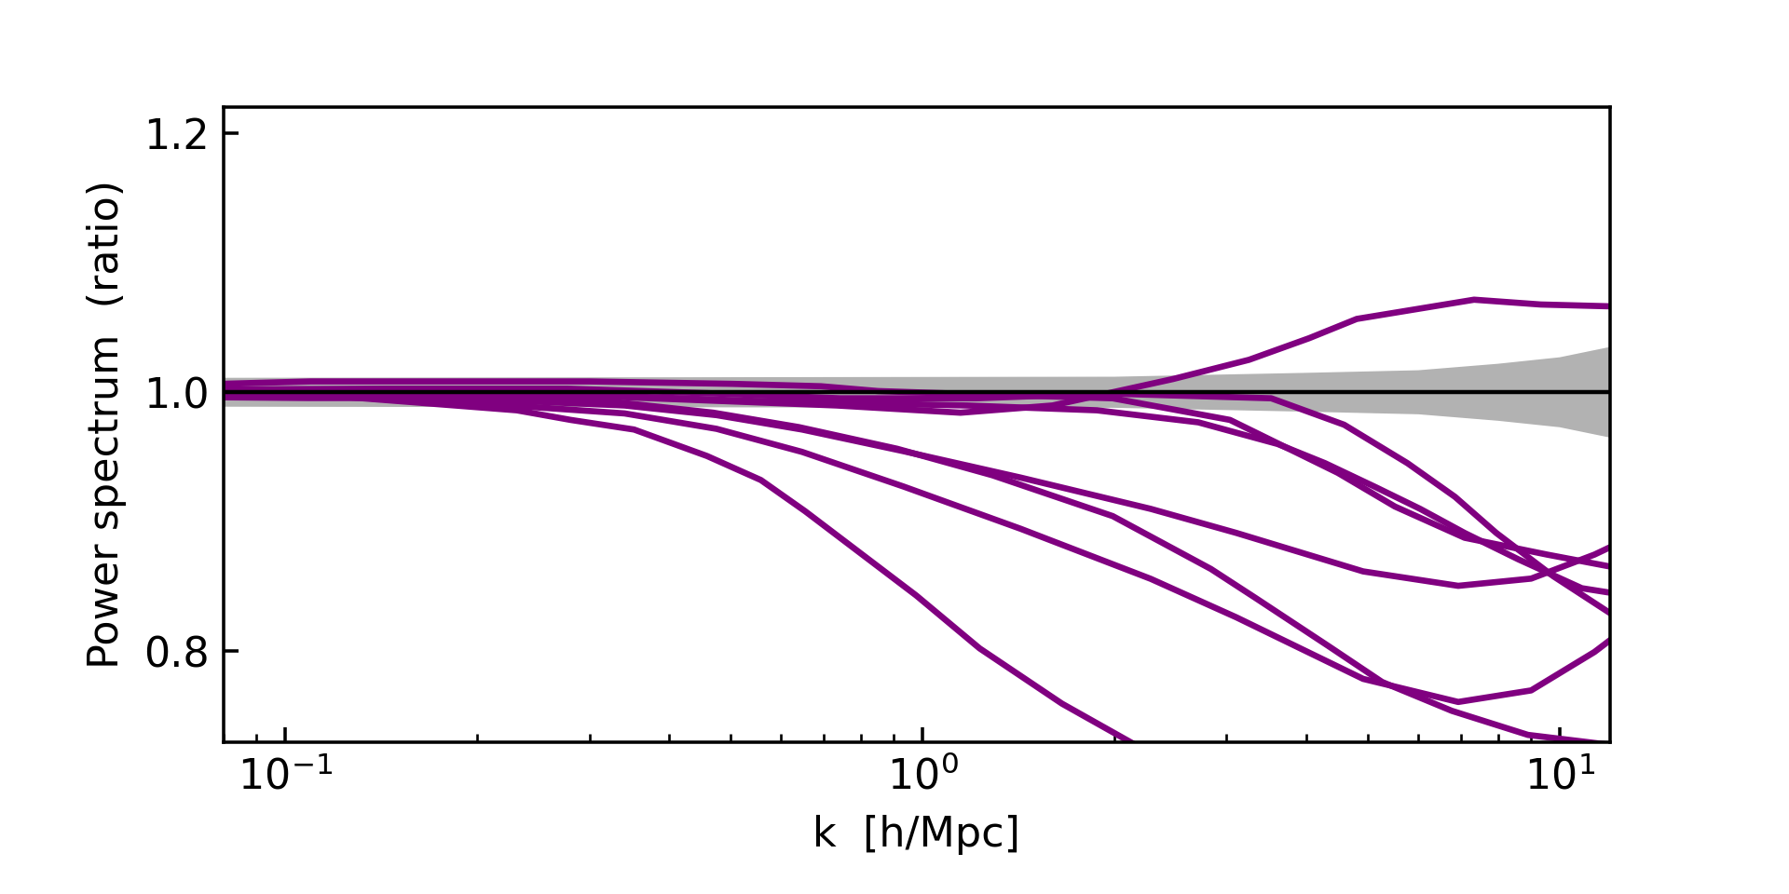
Modelling is difficult (and potentially unreliable)
    Euclid / LSST require precent precision up to k~10 h/Mpc.
Agreement between hydro simulations
(OWLS, CosmoOWLS, BAHAMAS, Illustris, TNG, Eagle, H-AGN)
Notes:
This is encouraging. But there remains a major problem which is that the real universe is not gravity only.
If you compare hydro sims (which include AGN feedback) you get large differences.
Major problem for modern cosmology
Not a problem that can be solved from first principles.
Sims rely on sub-grid modelling and calibration. They are not purely predictive and cannot easily be used in statistical analysis.

Slide 10
Scale-cuts are not a great option
Agreement between hydro simulations
(OWLS, CosmoOWLS, BAHAMAS, Illustris, TNG, Eagle, H-AGN)
Notes:
This is encouraging. But there remains a major problem which is that the real universe is not gravity only.
If you compare hydro sims (which include AGN feedback) you get large differences.
Major problem for modern cosmology
Not a problem that can be solved from first principles.
Sims rely on sub-grid modelling and calibration. They are not purely predictive and cannot easily be used in statistical analysis.

Slide 11
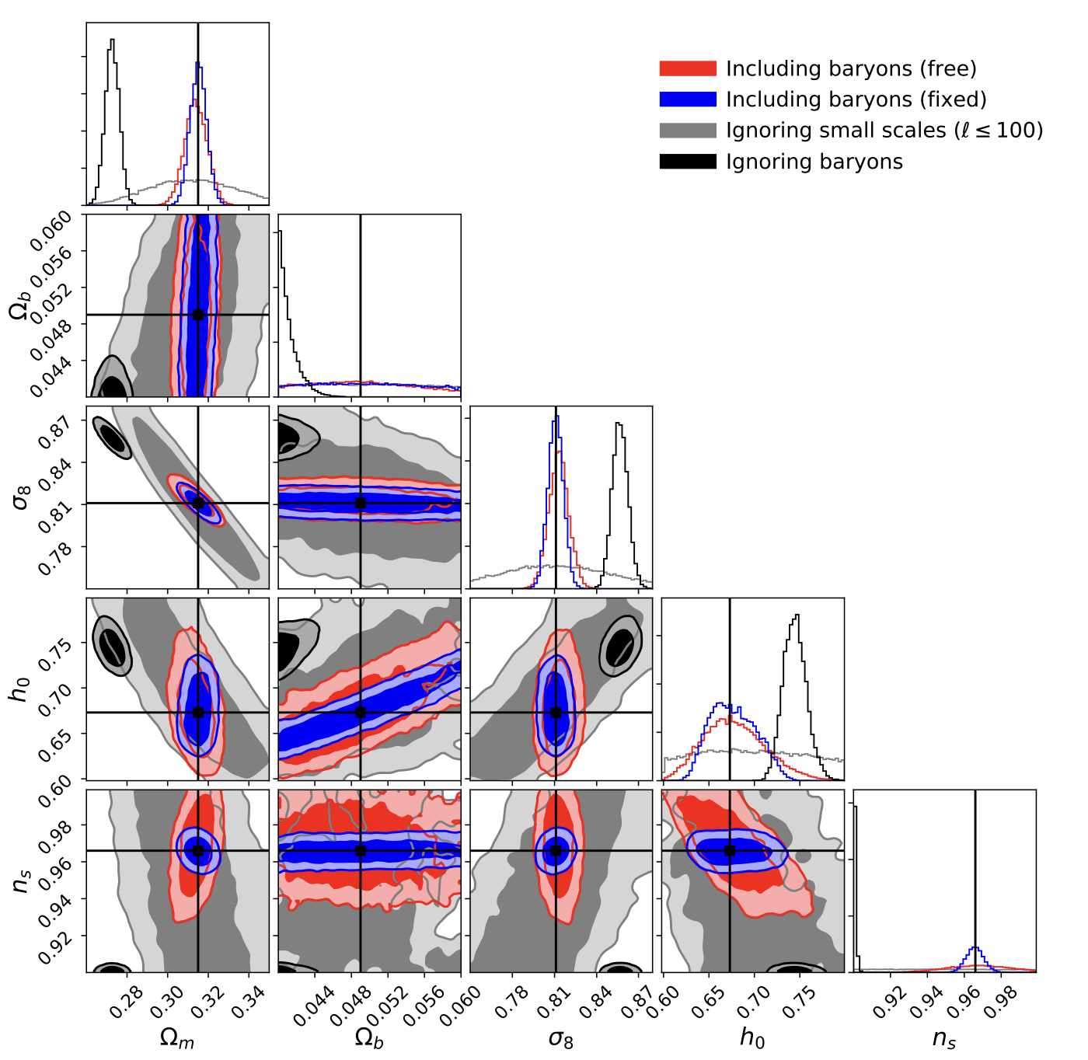
Scale-cuts are not a great option
    Euclid/LSST: Full modelling including feedback required.
Baryons (free)
Baryons (constrained)
Ignoring small scales
No Baryons
    Euclid forecast (AS et al 2020)
Notes:
This is encouraging. But there remains a major problem which is that the real universe is not gravity only.
If you compare hydro sims (which include AGN feedback) you get large differences.
Major problem for modern cosmology
Not a problem that can be solved from first principles.
Sims rely on sub-grid modelling and calibration. They are not purely predictive and cannot easily be used in statistical analysis.

Slide 12
Modelling with baryonification (BFC)
Notes:
In principle we need to come away from hydro sims as tools to produce mock universes to something truly predictive (where unknown physics is parametrised). This is not obvious / extremely expensive

Slide 13

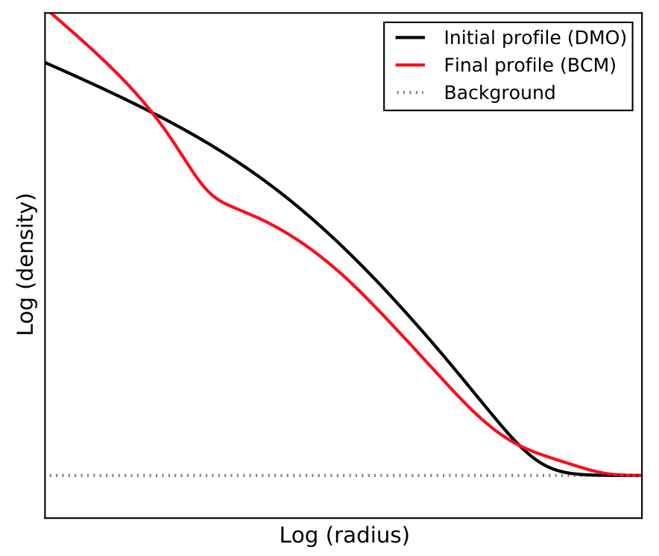
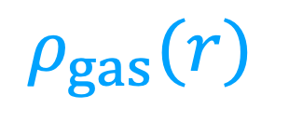
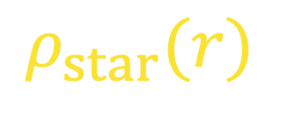
Modelling with baryonification (BFC)
$$ρ_{gas}(r)$$
$$ρ_{star}(r)$$
Notes:
In principle we need to come away from hydro sims as tools to produce mock universes to something truly predictive (where unknown physics is parametrised). This is not obvious / extremely expensive

Slide 14
Modelling with baryonification (BFC)
$$ρ_{gas}(r)$$
$$ρ_{star}(r)$$
Notes:
In principle we need to come away from hydro sims as tools to produce mock universes to something truly predictive (where unknown physics is parametrised). This is not obvious / extremely expensive

Slide 15
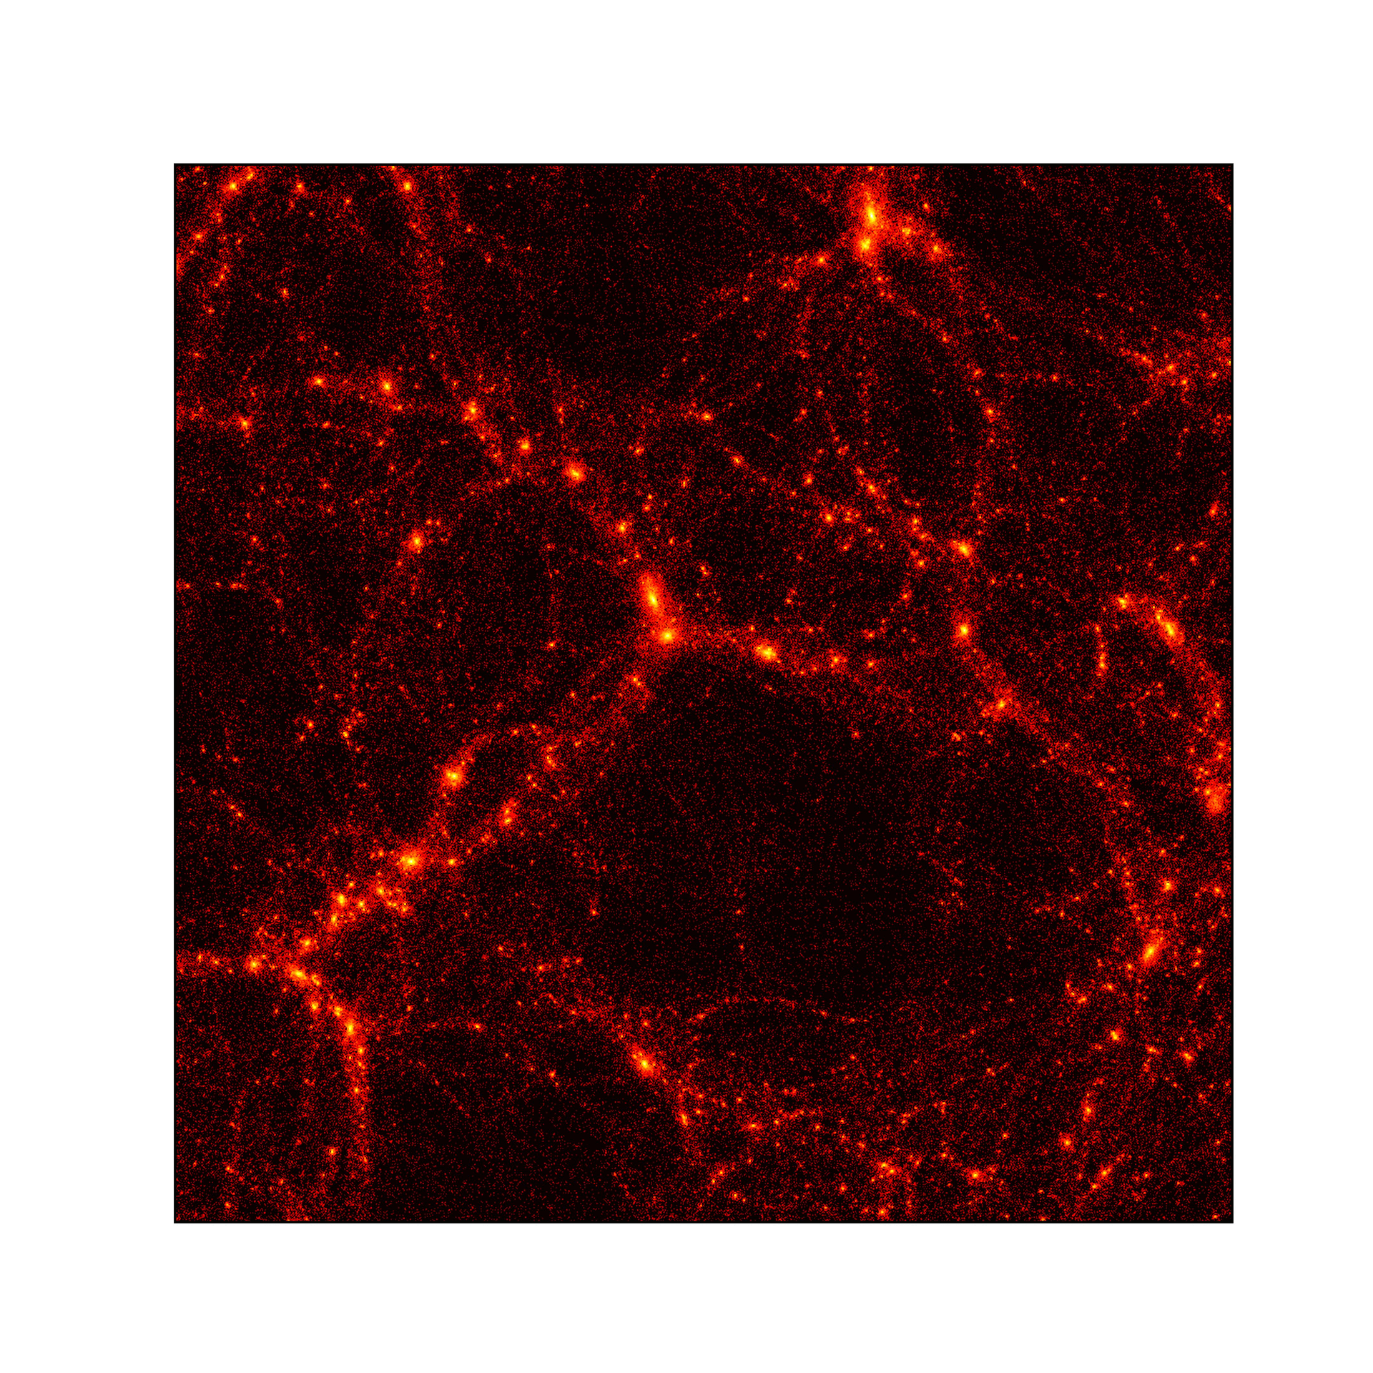
Modelling with baryonification (BFC)
Notes:
It looks ads if it’s a big effect but its not…

Slide 16
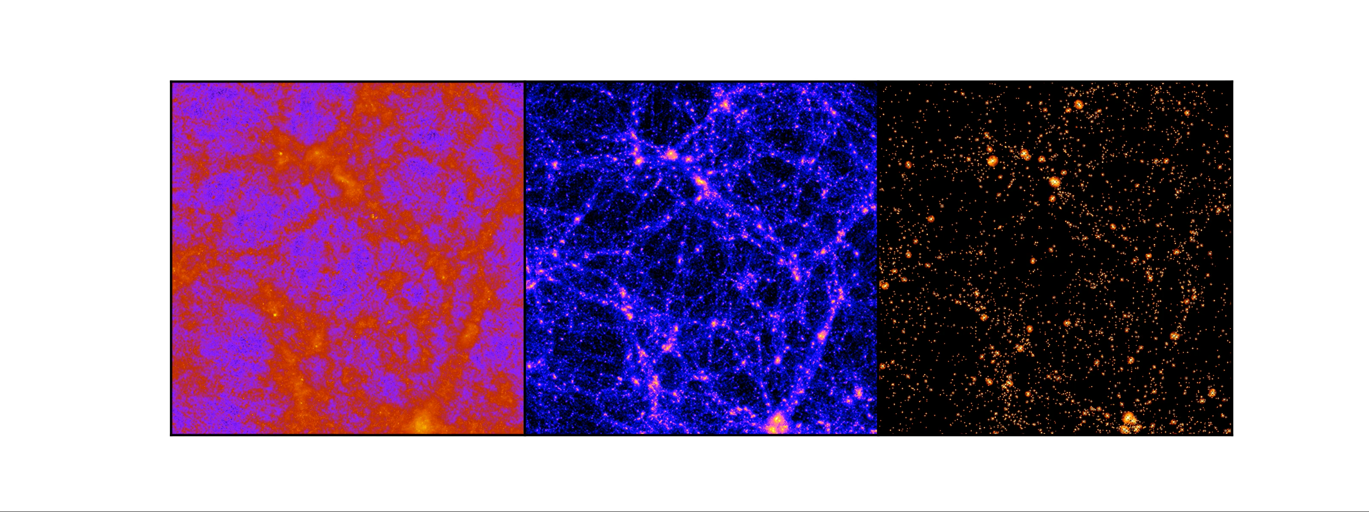
Component-wise BFC
    Individual species of stars, gas, dm.
    Pressure ad temperature (hydrostatic equation + corrections, ideal gas law)
Gas
Dark Matter
Stars

Slide 17
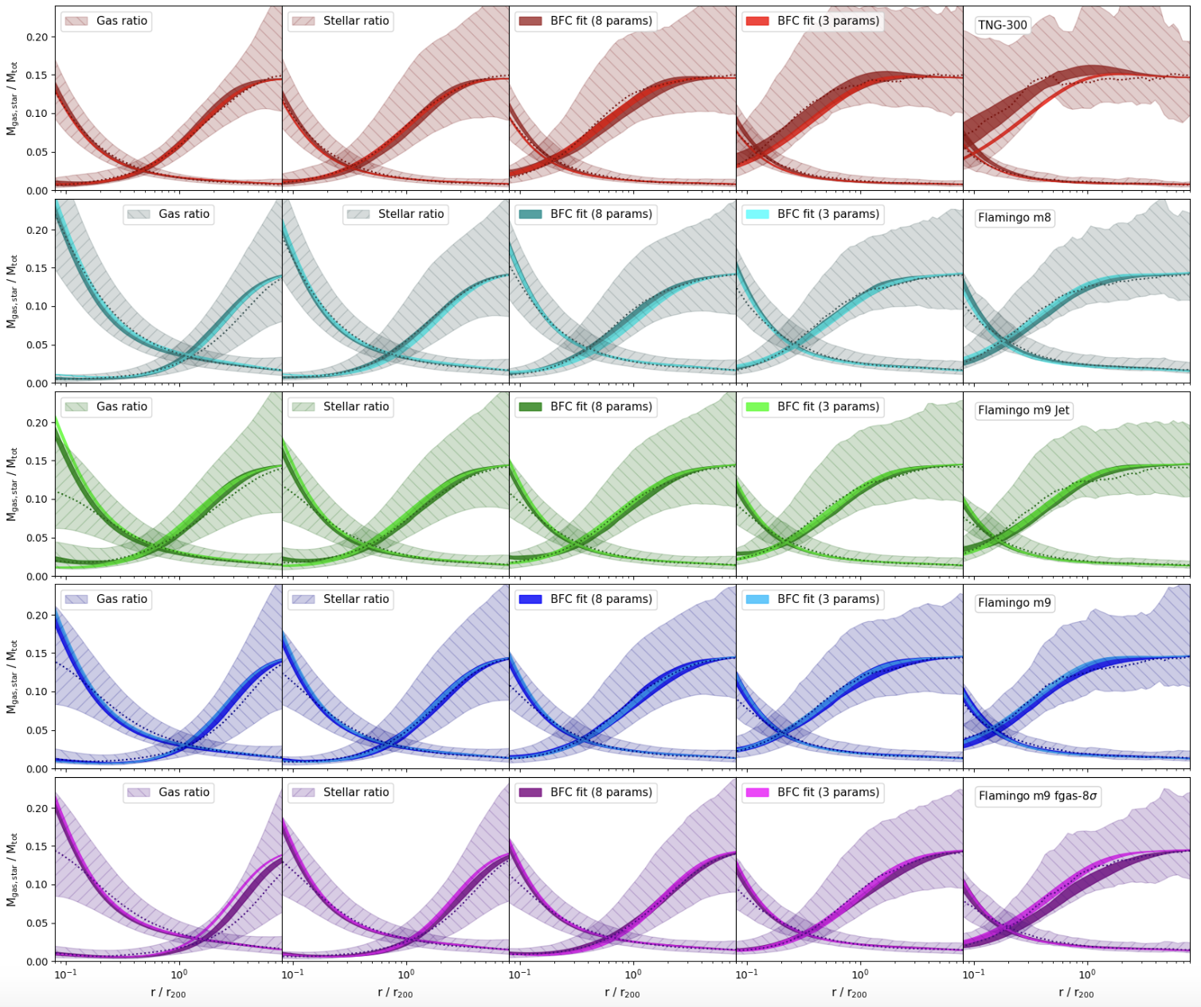
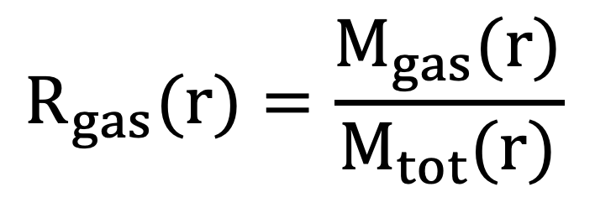
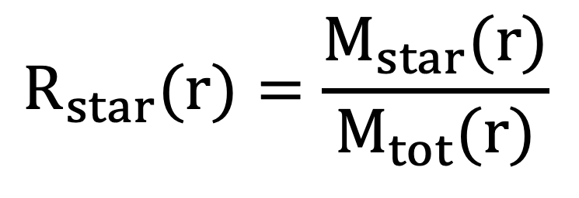
Component-wise BFC
From mass profiles …
… to power spectrum
TNG-300
Flamingo m8
$$R_{gas}(r)=\frac{M_{gas}(r)}{M_{tot}(r)}$$
Flamingo m9 jet
$$R_{star}(r)=\frac{M_{star}(r)}{M_{tot}(r)}$$
Flamingo m9
Flamingo m9 sAGN

Slide 18
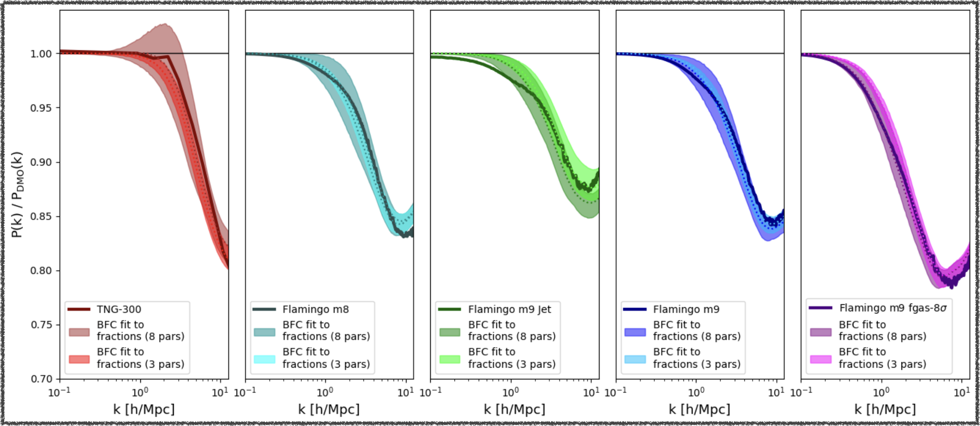
Component-wise BFC
From mass profiles …
… to power spectrum

Slide 19
Some applications

Slide 20
Constraining feedback suppression
with X-ray data

Slide 21
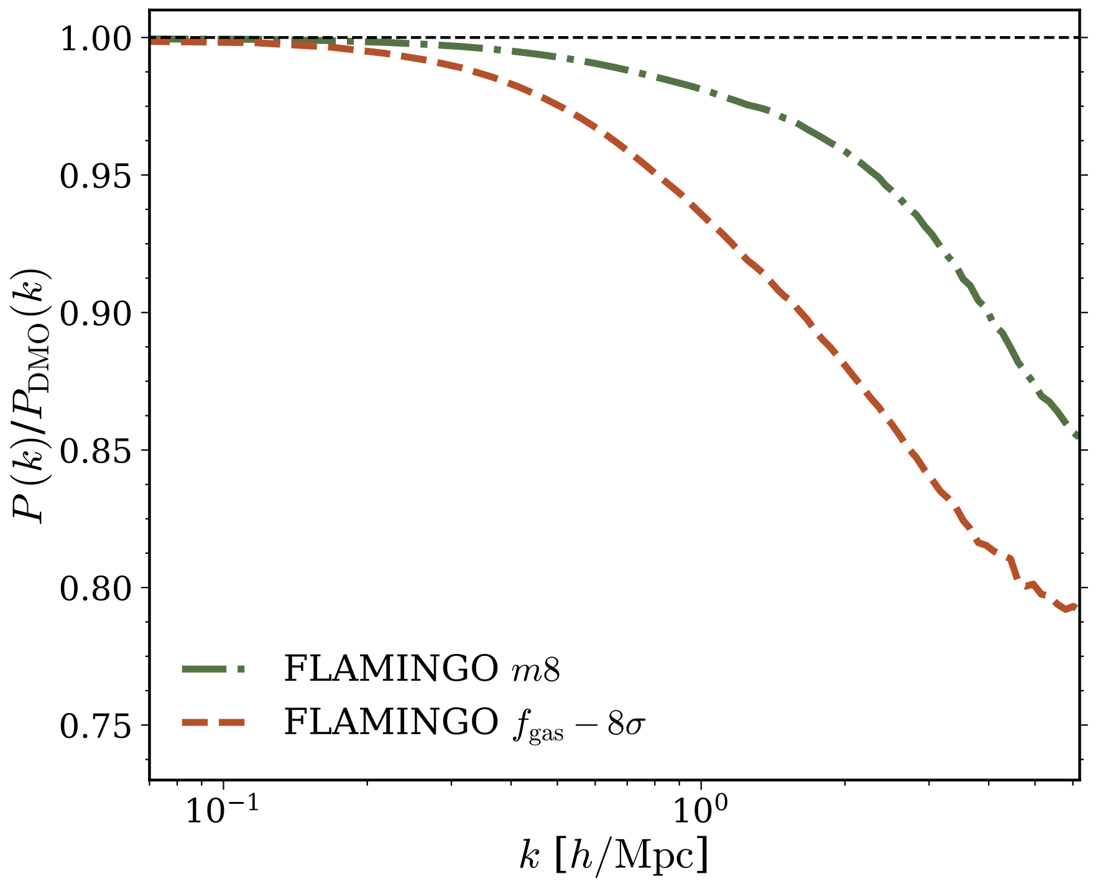
Constraining feedback suppression
with X-ray data
EAGLE
TNG-300
    (Kovac et al. in prep)

Slide 22
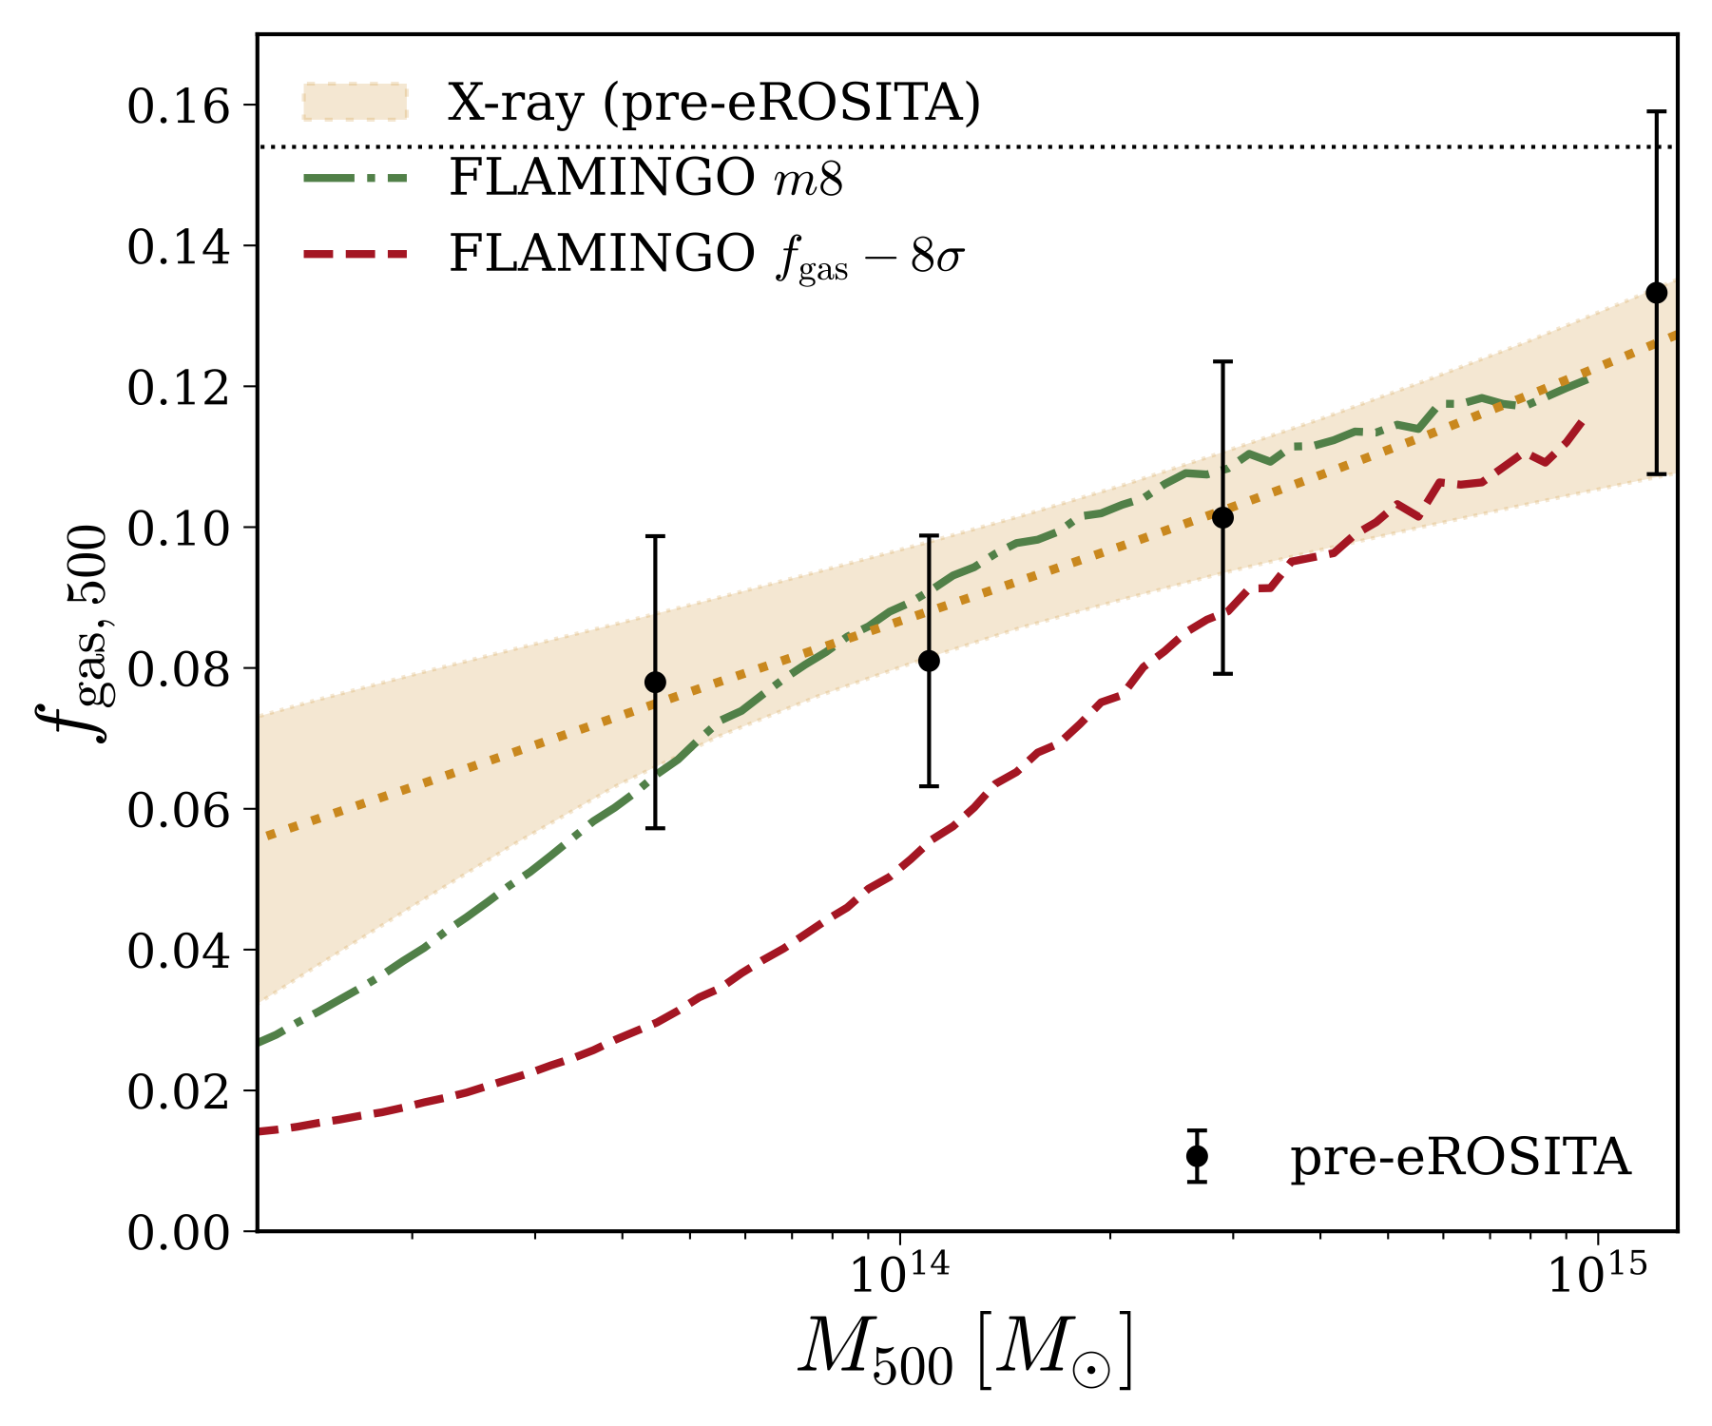
Constraining feedback suppression
with X-ray data
    Data from XMM-Newton, Chandra, …
EAGLE
TNG-300
    (Kovac et al. in prep)

Slide 23
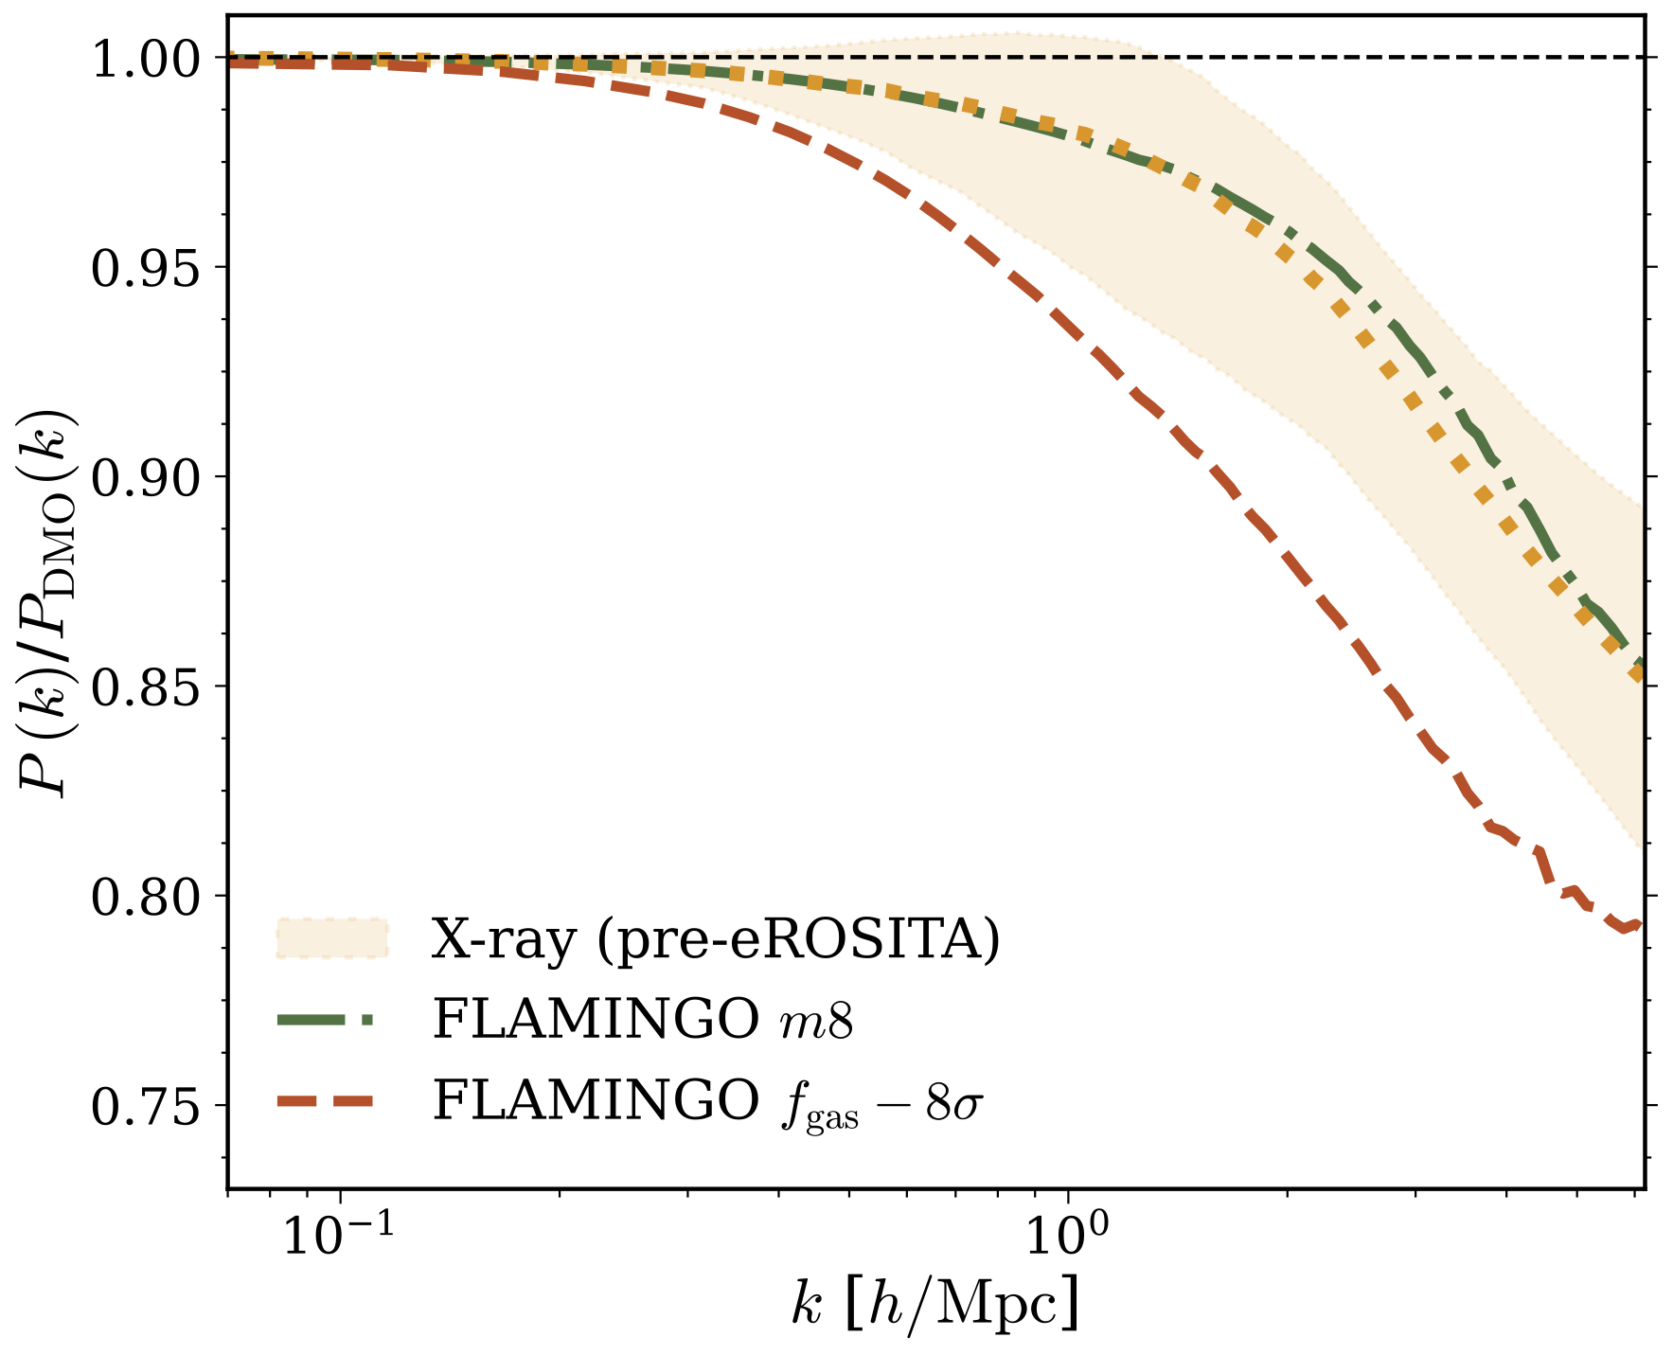
Constraining feedback suppression
with X-ray data
    Data from XMM-Newton, Chandra, …
EAGLE
TNG-300
    (Kovac et al. in prep)

Slide 24
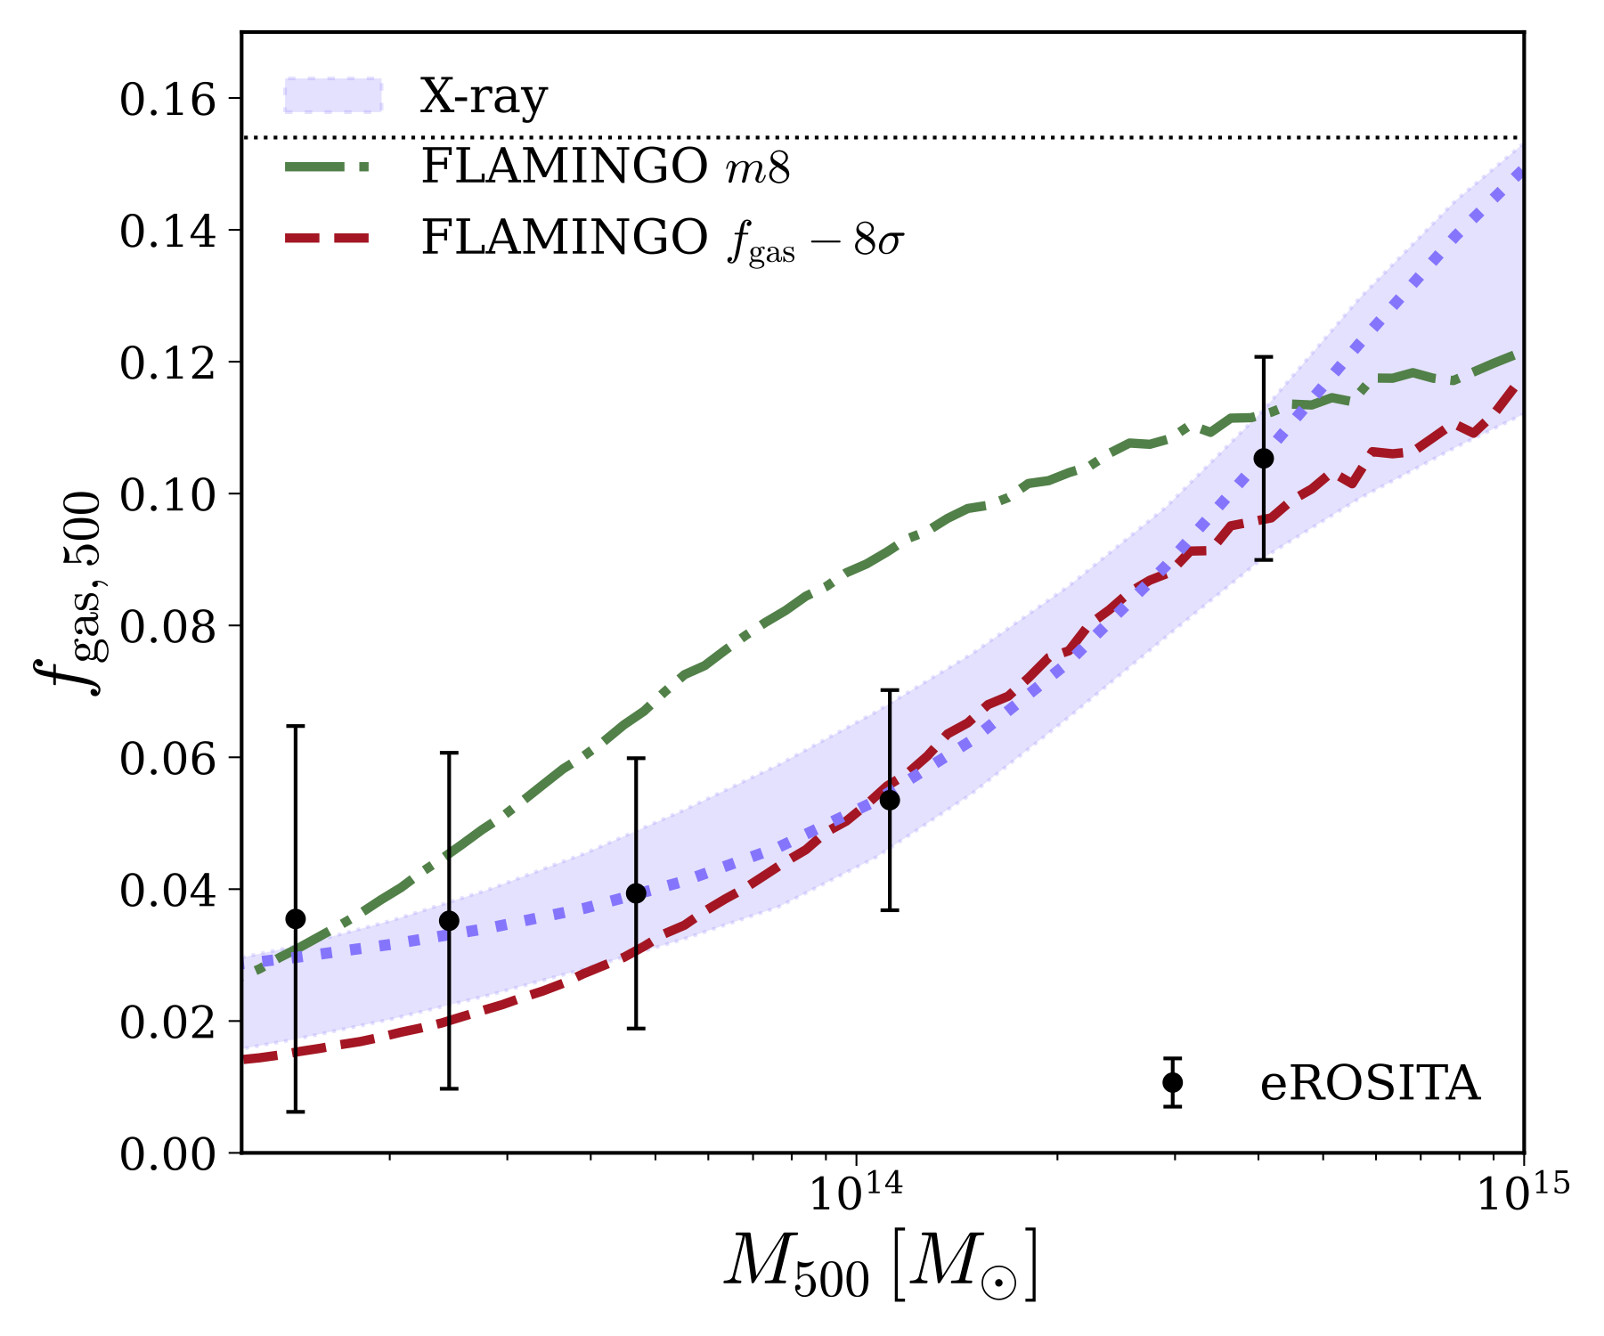
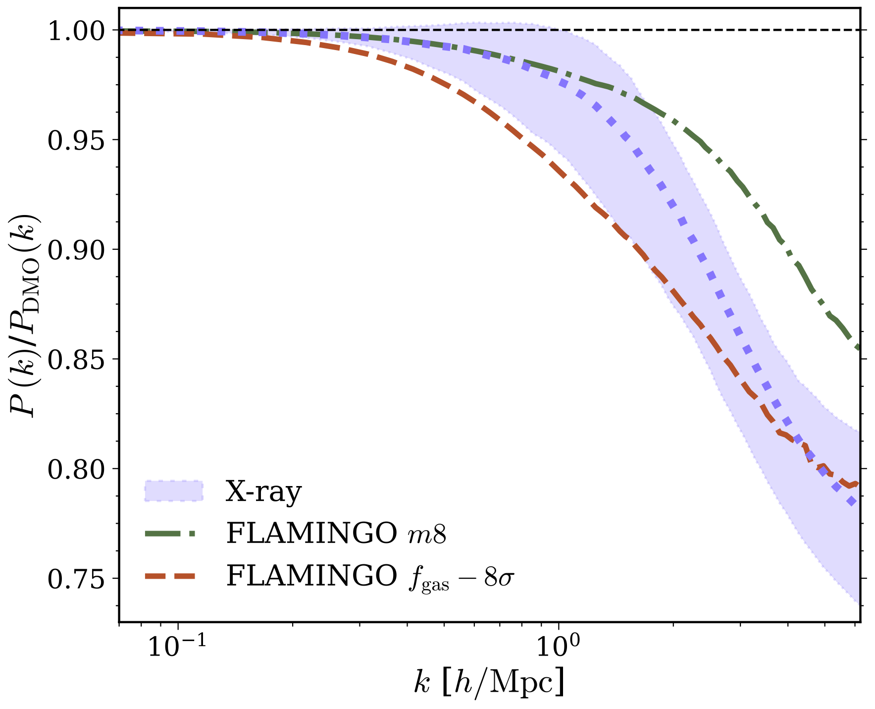
Constraining feedback suppression
with X-ray data
EAGLE
TNG-300
TNG-300
    (Kovac et al. in prep)

Slide 25
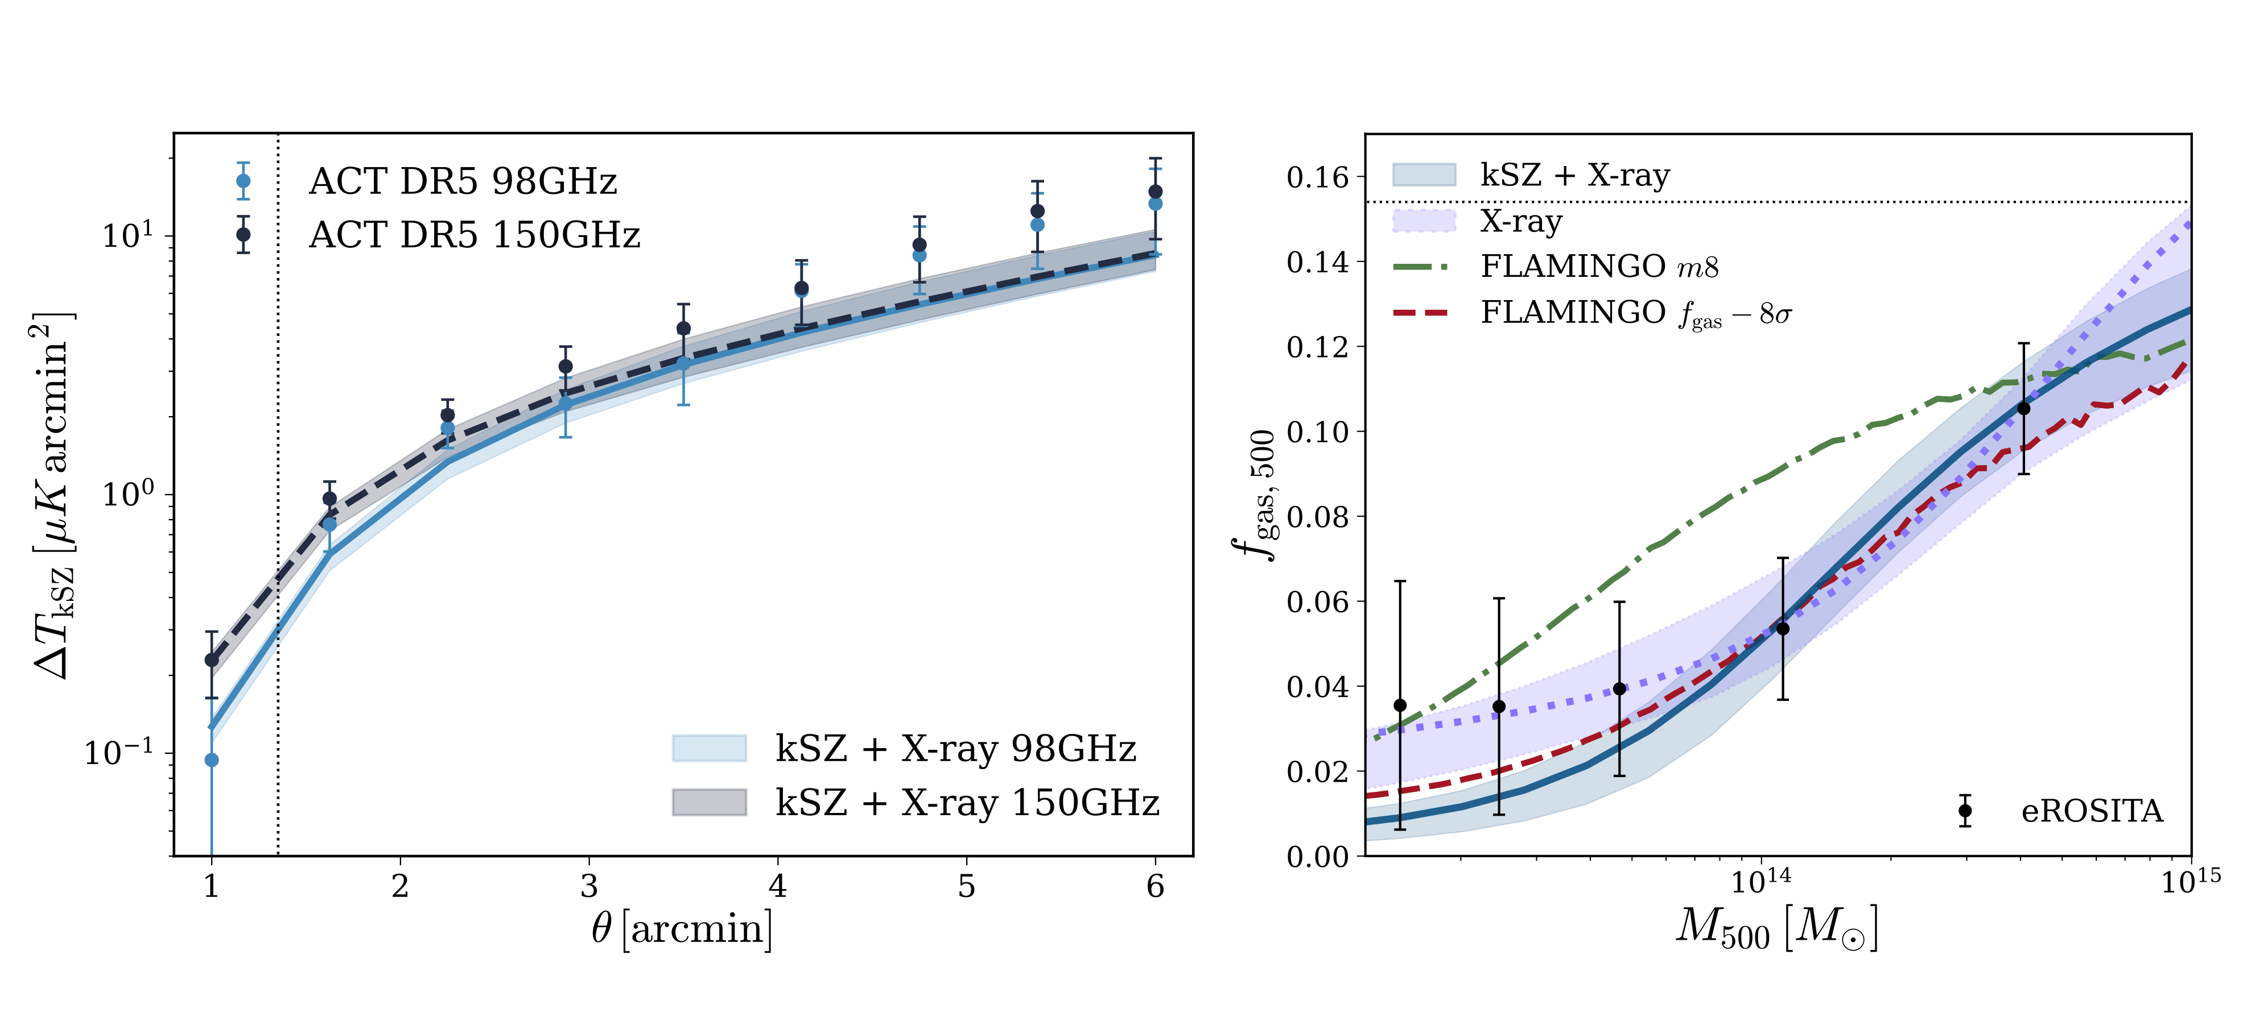
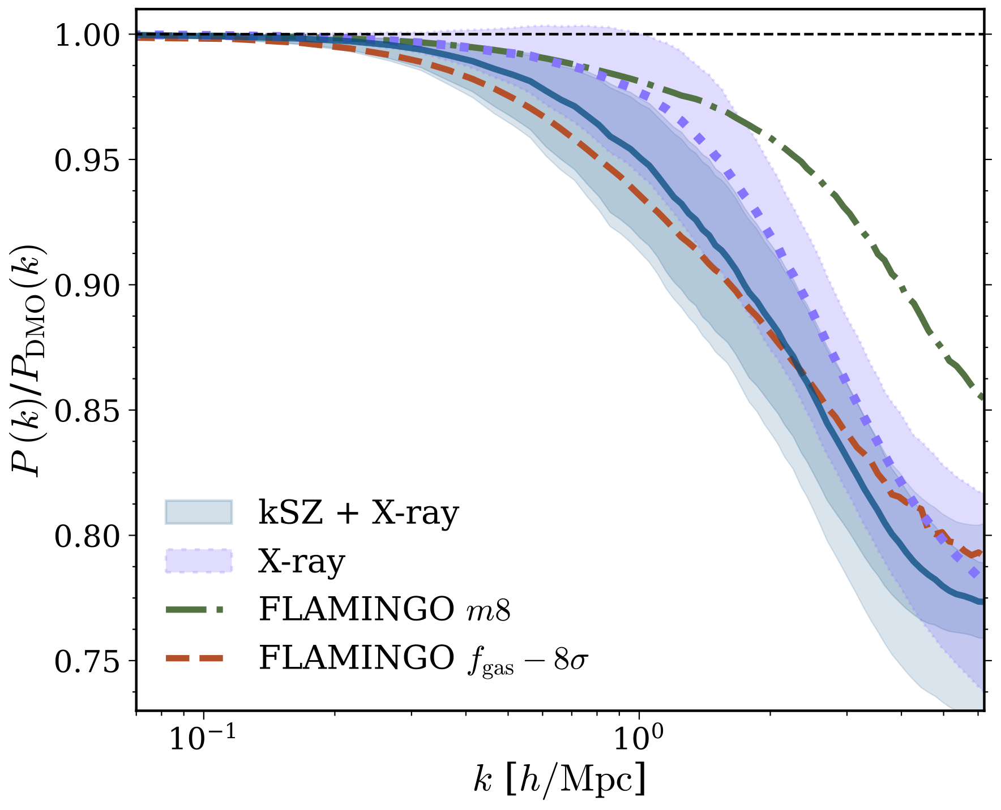
Constraining feedback suppression
with X-ray and kSZ data
EAGLE
    Data from ACT
TNG-300
TNG-300
    (Kovac et al. in prep)

Slide 26
Constraining feedback suppression
with weak lensing data
What about weak lensing ?
EAGLE
TNG-300
TNG-300

Slide 27
Constraining feedback suppression
with weak lensing data
What about weak lensing ?
DES Year 3
DES Year 3
EAGLE
TNG-300
(Bigwood et al 2024)

Slide 28
Constraining feedback suppression
with weak lensing and kSZ data
What about weak lensing ?
DES Year 3 + kSZ (ACT)
DES Year 3
DES Year 3 + kSZ
EAGLE
TNG-300
TNG-300
(Bigwood et al 2024)

Slide 29
Constraining feedback suppression
with weak lensing and kSZ data
DES Year 3
DES Year 3 + kSZ
EAGLE
TNG-300
TNG-300
(Bigwood et al 2024)

Slide 30
Constraining feedback suppression
with weak lensing and kSZ data
DES Year 3
DES Year 3 + kSZ
EAGLE
TNG-300
TNG-300
(Bigwood et al 2024)

Slide 31
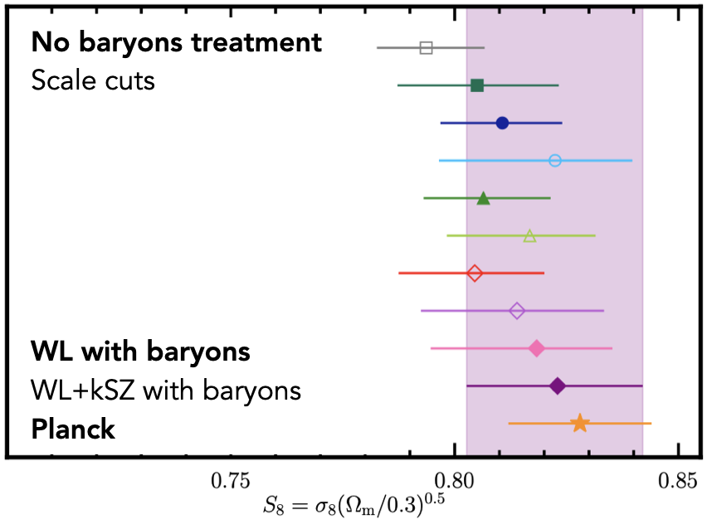
Constraining feedback suppression
with weak lensing and kSZ data
DES Year 3
DES Year 3 + kSZ
EAGLE
TNG-300
TNG-300
(Bigwood et al 2024)

Slide 32
Future with Euclid

Slide 33
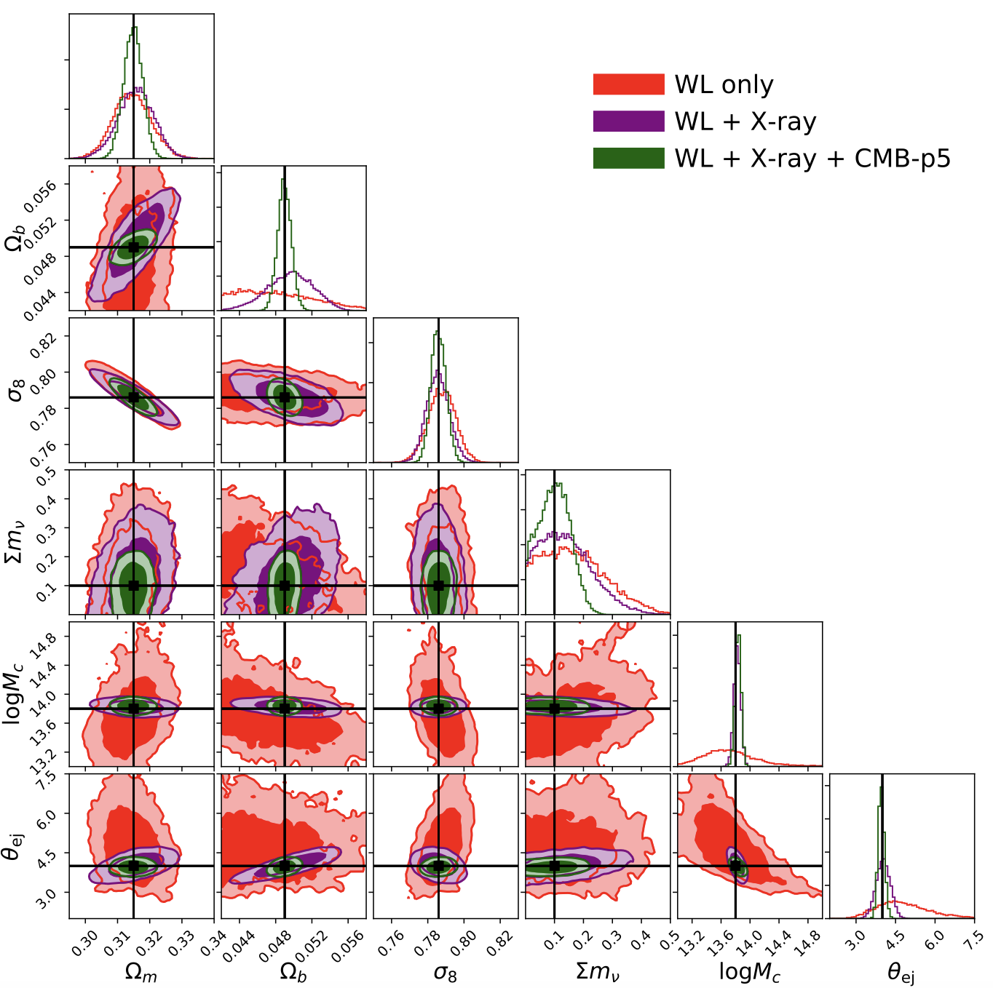
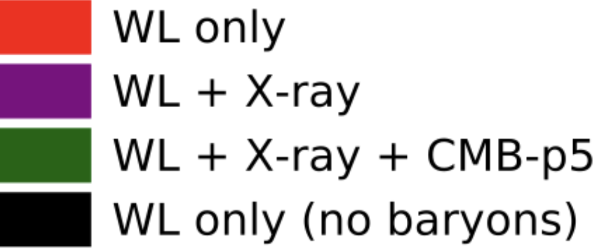
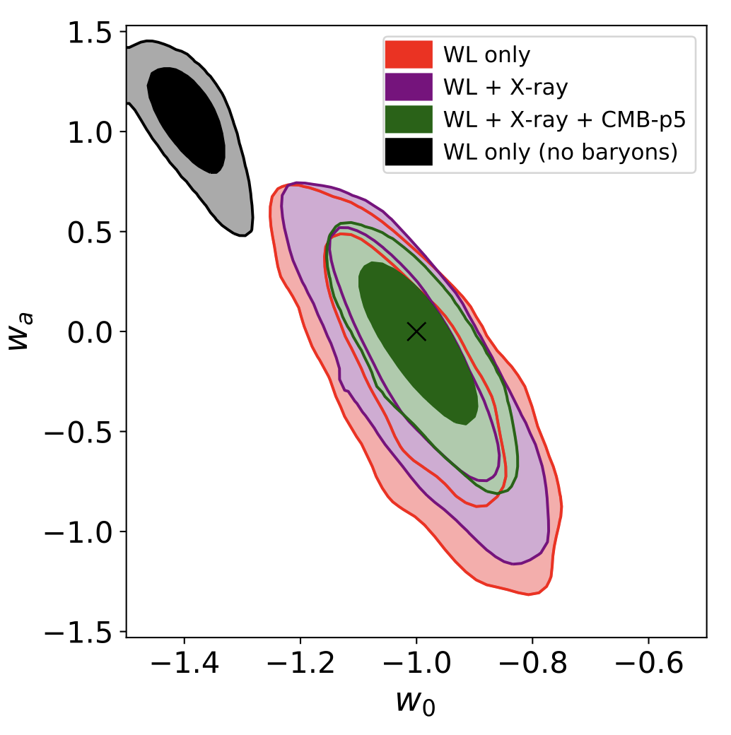
Future with Euclid
priors

Slide 34
Future: Field-level
cosmology

Slide 35
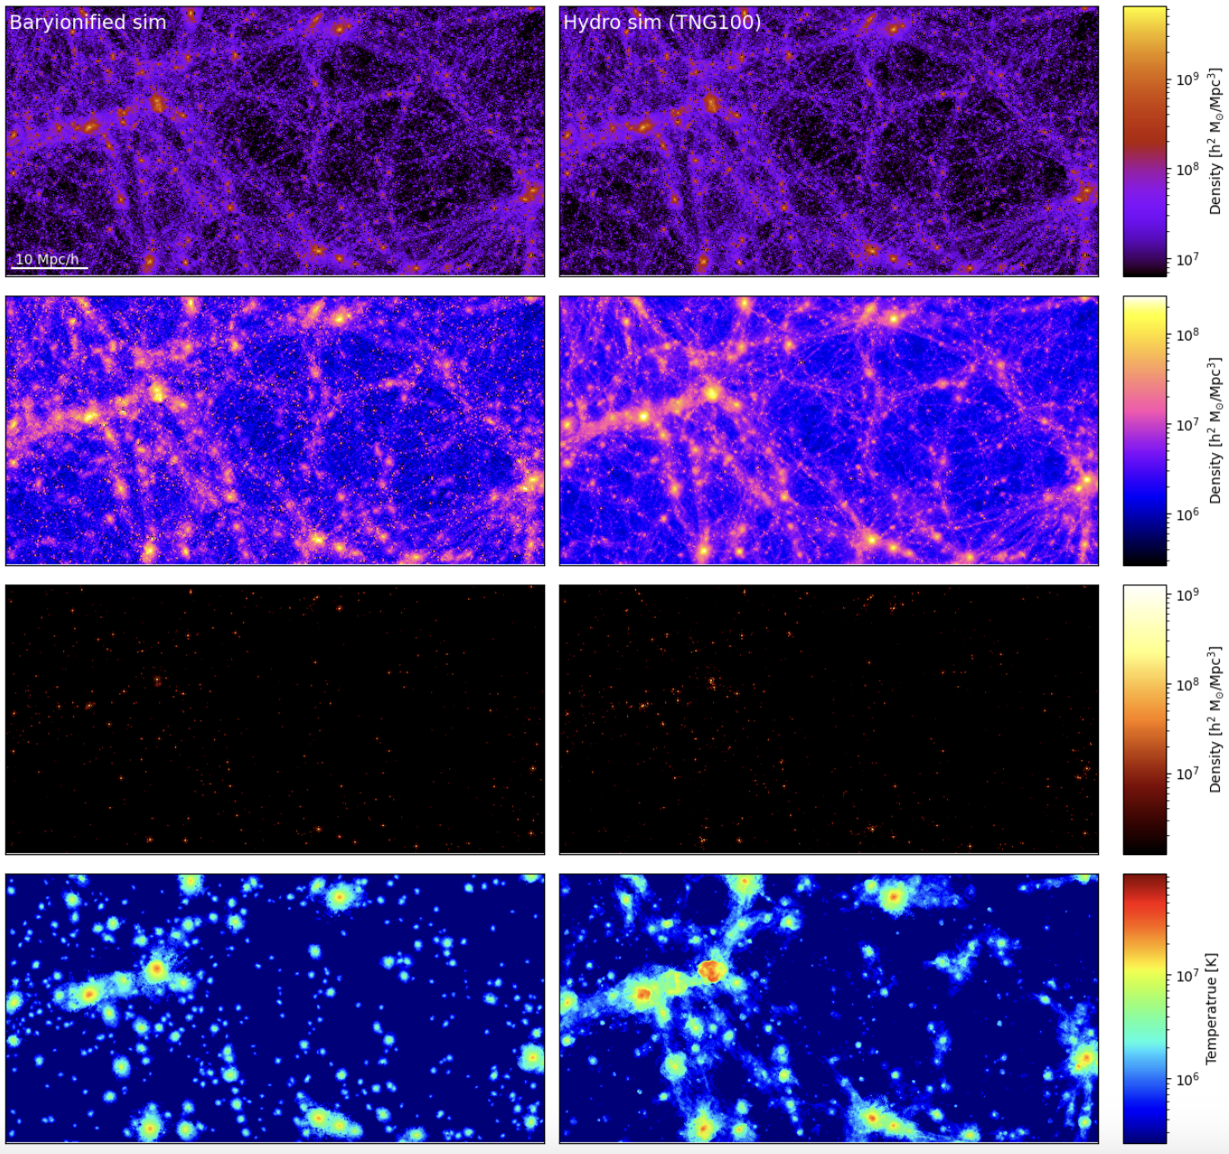
Future: Field-level
cosmology
DM density
Gas density
Stellar density
Temperature

Slide 36
Thanks!
Aurel Schneider, UZH
Lecture 2 — Radiation
Notes:
With this talk, I want to give you an overview over my research activities as well as an outlook towards some future projects.
As some might remember, I was here not very long ago. Some of the talk might therefore feel familiar but I have various new things to show.
My research is about predicting nonlinear scales of cosmology. These are the scales where things get complicated to model, not only bus they are linear but also bus gas and stars and feedback matter.
This can be observed in the two first images…
Next to cosmology at small scales, I am also interested in the very high redshifts. More particularly in the epoch of cosmic dawn and redo. This is illustrated in the third picture showing the expansion of ionised bubbles in the IGM.
Finally I want to mention that I have a special interest in particle cosmology (dark matter sector). My goal is therefore to use upcoming data from Euclid and SKA in order to learn something about the nature of DM (free-streaming properties, potential interactions etc).

Slide 37
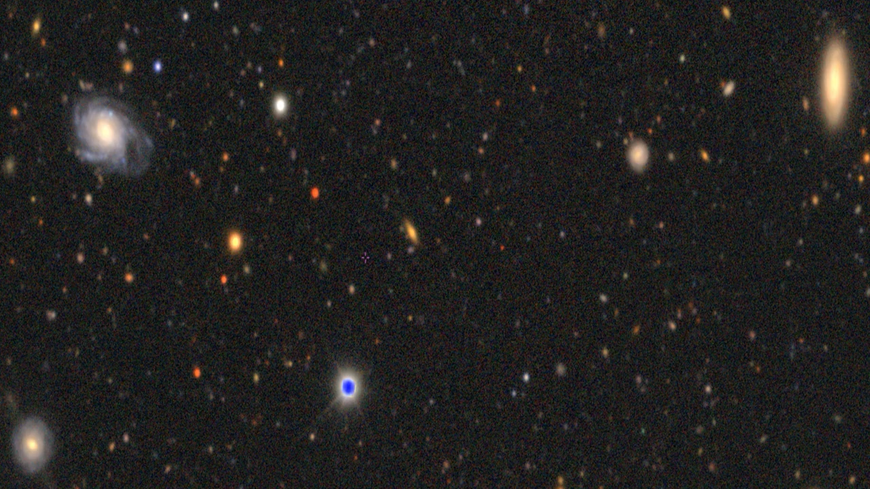
New cosmological surveys push into non-linear, messy scales
DES - Euclid
Notes:
As you may know, Euclid requires a percent precision for theory predictions of the matter power spectrum.
Explain plot

