Slide 1

Cosmology in latent space
Davide Piras (and many others)

Slide 2
But first… let me apologise
Notes:
Present you and work. Mention collaborators. Mention that you are open to questions, and that data science includes ML, etc.

Slide 3
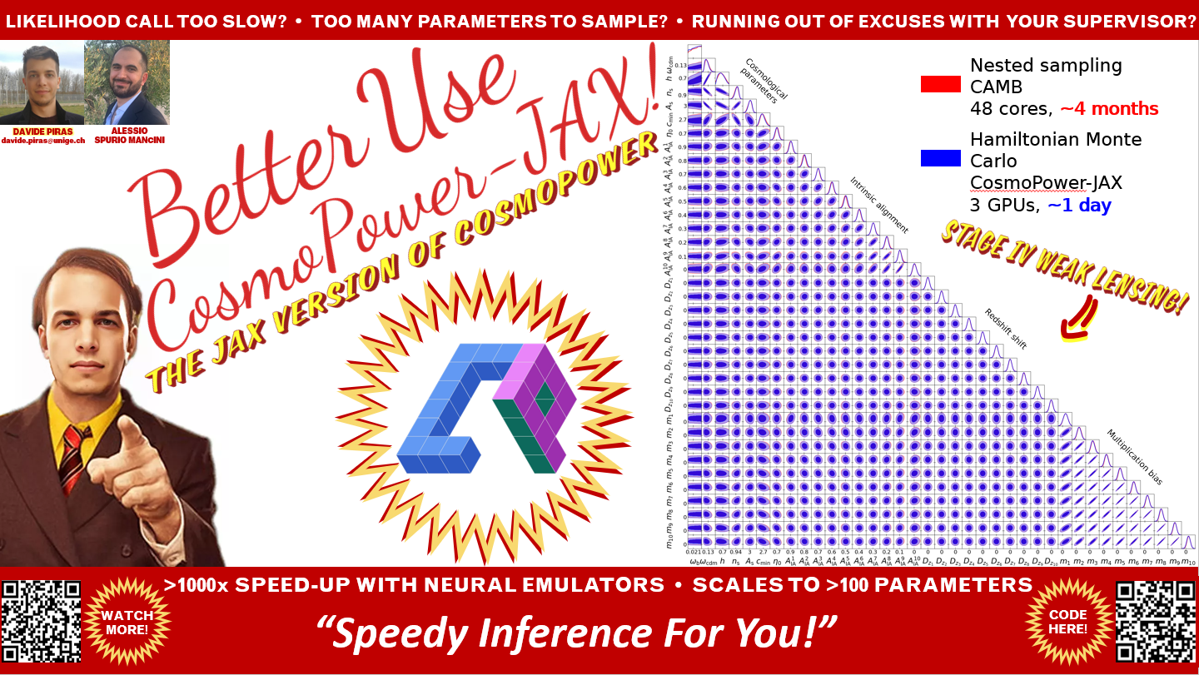




But first… let me apologise
Notes:
Present you and work. Mention collaborators. Mention that you are open to questions, and that data science includes ML, etc.

Slide 4
In a nutshell
Machine learning often used for acceleration

Slide 5


In a nutshell
Machine learning often used for acceleration
ALESSIO SPURIO MANCINI
Talk on THURSDAY
FRANCESCO SORRENTI
Talk on FRIDAY

Slide 6
In a nutshell
Machine learning often used for acceleration
Machine learning can be used to extract knowledge

Slide 7
Thank you for your attention
Cast
Davide DAVIDE PIRAS
Alessio ALESSIO SPURIO MANCINI
Francesco FRANCESCO SORRENTI
Lucas LUCAS LOMBRISER
Laura LAURA HEROLD
Luisa LUISA LUCIE-SMITH
Eiichiro EIICHIRO KOMATSU
Martin MARTIN KUNZ
Directed by DAVIDE PIRAS
Produced by THE COSMOFONDUE TEAM
Special effects DAVIDE PIRAS
If you are reading this it means you are really paying attention, well done
Spoiler: wait for the after-credit scene, you won’t regret it
Just kidding
No PhD students were harmed in the making of this presentation

Slide 8
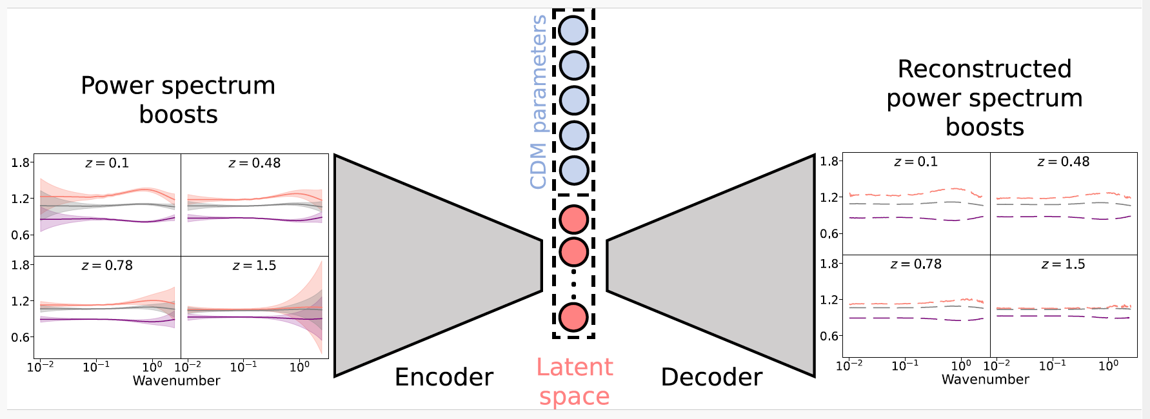
Machine learning to extract knowledge

Slide 9
Machine learning to extract knowledge
some Data

Slide 10
Machine learning to extract knowledge
bottleneck
some Data

Slide 11
Machine learning to extract knowledge
bottleneck
some Data
preDictions

Slide 12
Machine learning to extract knowledge
bottleneck
some Data
preDictions
VARIATIONAL AUTOENCODER (VAE)

Slide 13
Machine learning to extract knowledge
bottleneck
some Data
preDictions
VARIATIONAL AUTOENCODER (VAE)
Think: nonlinear principal component analysis (PCA)

Slide 14
Extract knowledge from what?
Notes:
Present yourself. You are going to talk about generative methods in Cosmology, as the title suggests. Mention other people that work with you.

Slide 15
Extract knowledge from what?
ΛCDM is good
Notes:
Present yourself. You are going to talk about generative methods in Cosmology, as the title suggests. Mention other people that work with you.

Slide 16
Extract knowledge from what?
ΛCDM is good
                Λ : cosmological constant
                CDM: cold dark matter
[insert standard cosmological image here]
Notes:
Present yourself. You are going to talk about generative methods in Cosmology, as the title suggests. Mention other people that work with you.

Slide 17
Extract knowledge from what?
ΛCDM is good… but not the entire story
Notes:
Present yourself. You are going to talk about generative methods in Cosmology, as the title suggests. Mention other people that work with you.

Slide 18
Extract knowledge from what?
ΛCDM is good… but not the entire story
                Tensions (H₀, S₈)
Notes:
Present yourself. You are going to talk about generative methods in Cosmology, as the title suggests. Mention other people that work with you.

Slide 19
Extract knowledge from what?
ΛCDM is good… but not the entire story
                Tensions (H₀, S₈)
                What is dark matter?
Notes:
Present yourself. You are going to talk about generative methods in Cosmology, as the title suggests. Mention other people that work with you.

Slide 20
Extract knowledge from what?
ΛCDM is good… but not the entire story
                Tensions (H₀, S₈)
                What is dark matter?
                And dark energy?
Notes:
Present yourself. You are going to talk about generative methods in Cosmology, as the title suggests. Mention other people that work with you.

Slide 21
Extract knowledge from what?
ΛCDM is good… but not the entire story
                Tensions (H₀, S₈)
                What is dark matter?
                And dark energy?
                …
Notes:
Present yourself. You are going to talk about generative methods in Cosmology, as the title suggests. Mention other people that work with you.

Slide 22
Extract knowledge from what?
ΛCDM is good… but not the entire story
Beyond-ΛCDM models add extra parameters
Notes:
Present yourself. You are going to talk about generative methods in Cosmology, as the title suggests. Mention other people that work with you.

Slide 23
Extract knowledge from what?
ΛCDM is good… but not the entire story
Beyond-ΛCDM models add extra parameters
ΛCDM
ω_{b} ω_{m} h τ n_{s} A_{s}
Notes:
Present yourself. You are going to talk about generative methods in Cosmology, as the title suggests. Mention other people that work with you.

Slide 24
Extract knowledge from what?
ΛCDM is good… but not the entire story
Beyond-ΛCDM models add extra parameters
w₀w_{a}CDM
ΛCDM
ω_{b} ω_{m} h τ n_{s} A_{s}
ω_{b} ω_{m} h τ n_{s} A_{s}
w₀ w_{a}
Notes:
Present yourself. You are going to talk about generative methods in Cosmology, as the title suggests. Mention other people that work with you.

Slide 25
Extract knowledge from what?
ΛCDM is good… but not the entire story
Beyond-ΛCDM models add extra parameters
ΛCDM
Dvali-Gabadadze-Porrati
ω_{b} ω_{m} h τ n_{s} A_{s}
ω_{b} ω_{m} h τ n_{s} A_{s}
Ω_{rc}
Notes:
Present yourself. You are going to talk about generative methods in Cosmology, as the title suggests. Mention other people that work with you.`

Slide 26
Extract knowledge from what?
ΛCDM is good… but not the entire story
Beyond-ΛCDM models add extra parameters
ΛCDM
Early dark energy
ω_{b} ω_{m} h τ n_{s} A_{s}
ω_{b} ω_{m} h τ n_{s} A_{s}
f_{EDE}
z_{c}
θ_{i}
Notes:
Present yourself. You are going to talk about generative methods in Cosmology, as the title suggests. Mention other people that work with you.

Slide 27
Extract knowledge from what?
ΛCDM is good… but not the entire story
Beyond-ΛCDM models add extra parameters
ΛCDM
…
ω_{b} ω_{m} h τ n_{s} A_{s}
ω_{b} ω_{m} h τ n_{s} A_{s}
…
Notes:
Present yourself. You are going to talk about generative methods in Cosmology, as the title suggests. Mention other people that work with you.

Slide 28
Extract knowledge from what?
ΛCDM is good… but not the entire story
Beyond-ΛCDM models add extra parameters
What are the actual degrees of freedom in the data?
Notes:
Present yourself. You are going to talk about generative methods in Cosmology, as the title suggests. Mention other people that work with you.

Slide 29
Goal
We want to be data-driven
Notes:
Present yourself. You are going to talk about generative methods in Cosmology, as the title suggests. Mention other people that work with you.

Slide 30
Application to w₀w_{a}CDM matter power spectra
Piras & Lombriser, PRD
Notes:
Present yourself. You are going to talk about generative methods in Cosmology, as the title suggests. Mention other people that work with you.

Slide 31

Application to w₀w_{a}CDM matter power spectra
Piras & Lombriser, PRD
Notes:
Present yourself. You are going to talk about generative methods in Cosmology, as the title suggests. Mention other people that work with you.

Slide 32

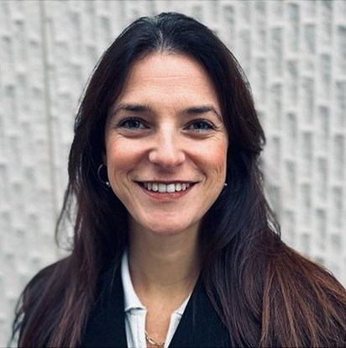
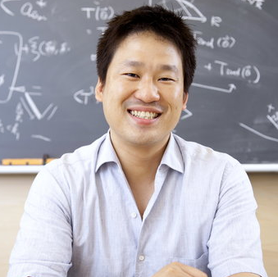
Application to CMB
LAURA HEROLD
LUISA LUCIE-SMITH
EIICHIRO KOMATSU

Slide 33
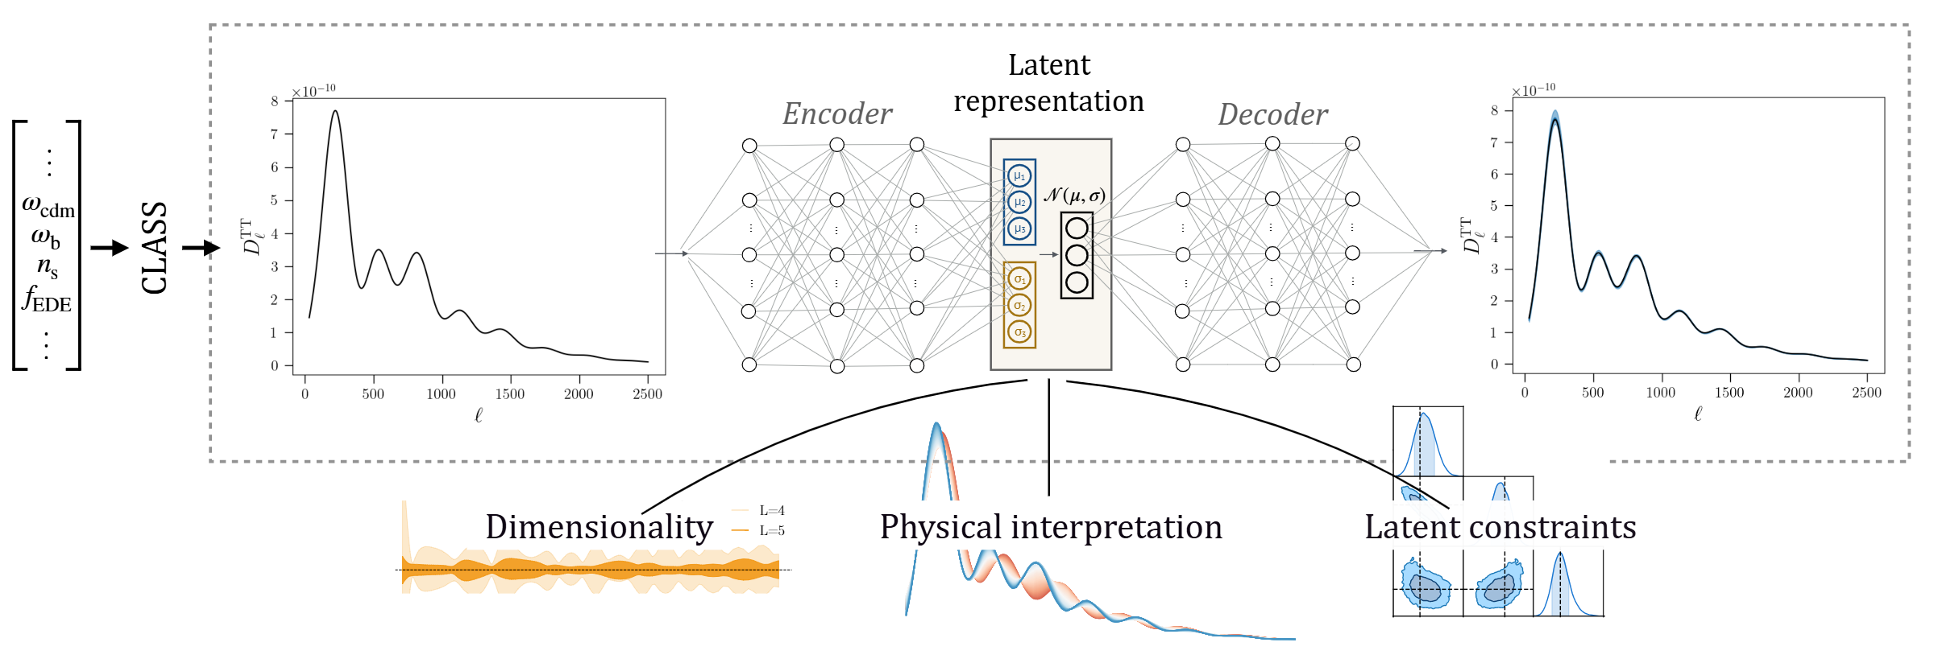
Application to CMB
Piras et al., PRD

Slide 34
Application to CMB
Piras et al., PRD

Slide 35
Application to CMB
Piras et al., PRD

Slide 36
Application to CMB
Piras et al., PRD

Slide 37
Application to CMB
Piras et al., PRD
How Many Parameters
Describe The Data?

Slide 38
Application to CMB
Piras et al., PRD
How Many Parameters
Describe The Data?
How Do We
interpret them?

Slide 39
Application to CMB
Piras et al., PRD
How Many Parameters
Describe The Data?
How Do We
interpret them?
Can We
Constrain Them?

Slide 40
Data
Two models: ΛCDM and EDE (early dark energy)
ΛCDM
EDE
ω_{b} ω_{m} h τ n_{s} A_{s}
ω_{b} ω_{m} h τ n_{s} A_{s}
f_{EDE}
z_{c}
θ_{i}

Slide 41
Data
Two models: ΛCDM and EDE (early dark energy)
ΛCDM
EDE
ω_{b} ω_{m} h τ n_{s} A_{s}
ω_{b} ω_{m} h τ n_{s} A_{s}
f_{EDE}
z_{c}
θ_{i}
PROMISING SOLUTION to Hubble tension (?)

Slide 42
Data
Two models: ΛCDM and EDE (early dark energy)
ΛCDM
EDE
ω_{b} ω_{m} h τ n_{s} A_{s}
ω_{b} ω_{m} h τ n_{s} A_{s}
f_{EDE}
z_{c}
θ_{i}
PROMISING SOLUTION to Hubble tension (?)
if f_{EDE} = 0 then EDE=ΛCDM

Slide 43
Data
Two models: ΛCDM and EDE (early dark energy)
Consider CMB temperature power spectra
ΛCDM
EDE
ω_{b} ω_{m} h τ n_{s} A_{s}
ω_{b} ω_{m} h τ n_{s} A_{s}
f_{EDE}
z_{c}
θ_{i}

Slide 44
How many parameters describe the data?

Slide 45
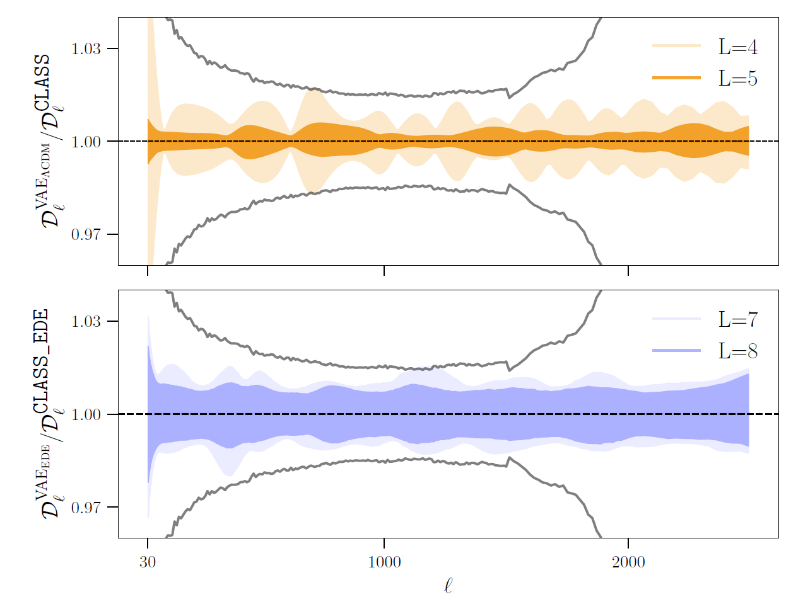
How many parameters describe the data?
ΛCDM
PLANCK
ERROR
EDE

Slide 46
How many parameters describe the data?
ΛCDM
Known DegeNeracY
in ΛCDM
PLANCK
ERROR
EDE

Slide 47
How many parameters describe the data?
ΛCDM
Known DegeNeracY
in ΛCDM
PLANCK
ERROR
EDE
EDE = ΛCDM+3

Slide 48

How do we interpret latent parameters?
We use mutual information
“Jimmie”

Slide 49
How do we interpret latent parameters?
We use mutual information
Captures dependence between variables

Slide 50
How do we interpret latent parameters?
We use mutual information
Captures dependence between variables
Think: nonlinear Pearson correlation coefficient

Slide 51
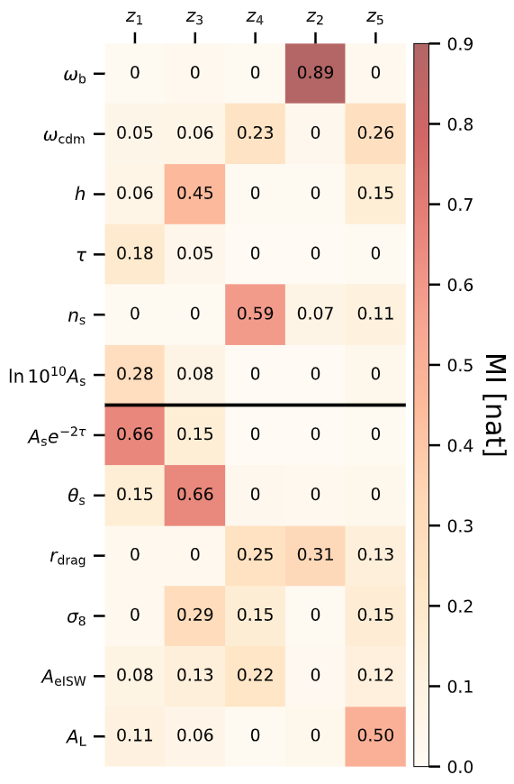
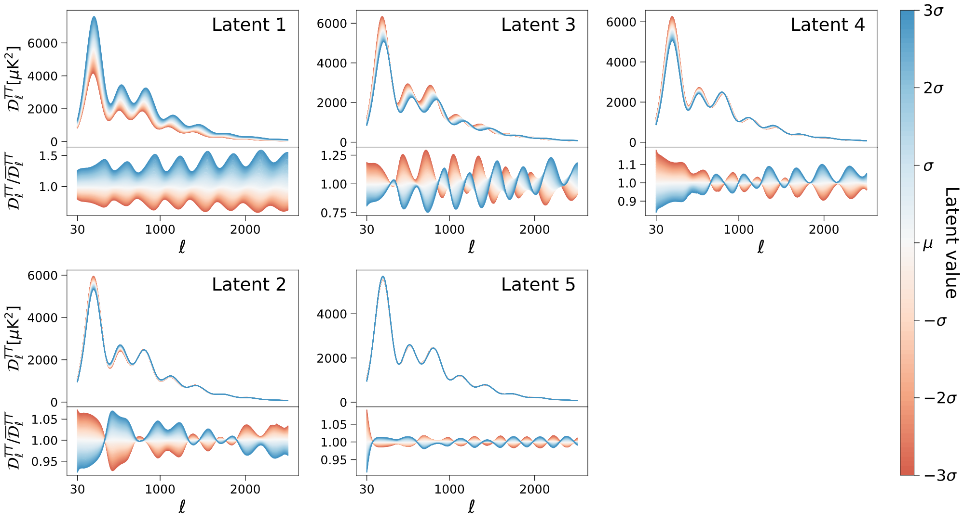
How do we interpret ΛCDM latent parameters?
latent parameters
cosmological parameters
AMPLITUDE
LATENT

Slide 52
How do we interpret ΛCDM latent parameters?
latent parameters
cosmological parameters
SOUND HORIZON LATENT

Slide 53
How do we interpret ΛCDM latent parameters?
latent parameters
cosmological parameters
EVEN-ODD
LATENT

Slide 54
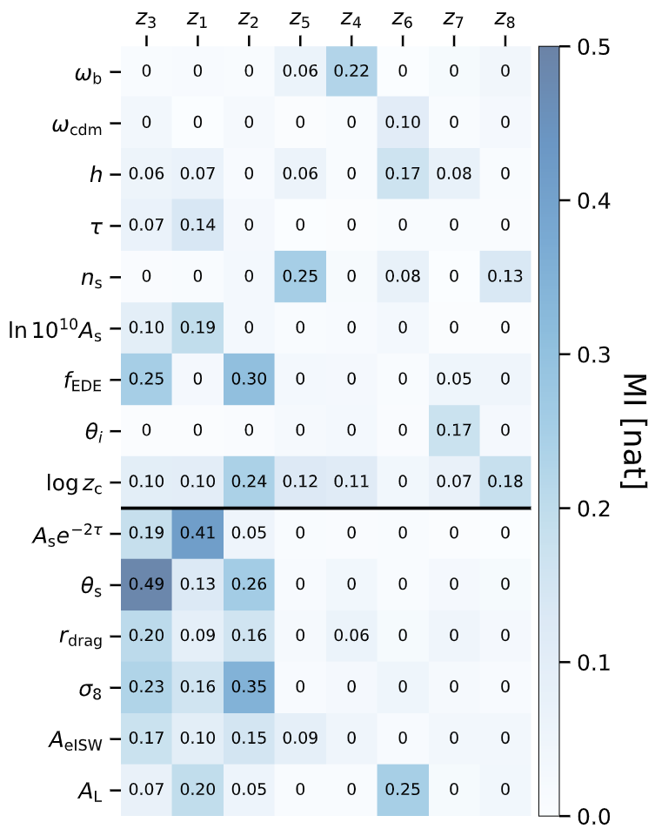
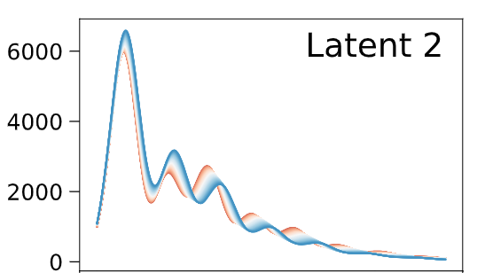
How do we interpret EDE latent parameters?
latent parameters
cosmological parameters
EDE
LATENT

Slide 55

How do we interpret EDE latent parameters?
latent parameters
cosmological parameters
EDE
LATENT

Slide 56
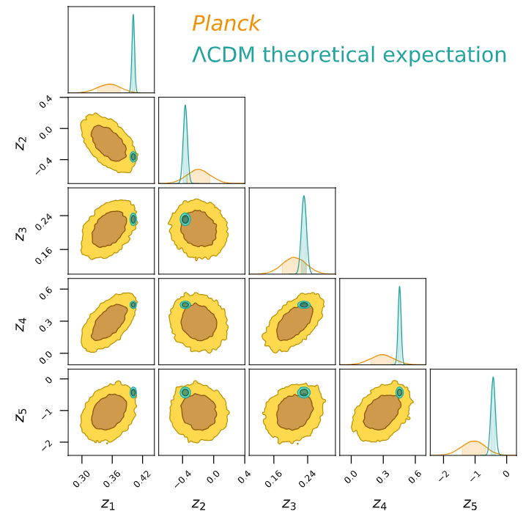
Can we constrain ΛCDM latent parameters?
Planck (this work)
ΛCDM best-fit
Yes! Just run inference
in latent space

Slide 57
Can we constrain ΛCDM latent parameters?
Planck (this work)
ΛCDM best-fit
Yes! Just run inference
in latent space
Decoder used as
Boltzmann solver

Slide 58
Can we constrain ΛCDM latent parameters?
Planck (this work)
ΛCDM best-fit
Yes! Just run inference
in latent space
Decoder used as
Boltzmann solver
Compare to encoded CLASS
power spectrum (green)

Slide 59
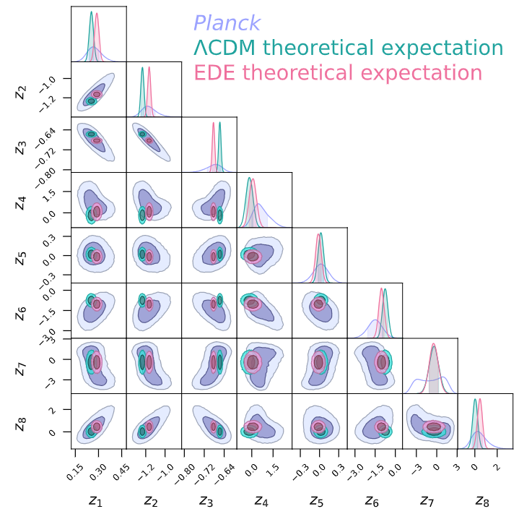
Can we constrain EDE latent parameters?
Planck (this work)
ΛCDM best-fit
EDE best-fit
Yes! Just run inference
in latent space

Slide 60
Can we constrain EDE latent parameters?
EDE
latent
Planck (this work)
ΛCDM best-fit
EDE best-fit
Yes! Just run inference
in latent space

Slide 61
Can we constrain EDE latent parameters?
Planck (this work)
ΛCDM best-fit
EDE best-fit
Yes! Just run inference
in latent space
Could be useful to solve
prior-volume effects?

Slide 62
Conclusions
Machine learning can find data-driven parameterisations of cosmology
(and beyond)

Slide 63
Conclusions
Machine learning can find data-driven parameterisations of cosmology
(and beyond)
Interpretation achieved with mutual information (plus expert knowledge)

Slide 64
Conclusions
Machine learning can find data-driven parameterisations of cosmology
(and beyond)
Interpretation achieved with mutual information (plus expert knowledge)
Next: combine temperature, polarisation, lensing, and DESI data

Slide 65
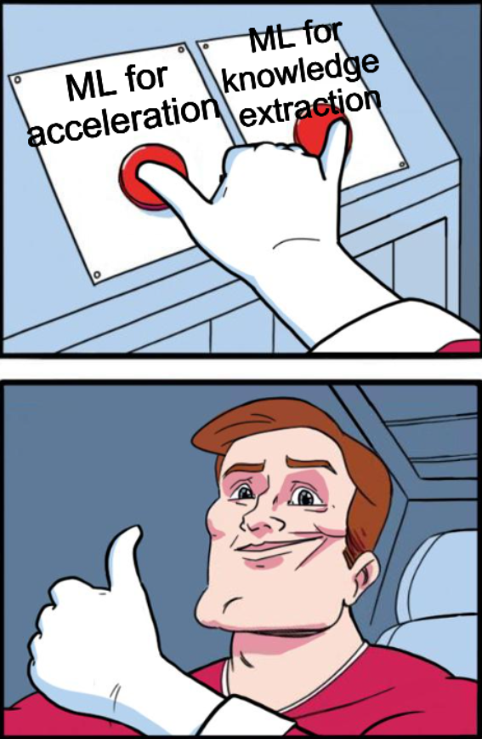

Conclusions

Slide 66
Extra slides

Slide 67
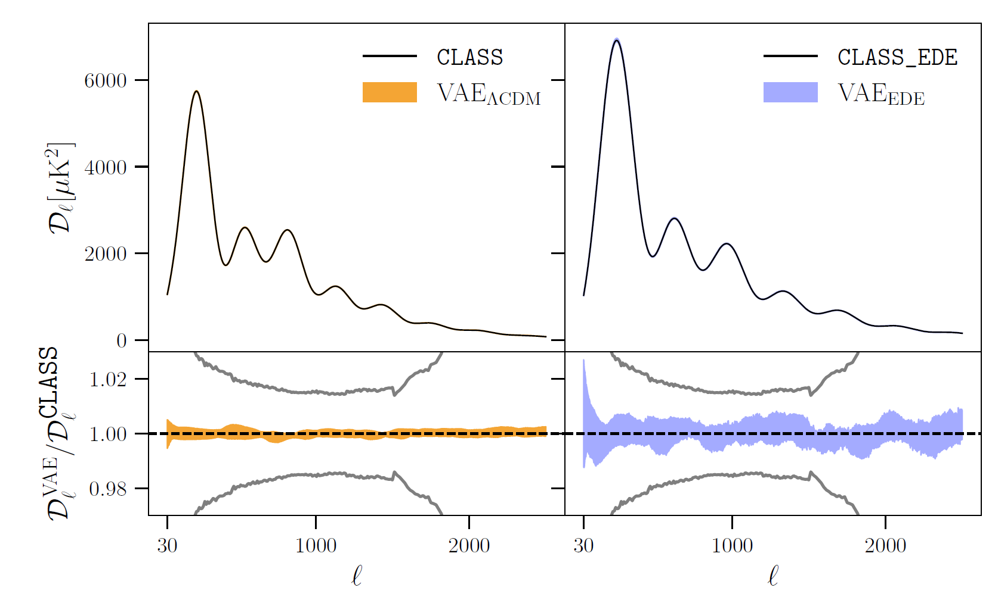
An individual example
PLANCK
ERROR

Slide 68
How do we interpret ΛCDM latent parameters?
latent parameters
cosmological parameters
TILT
LATENT

Slide 69
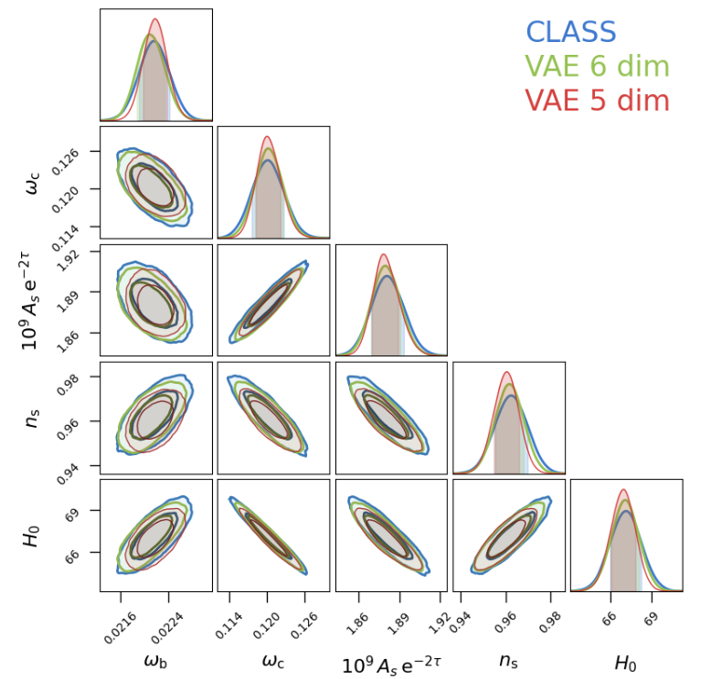
Can we map latents to cosmological parameters?
CLASS
VAE_{ΛCDM} (5 latents)
VAE_{ΛCDM} (6 latents)
Yes! Could be useful to solve prior-volume effects

Slide 70

Didn’t know where to best use this, glad you found it down here :)

