Slide 1
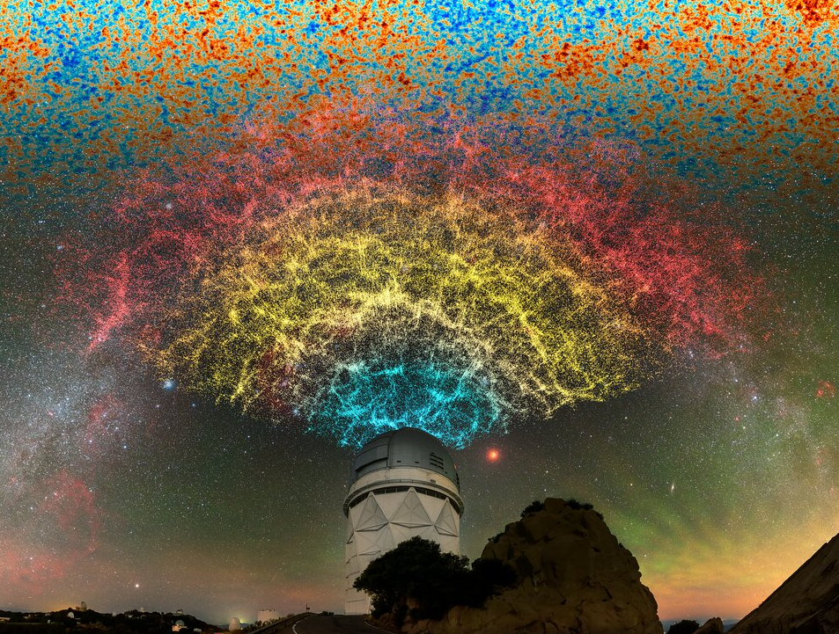
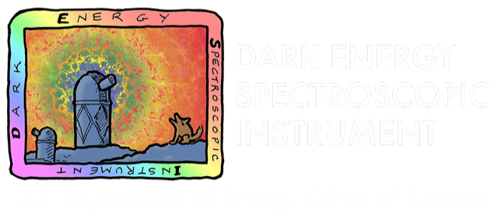

The DESI survey
and its cosmological Implications
Antoine Rocher
Rafaela Gsponer
Postdocs
Ecole Polytechnique Fédérale de Lausanne
On behalf of the DESI collaboration
CosmoFONDUE – 2025 June 12th - Geneva
Credit : DESI collaboration

Slide 2
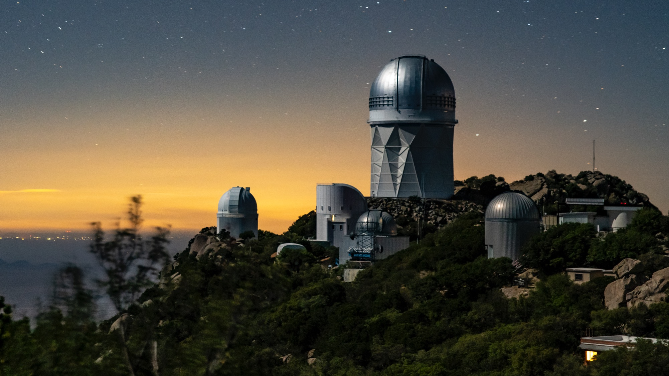










Thanks to our sponsors and 72 Participating Institutions!

Slide 3
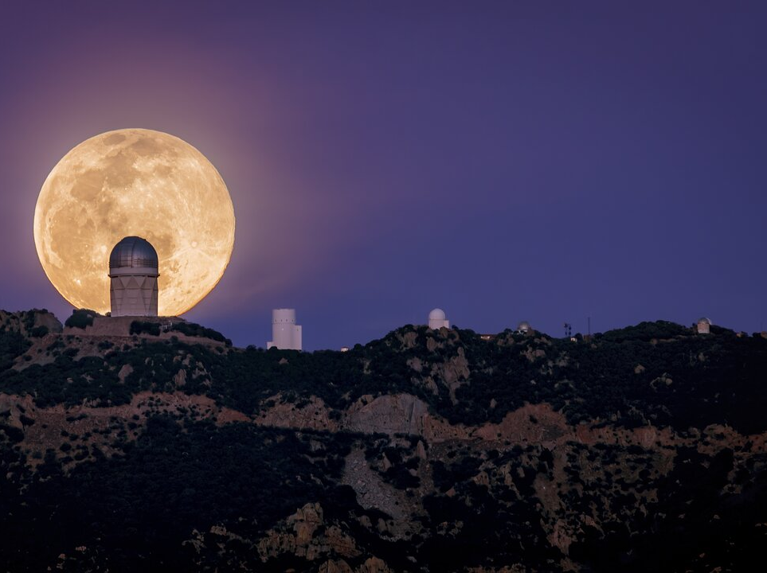
Dark Energy Spectroscopic Instrument
DESI is a state-of-the-art spectroscopic instrument installed at the Mayall 4-meter telescope at Kitt Peak National Observatory.
First Stage-4 spectroscopic survey on sky
  measures the 3D distributions of galaxies
  1/3 sky 14000 deg²
40M redshifts at the end of the survey (5 years)
  x13 previous spectroscopic surveys

Slide 4
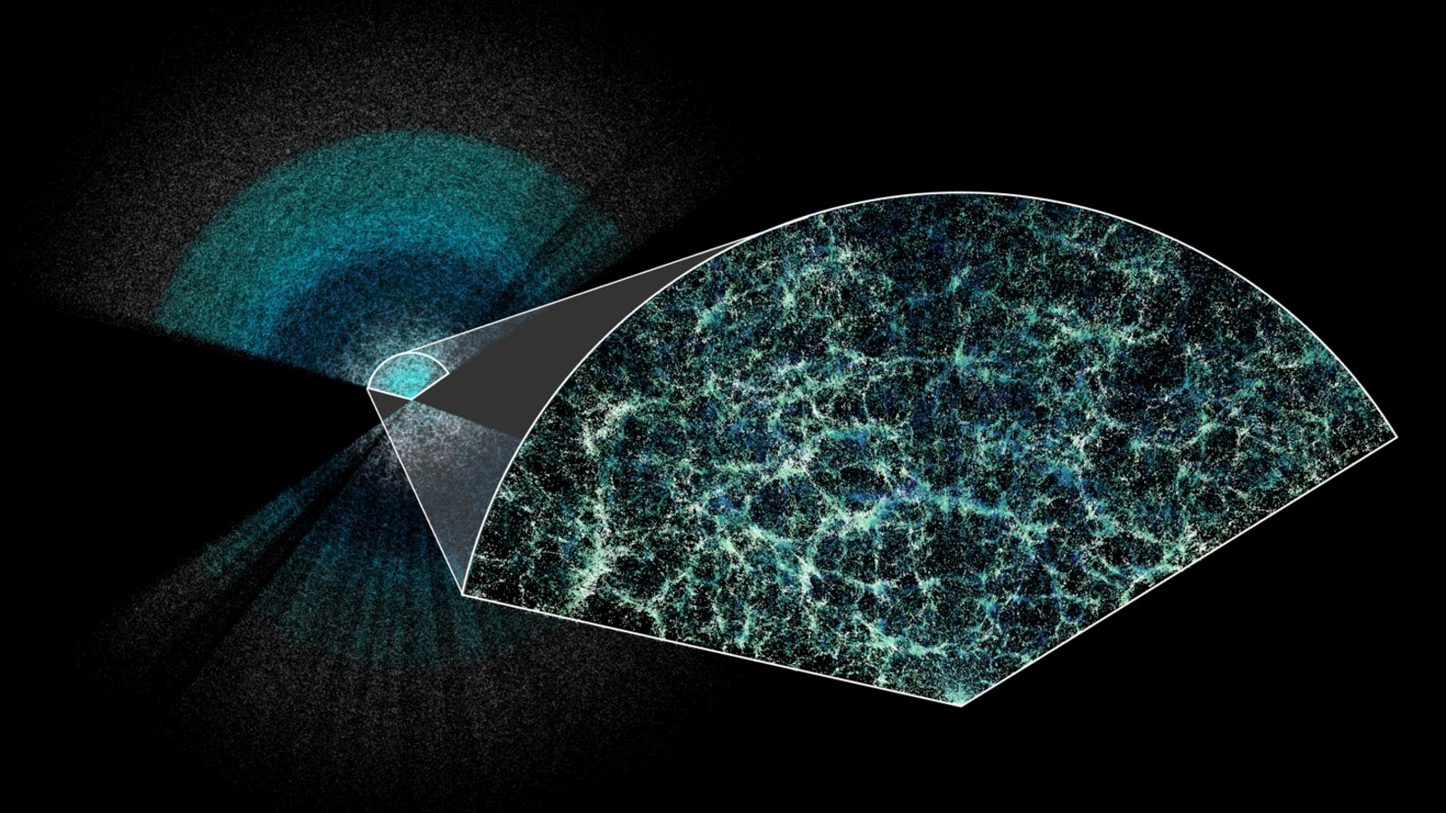
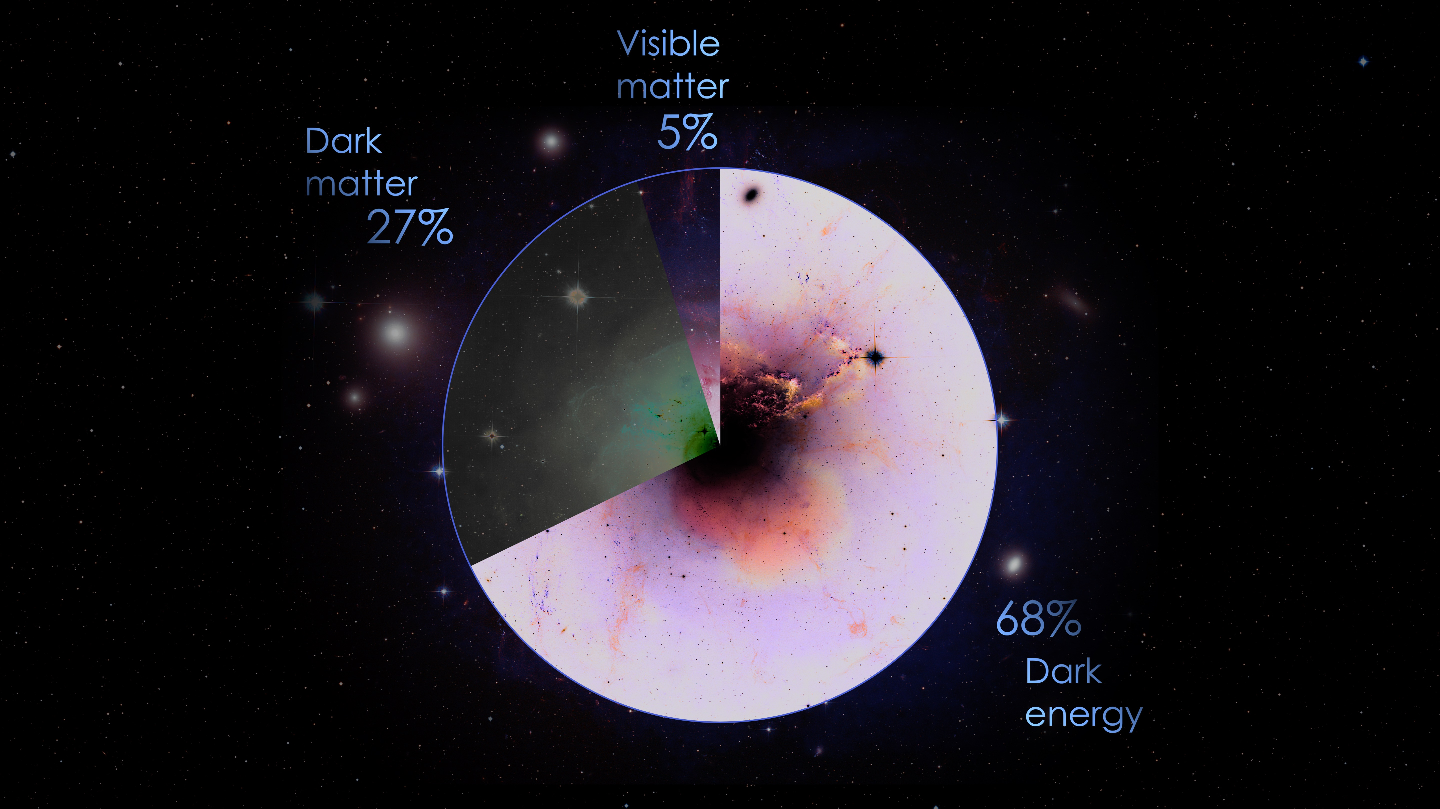
Dark Energy Spectroscopic Instrument
Key questions:
Expansion history of the Universe
  => Constraint Dark Energy with BAO
How does the structure form?
  => Test of gravity (GR)
Primordial physics, inflation (f_{nl})
Neutrino mass, dark matter models...
+ many other science cases
Map the Universe in 3D to constrain the cosmological model
ΛCDM
Credit : DESI collaboration/Claire Lamman

Slide 5
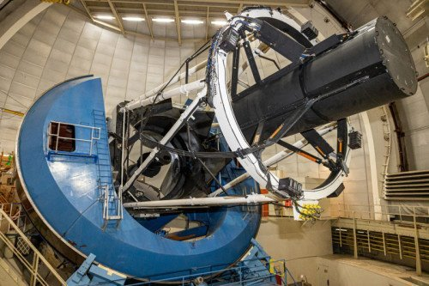
DESI is a state-of-the-art instrument installed at the Mayall 4-meter telescope at Kitt Peak National Observatory.

Slide 6
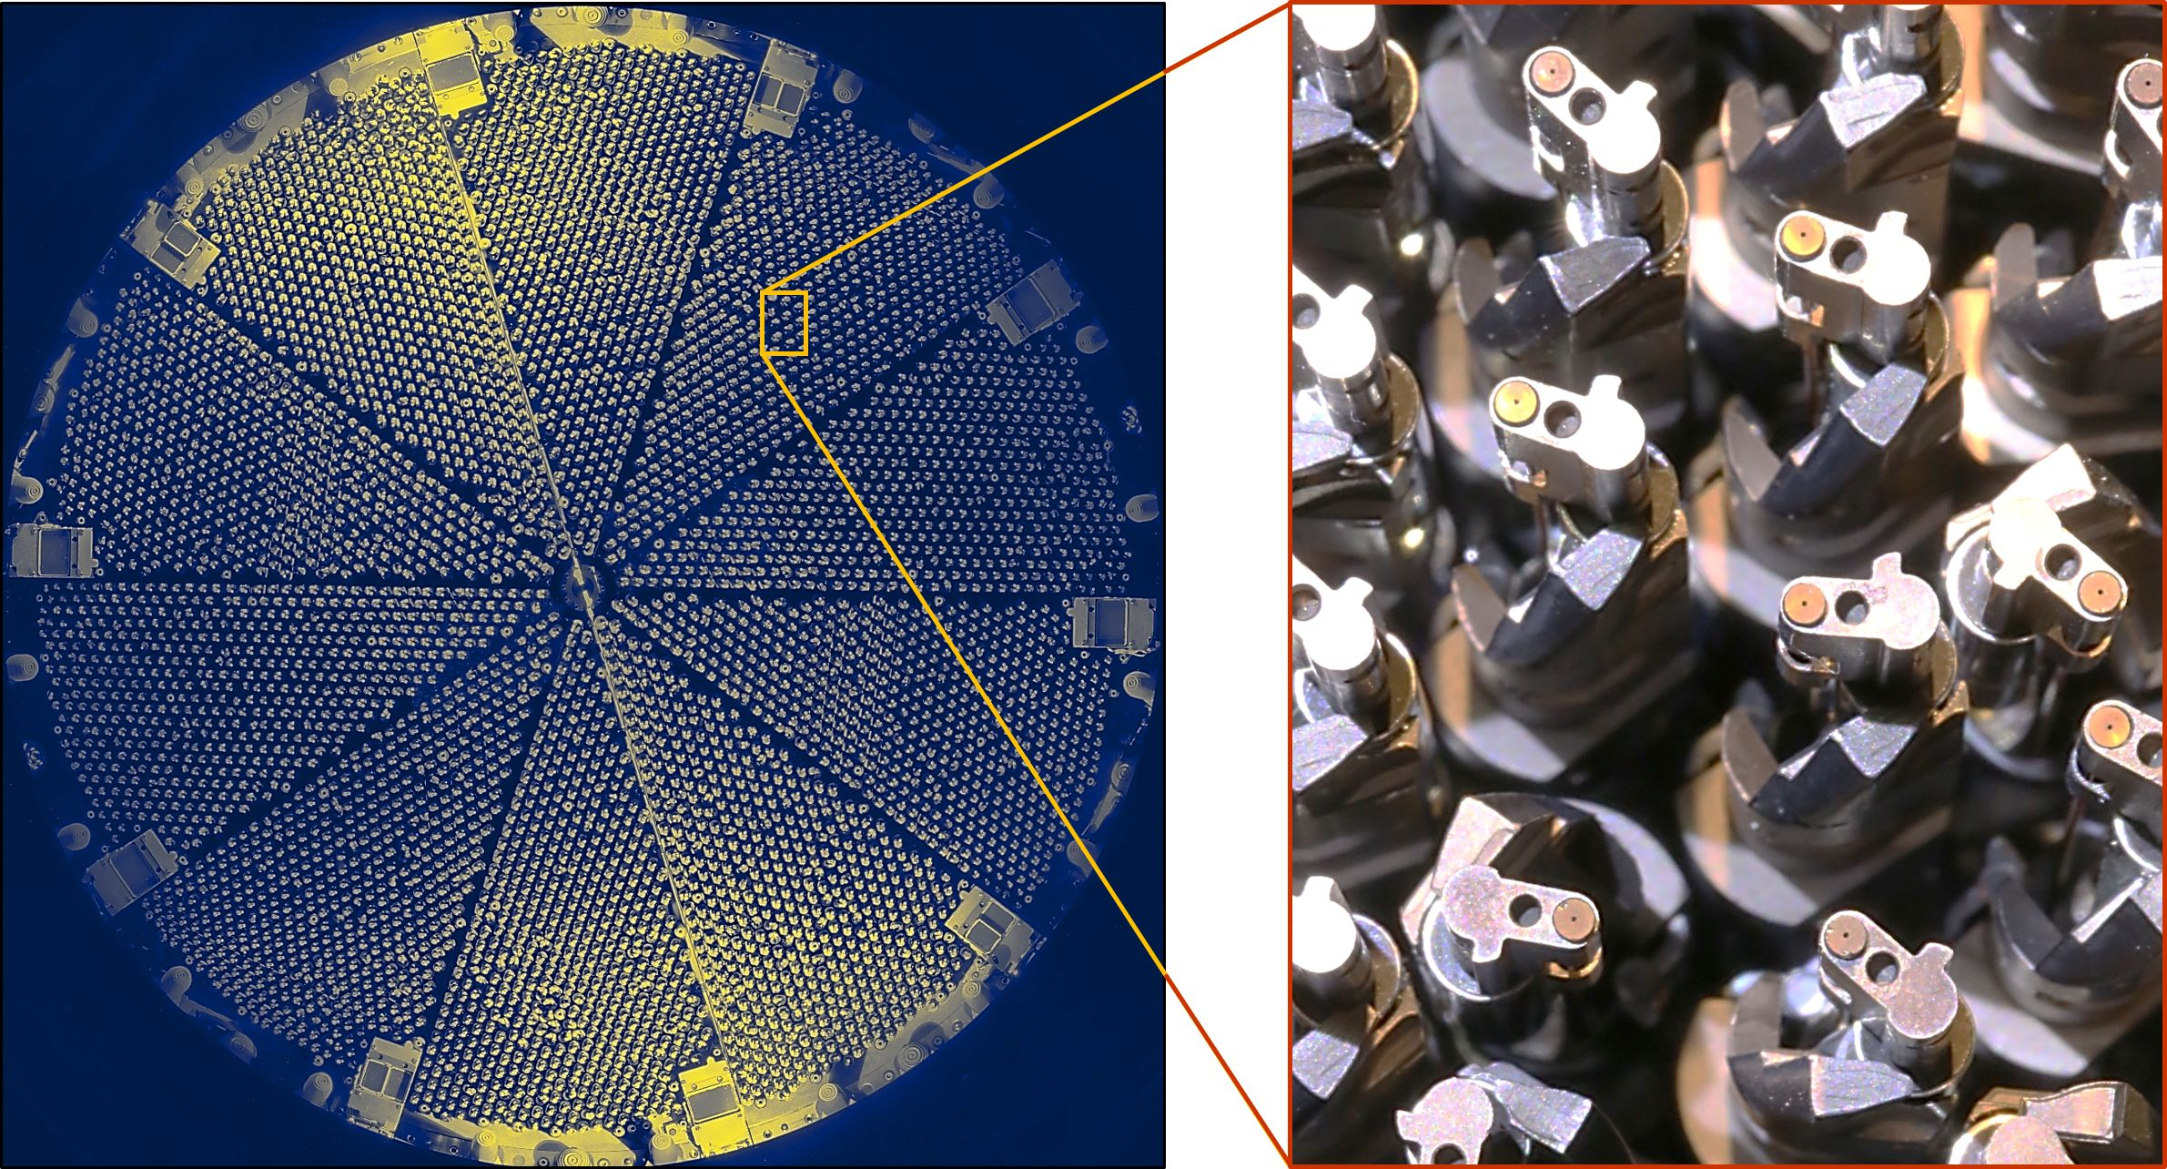
Focal plane is populated with 5000 robotics fibers
DESI is a state-of-the-art instrument installed at the Mayall 4-meter telescope at Kitt Peak National Observatory.

Slide 7
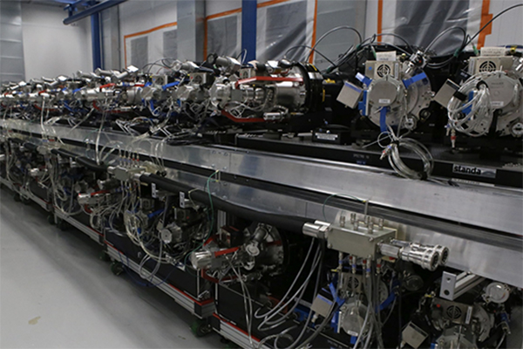
Focal plane is populated with 5000 robotics fibers
That feed
10 spectrographs λ ~ 360-980 nm
DESI is a state-of-the-art instrument installed at the Mayall 4-meter telescope at Kitt Peak National Observatory.

Slide 8
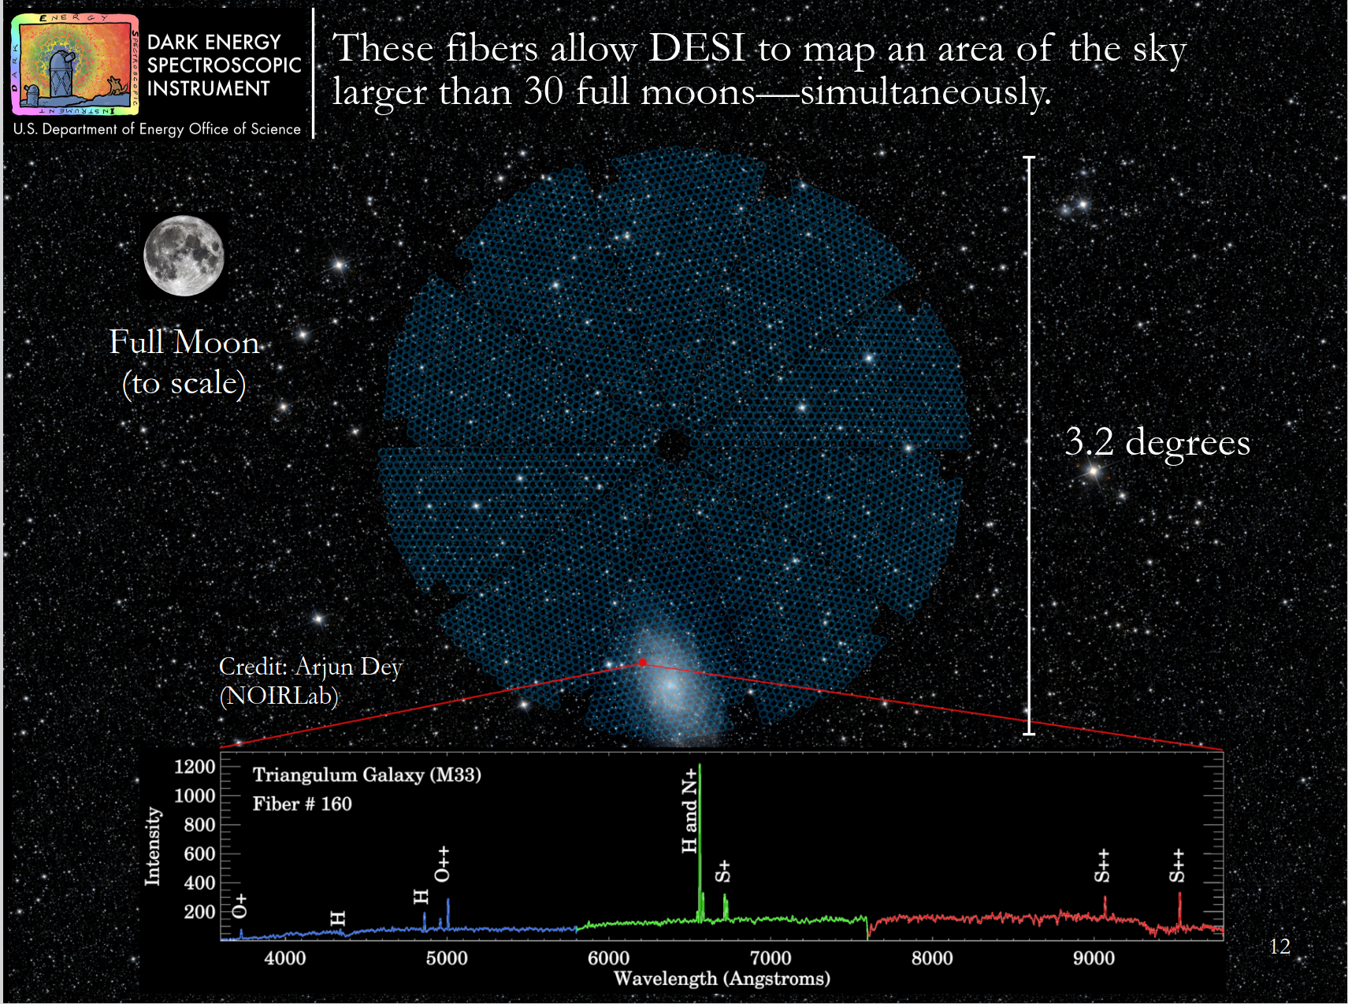

Slide 9
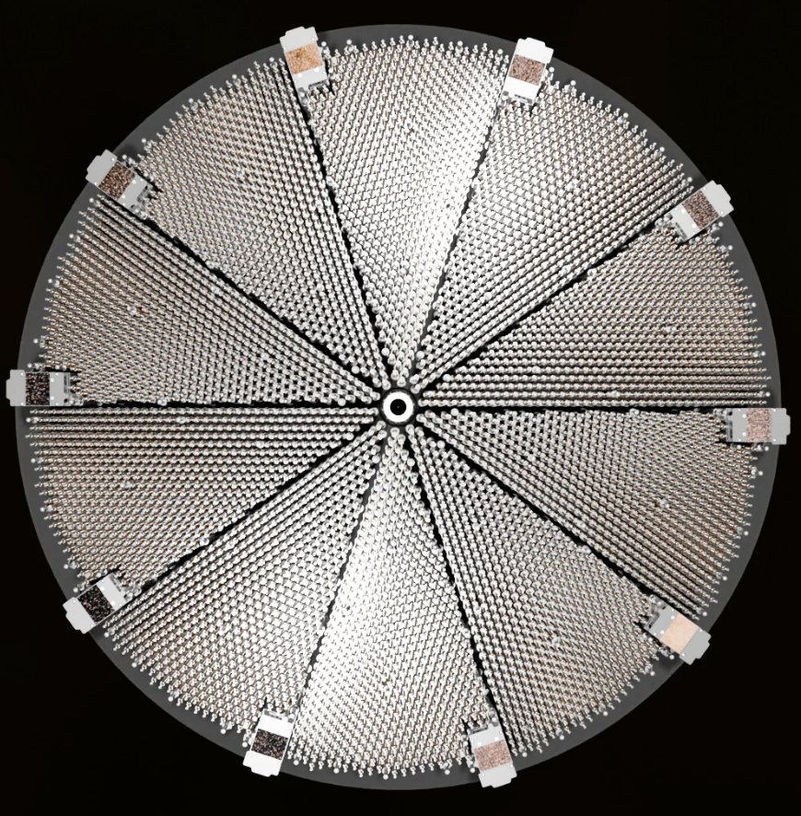
20

Slide 10
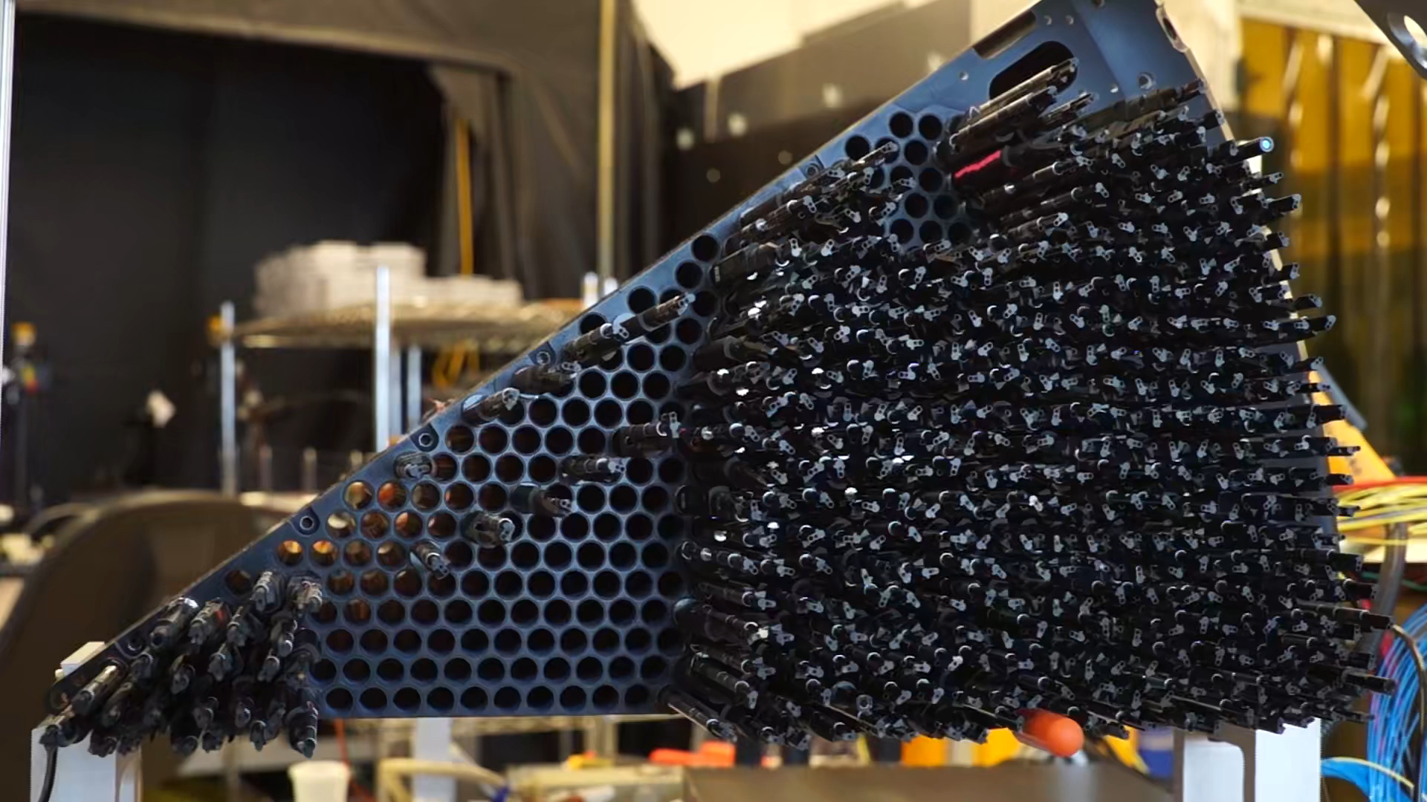
20
Reconfiguration time < 2min

Slide 11

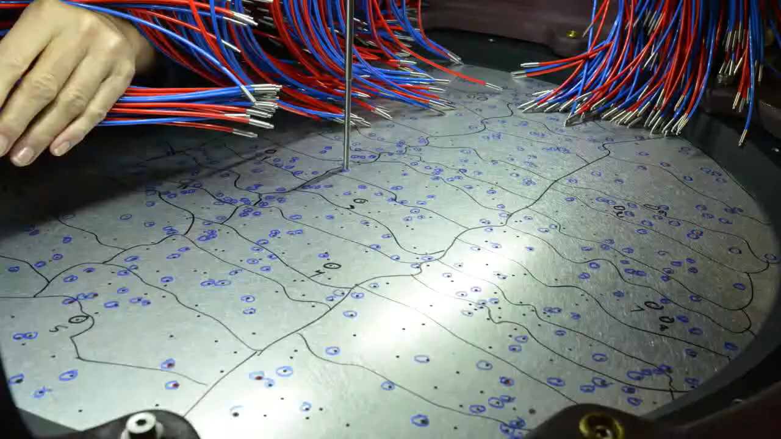
20
~20 min between 2 exposures
Reconfiguration time < 2min

Slide 12

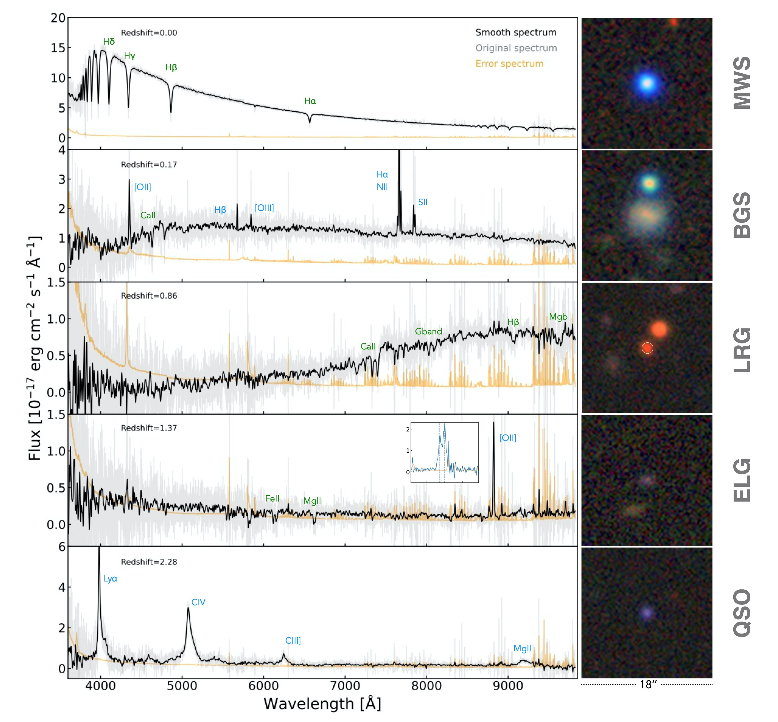
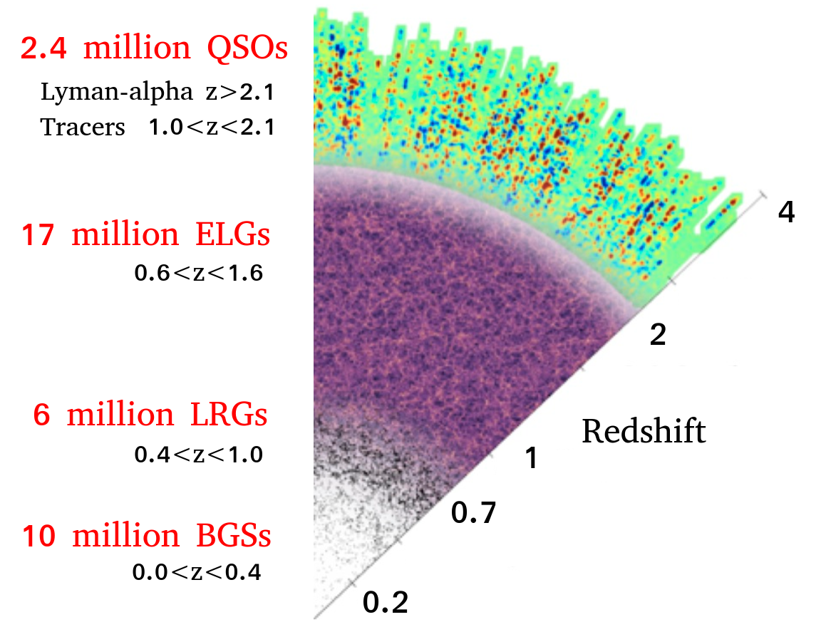
The DESI main survey
4 different tracers to probe the Universe z < 3.5
Dark time survey
3M Quasars (QSOs)
0.8<z<2.6
+ Ly-α z > 2.1
17M Emission line galaxies (ELGs)
0.6<z<1.6
8M Luminous red galaxies (LRGs)
0.4<z<1.1
z
13.5M Bright galaxies
0<z<0.5
+ Milky way Stars
Bright time survey

Slide 13
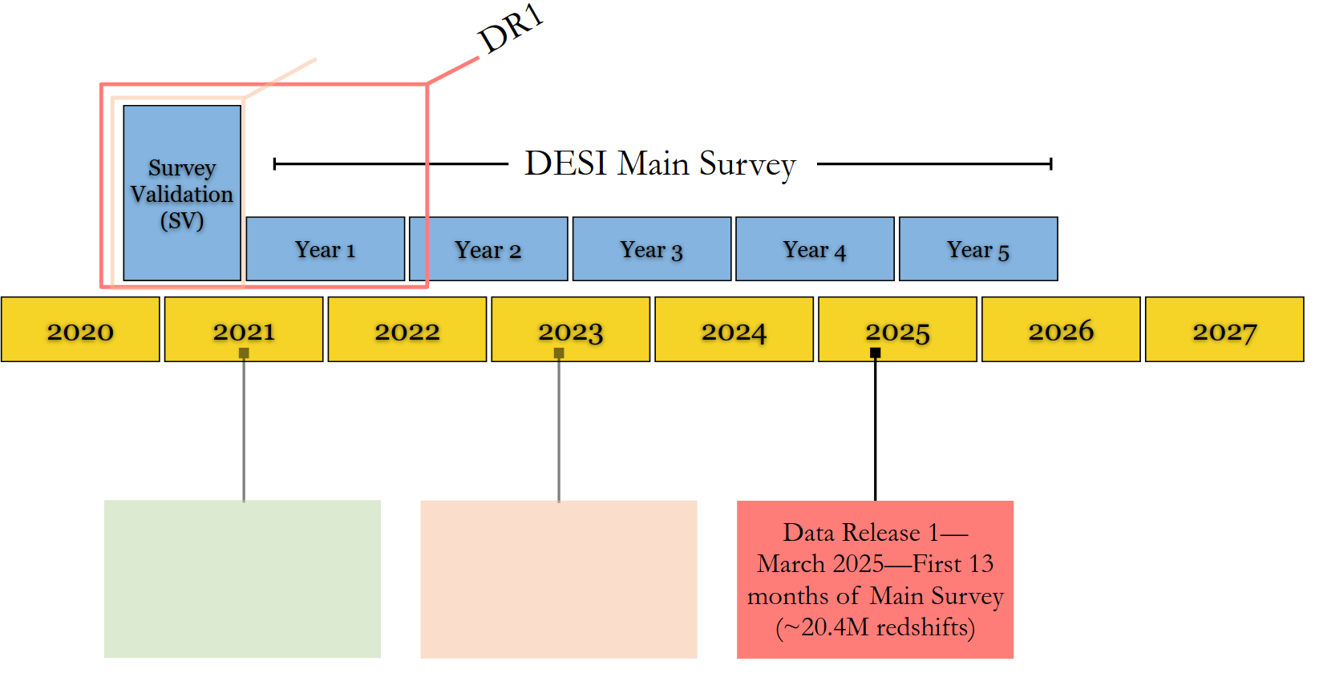


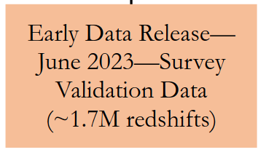
DESI Timeline
DR2
40M extragalactic redshifts
DR1
Full shape results
DR2
BAO results
DR1
BAO results

Slide 14
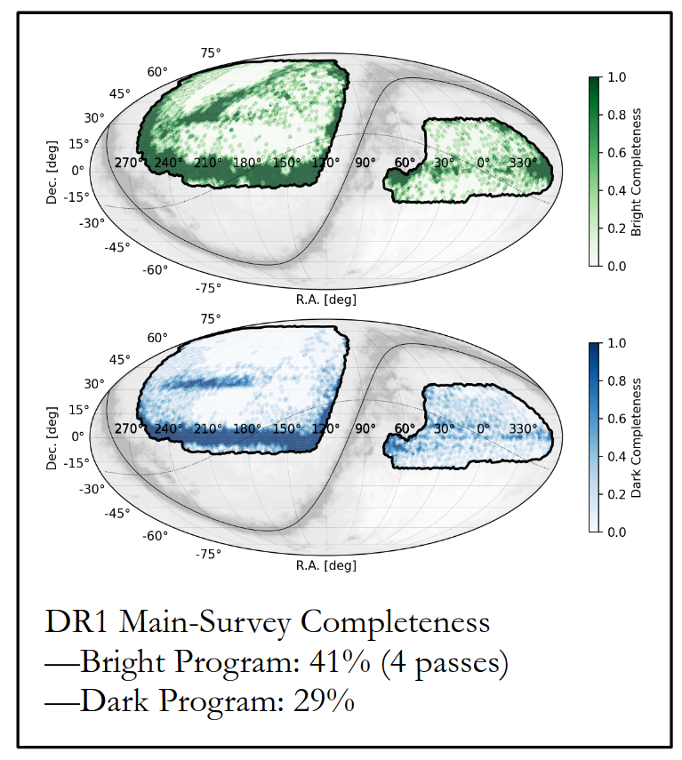
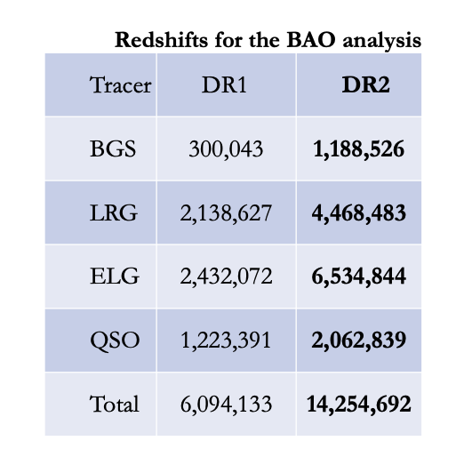
DESI DR1 contains the most detailed 3D map of the universe ever, spanning 12 billion years of cosmic time.
~ 9'700 deg²
Main Survey :
13.1M galaxies
1.6M quasars
4M stars
+ Survey Validation (1.7M objects)
Total: 20.4M redshifts
~ 9'500 deg²
Publicly available: https://data.desi.lbl.gov/doc/releases/dr1

Slide 15
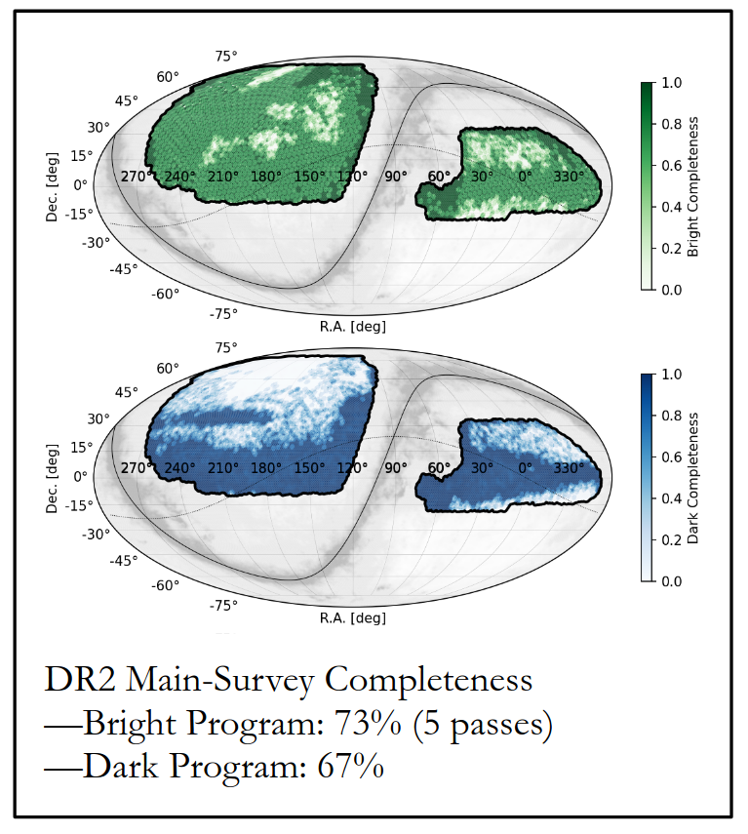
DESI DR2 will contain two-thirds of the 5-year survey data and ~50M redshifts, two times more than DR1!
~ 12'355 deg²
Main Survey (internal release):
31M galaxies
2.8M quasars
12.3M stars
+ Survey Validation (1.7M objects)
Total: 46.1M redshifts
~ 10'500 deg²

Slide 16
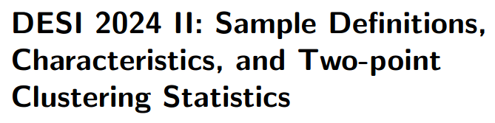
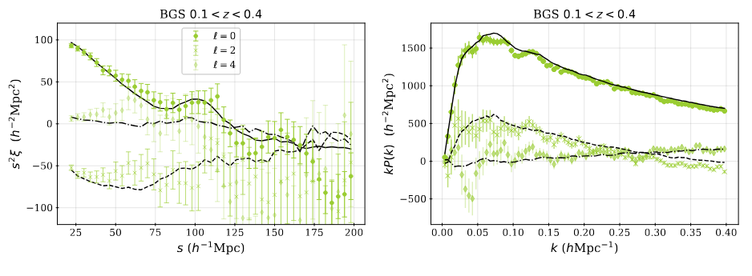
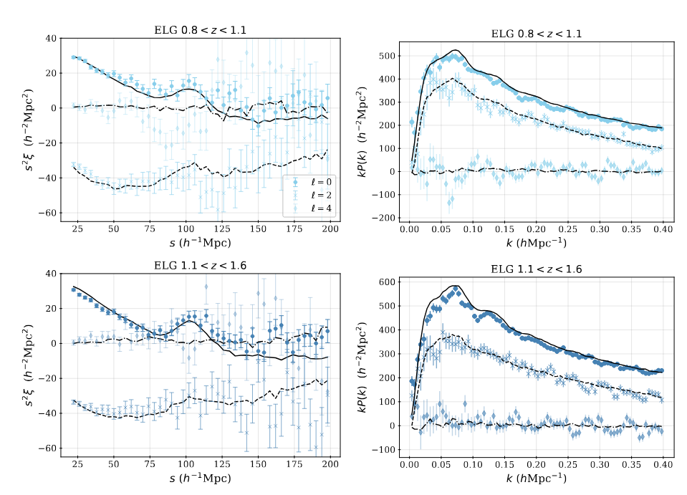
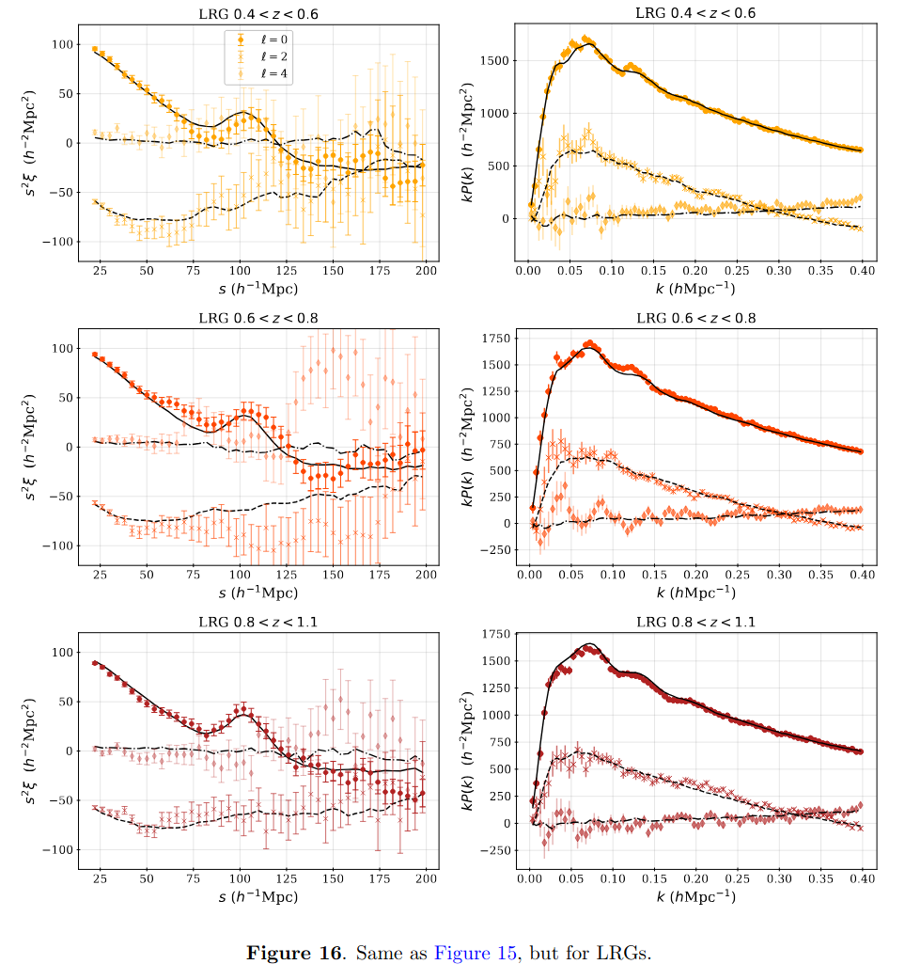
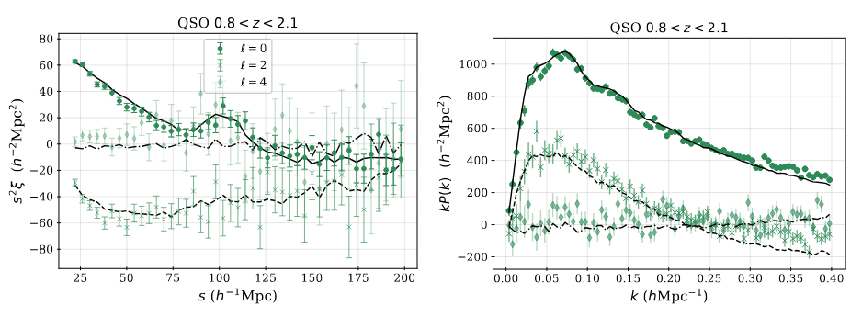
arxiv: 2411.12020v1

Slide 17
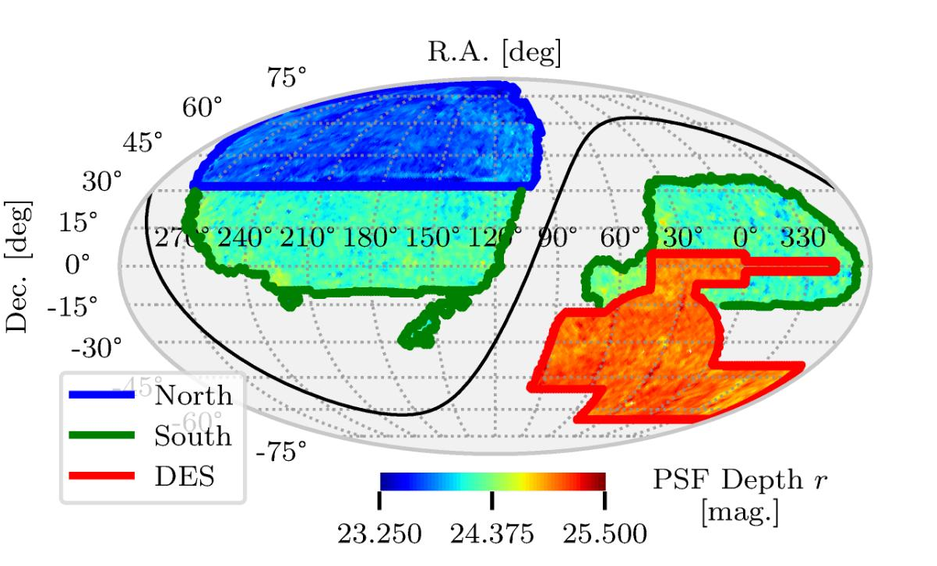
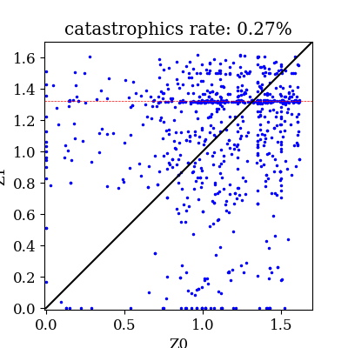
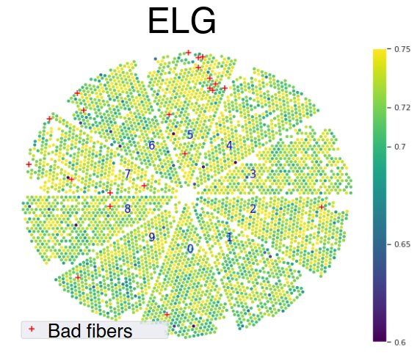
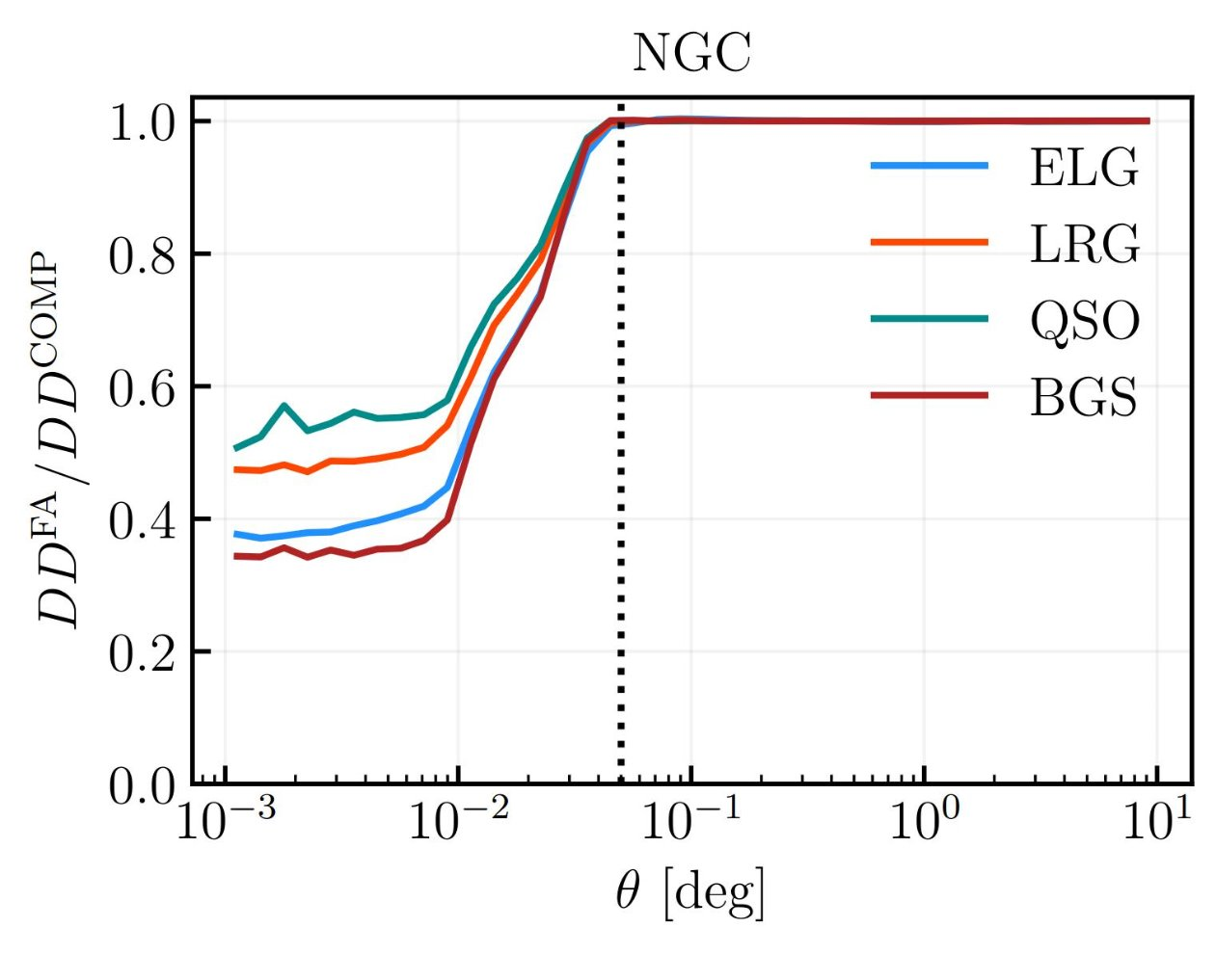
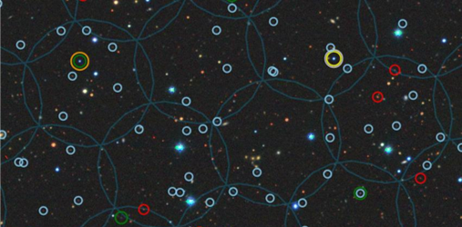
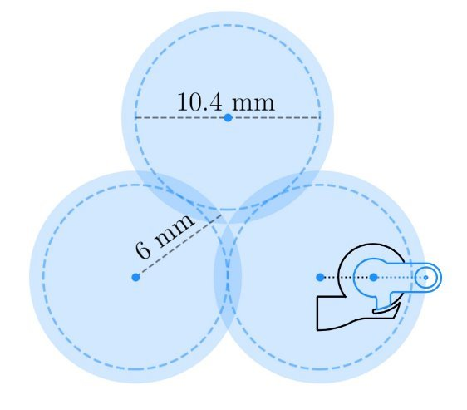
Main observational systematic sources
arxiv: 2411.12020v1
Chaussidon et al 2022
Systematic errors from the target selection (imaging systematics):​
  Target density variations due to photometric properties
Yu et al. 2024
Krolewski et al. 2024
[OII] line confusion
Systematic errors from spectroscopic operations:
  Change in spectroscopic success rate (SSR) due to instrumentation or observing conditions
Fiber assignment effects:
  Miss close pairs of objects
z estimated
Spectroscopic succes rate
z true
Fiber patrol radius
:BGS
:LRGs
:ELGs
:QSOs
Y1 FA mocks
Pinon et al 2024

Slide 18
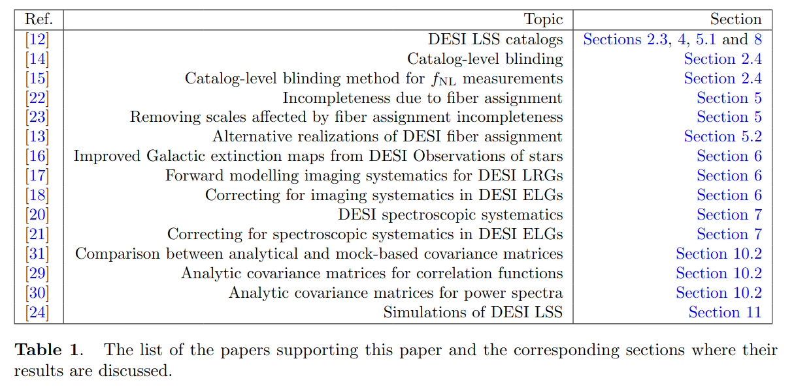
Main observational systematic sources
arxiv: 2411.12020v1
Chaussidon et al 2022
Systematic errors from the target selection (imaging systematics):​
  Target density variations due to photometric properties
Yu et al. 2024
Krolewski et al. 2024
[OII] line confusion
Systematic errors from spectroscopic operations:
  Change in spectroscopic success rate (SSR) due to instrumentation or observing conditions
Fiber assignment effects:
  Miss close pairs of objects
z estimated
Spectroscopic succes rate
z true
Fiber patrol radius
:BGS
:LRGs
:ELGs
:QSOs
Y1 FA mocks
Pinon et al 2024

Slide 19
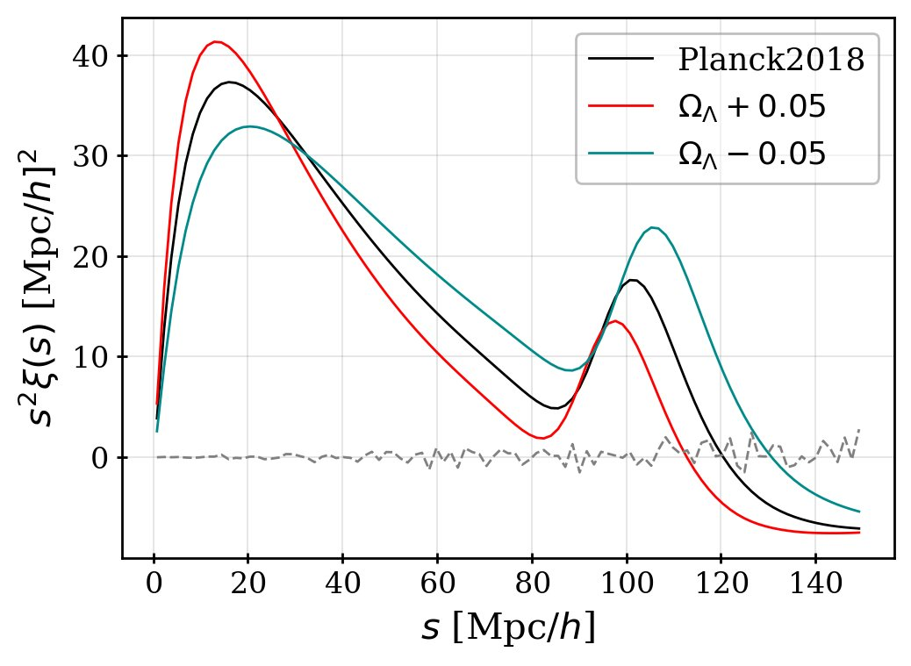
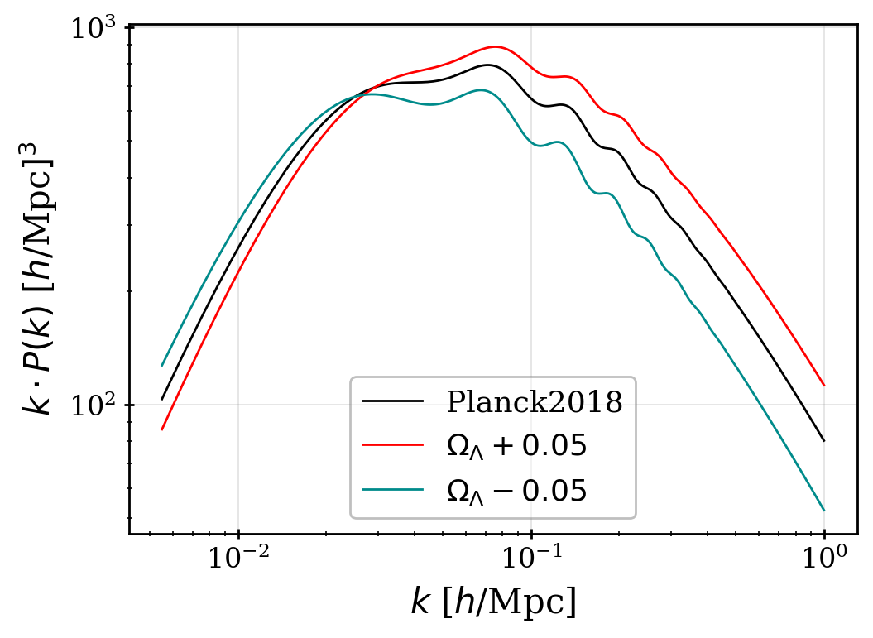
Full-shape & BAO in a Nutshell
From the galaxy distribution we can compute field statistics like 2PCF​
Baryonic acoustic oscillations (BAO):
Measure the position of the peak/wiggles
Redshift space distortions:
Shape of the 2PCF
Two-point correlation function (2PCF)
Power spectrum
uniform distribution

Slide 20
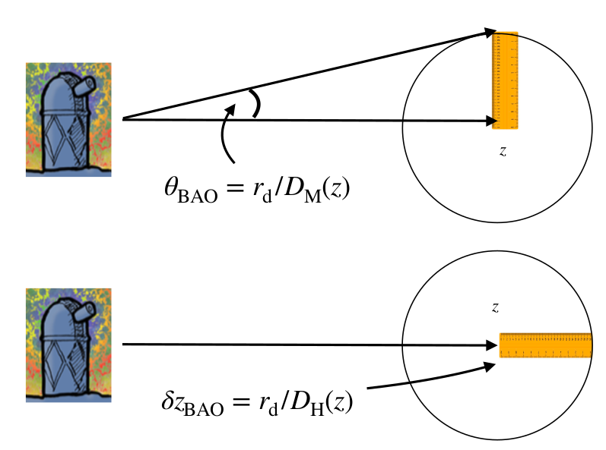
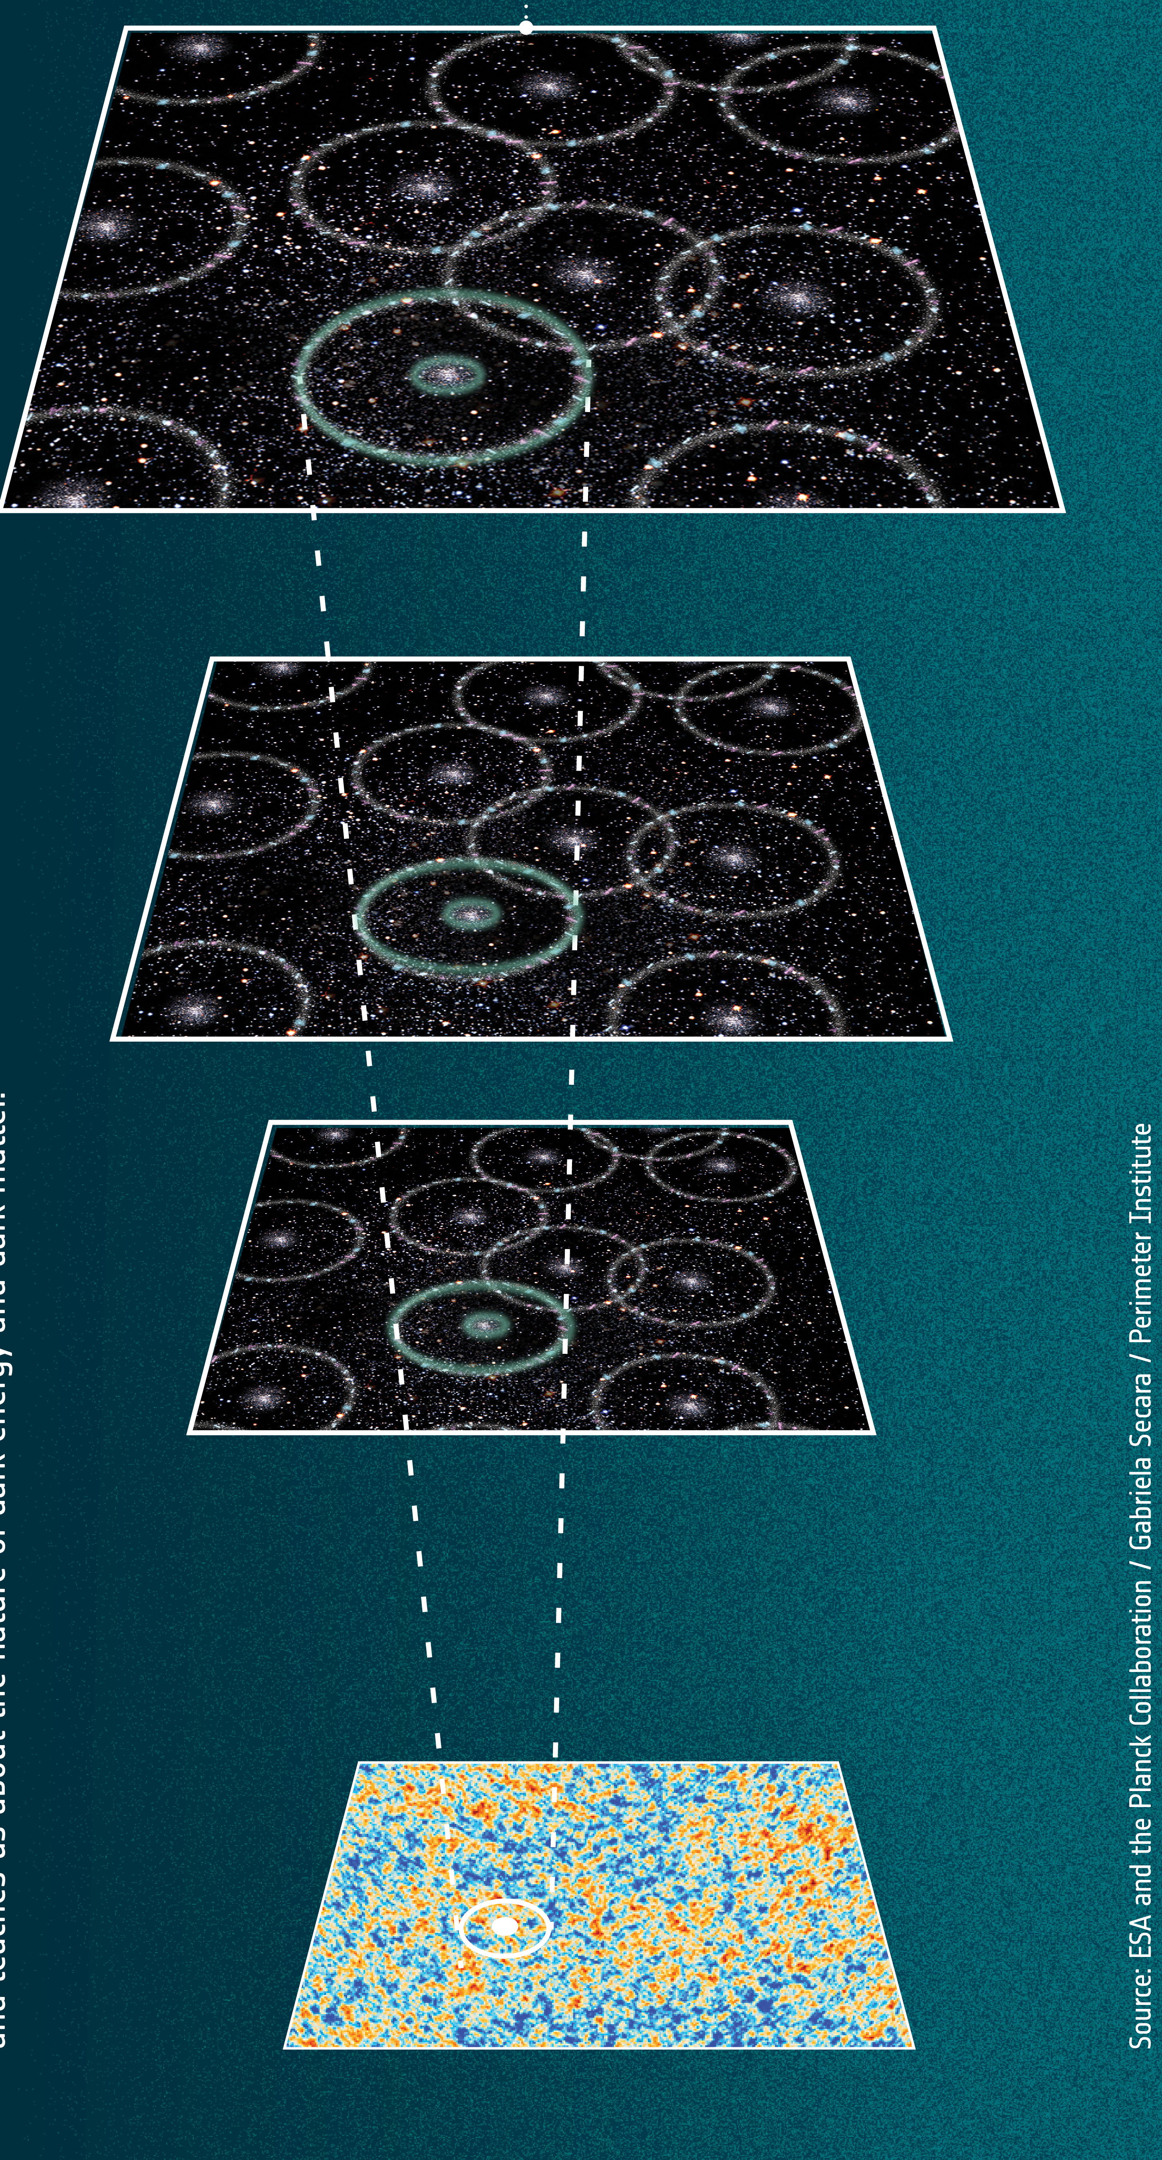
Full-shape & BAO in a Nutshell
BAO → Expansion (Dark Matter, Dark Energy)
transverse comoving distance
Hubble distance
sound horizon r_{d}

Slide 21
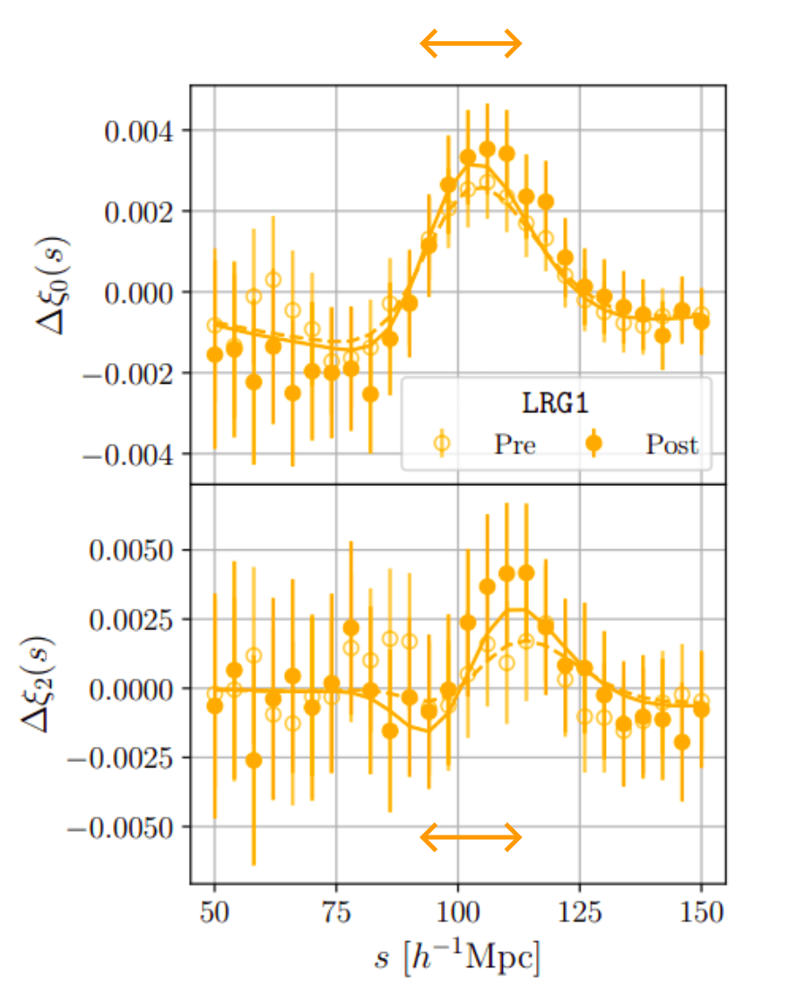
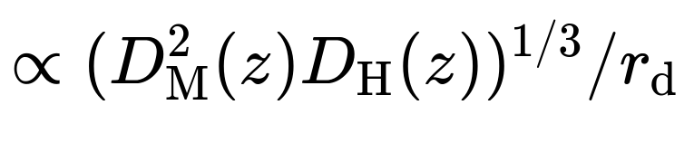
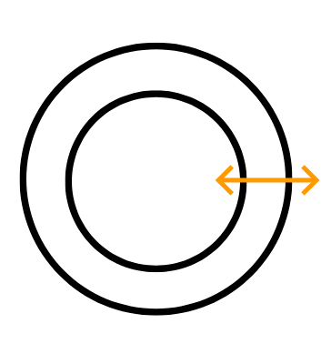
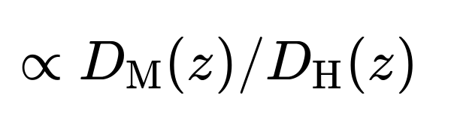
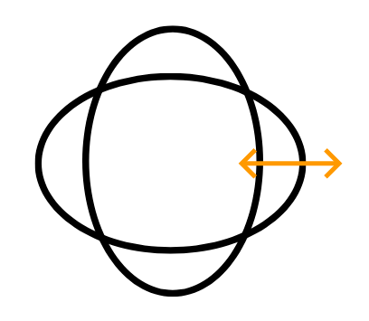
Full-shape & BAO in a Nutshell
BAO → Expansion (Dark Matter, Dark Energy)
isotropic measurement
anisotropic measurement

Slide 22
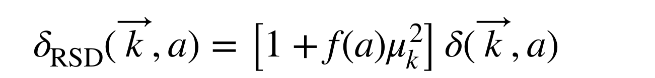
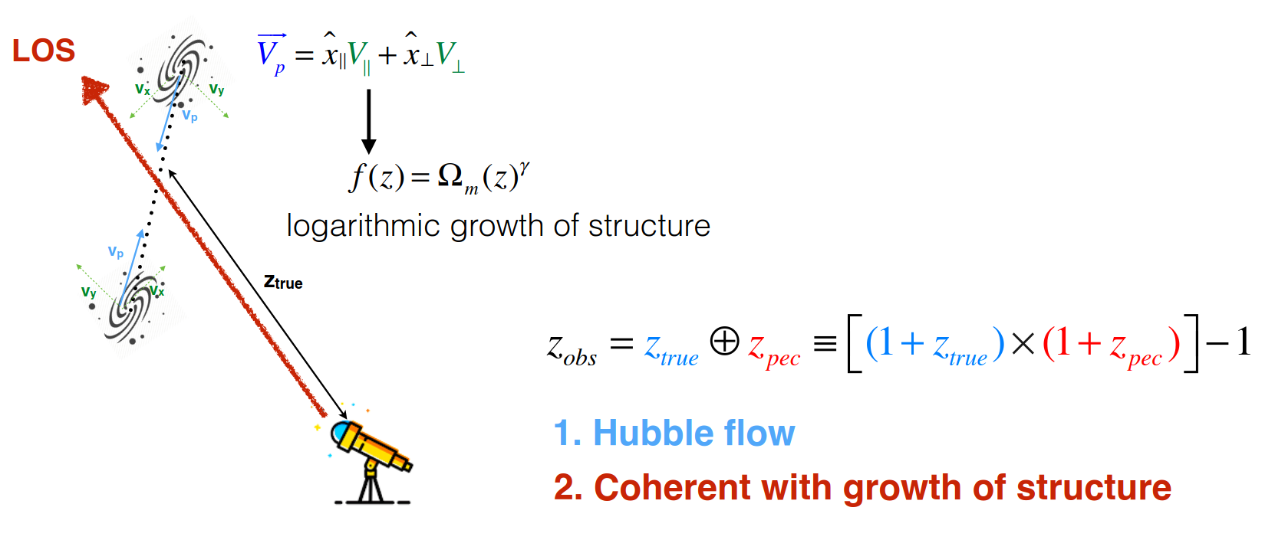
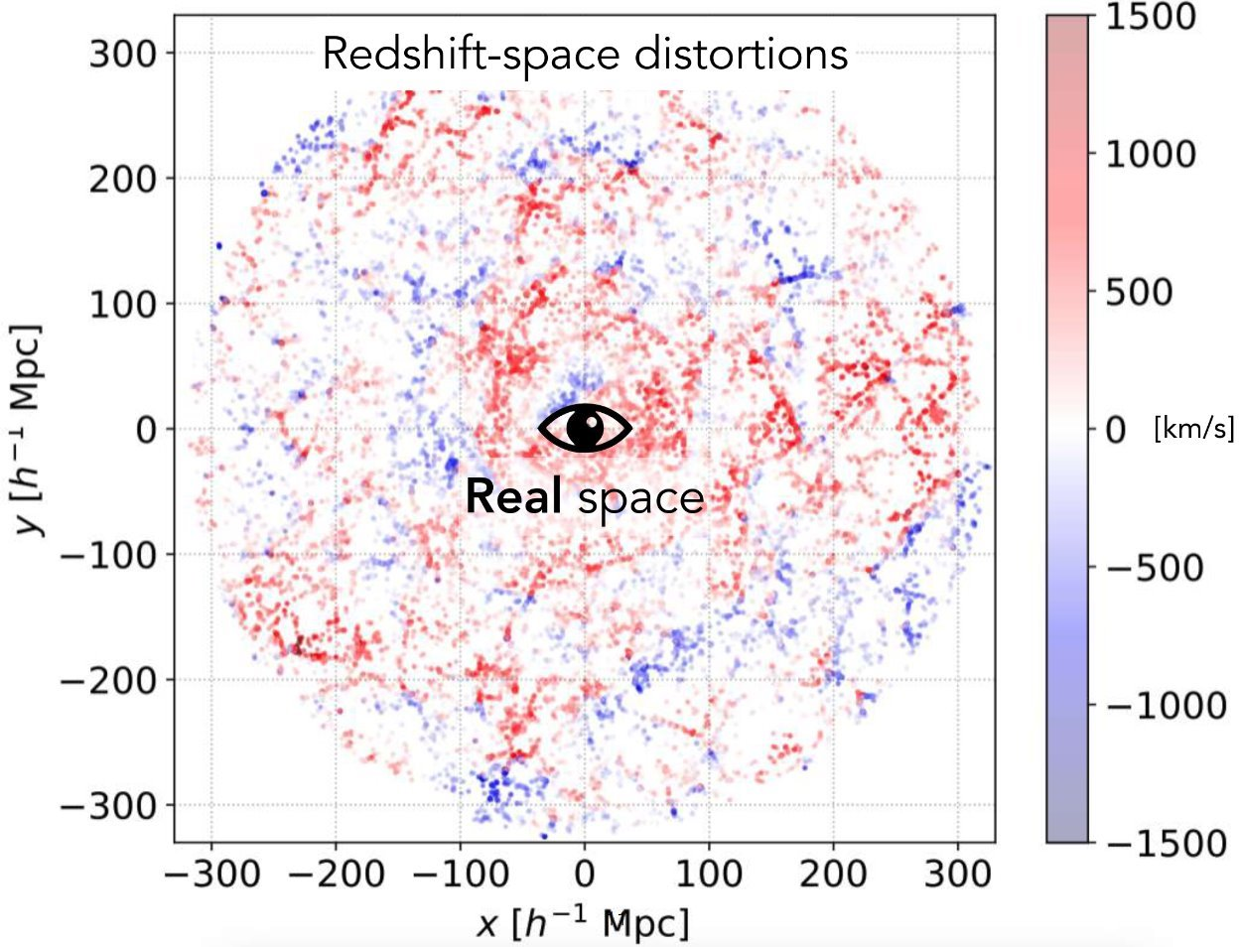
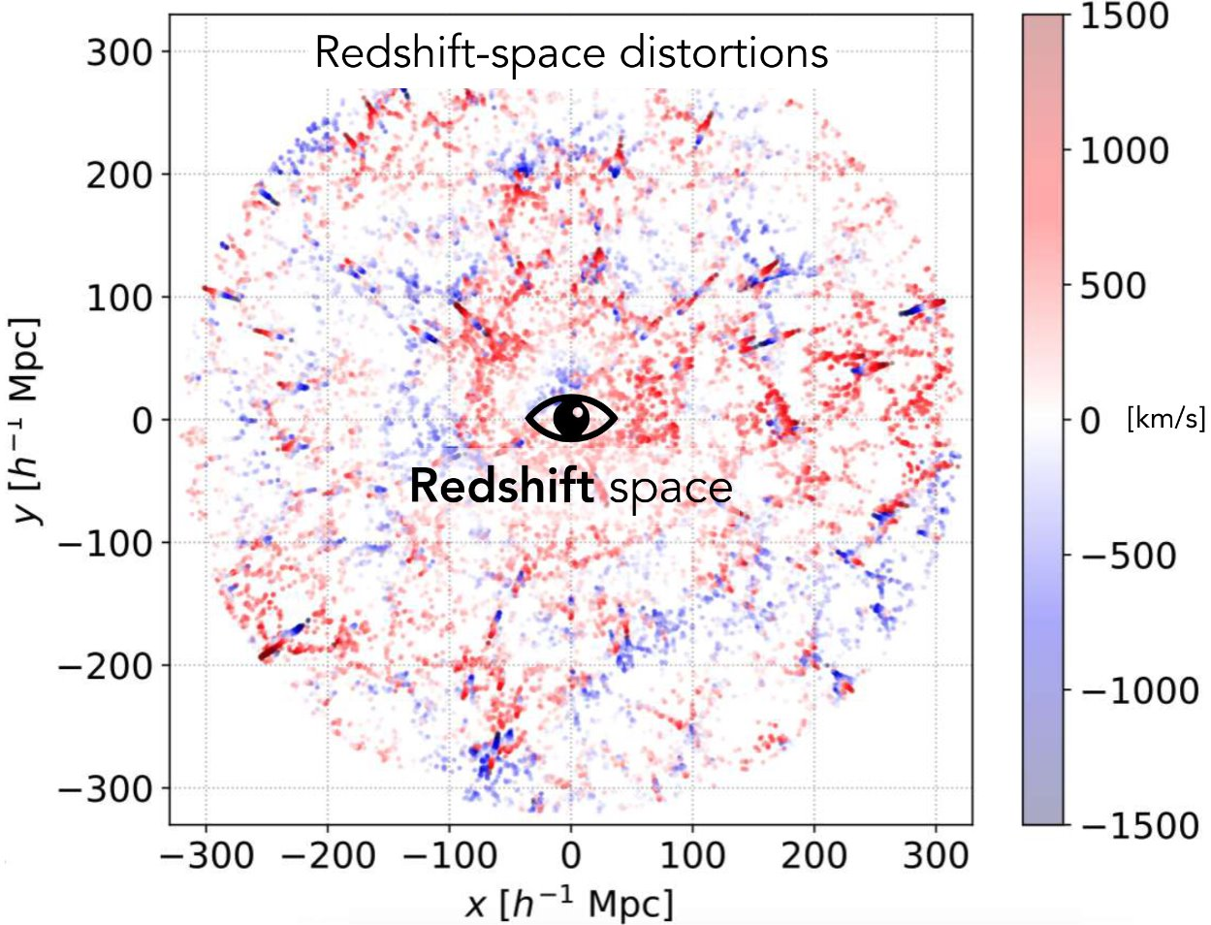

Full-shape & BAO in a Nutshell
Peculiar velocities impact the measurement of the redshift and create anisotropies in the galaxy distribution
(Kaiser 1987)
GR predict γ ≈ 0.55
Observed positions
Credit : J. Bautista
Enhancement / reduction of the clustering along the line-of-sight (LOS)
Credit : H. Gil-Marin

Slide 23
Full-shape & BAO in a Nutshell
Peculiar velocities impact the measurement of the redshift and create anisotropies in the galaxy distribution
(Kaiser 1987)
GR predict γ ≈ 0.55
Observed positions
Credit : J. Bautista
Enhancement / reduction of the clustering along the line-of-sight (LOS)
Credit : H. Gil-Marin

Slide 24
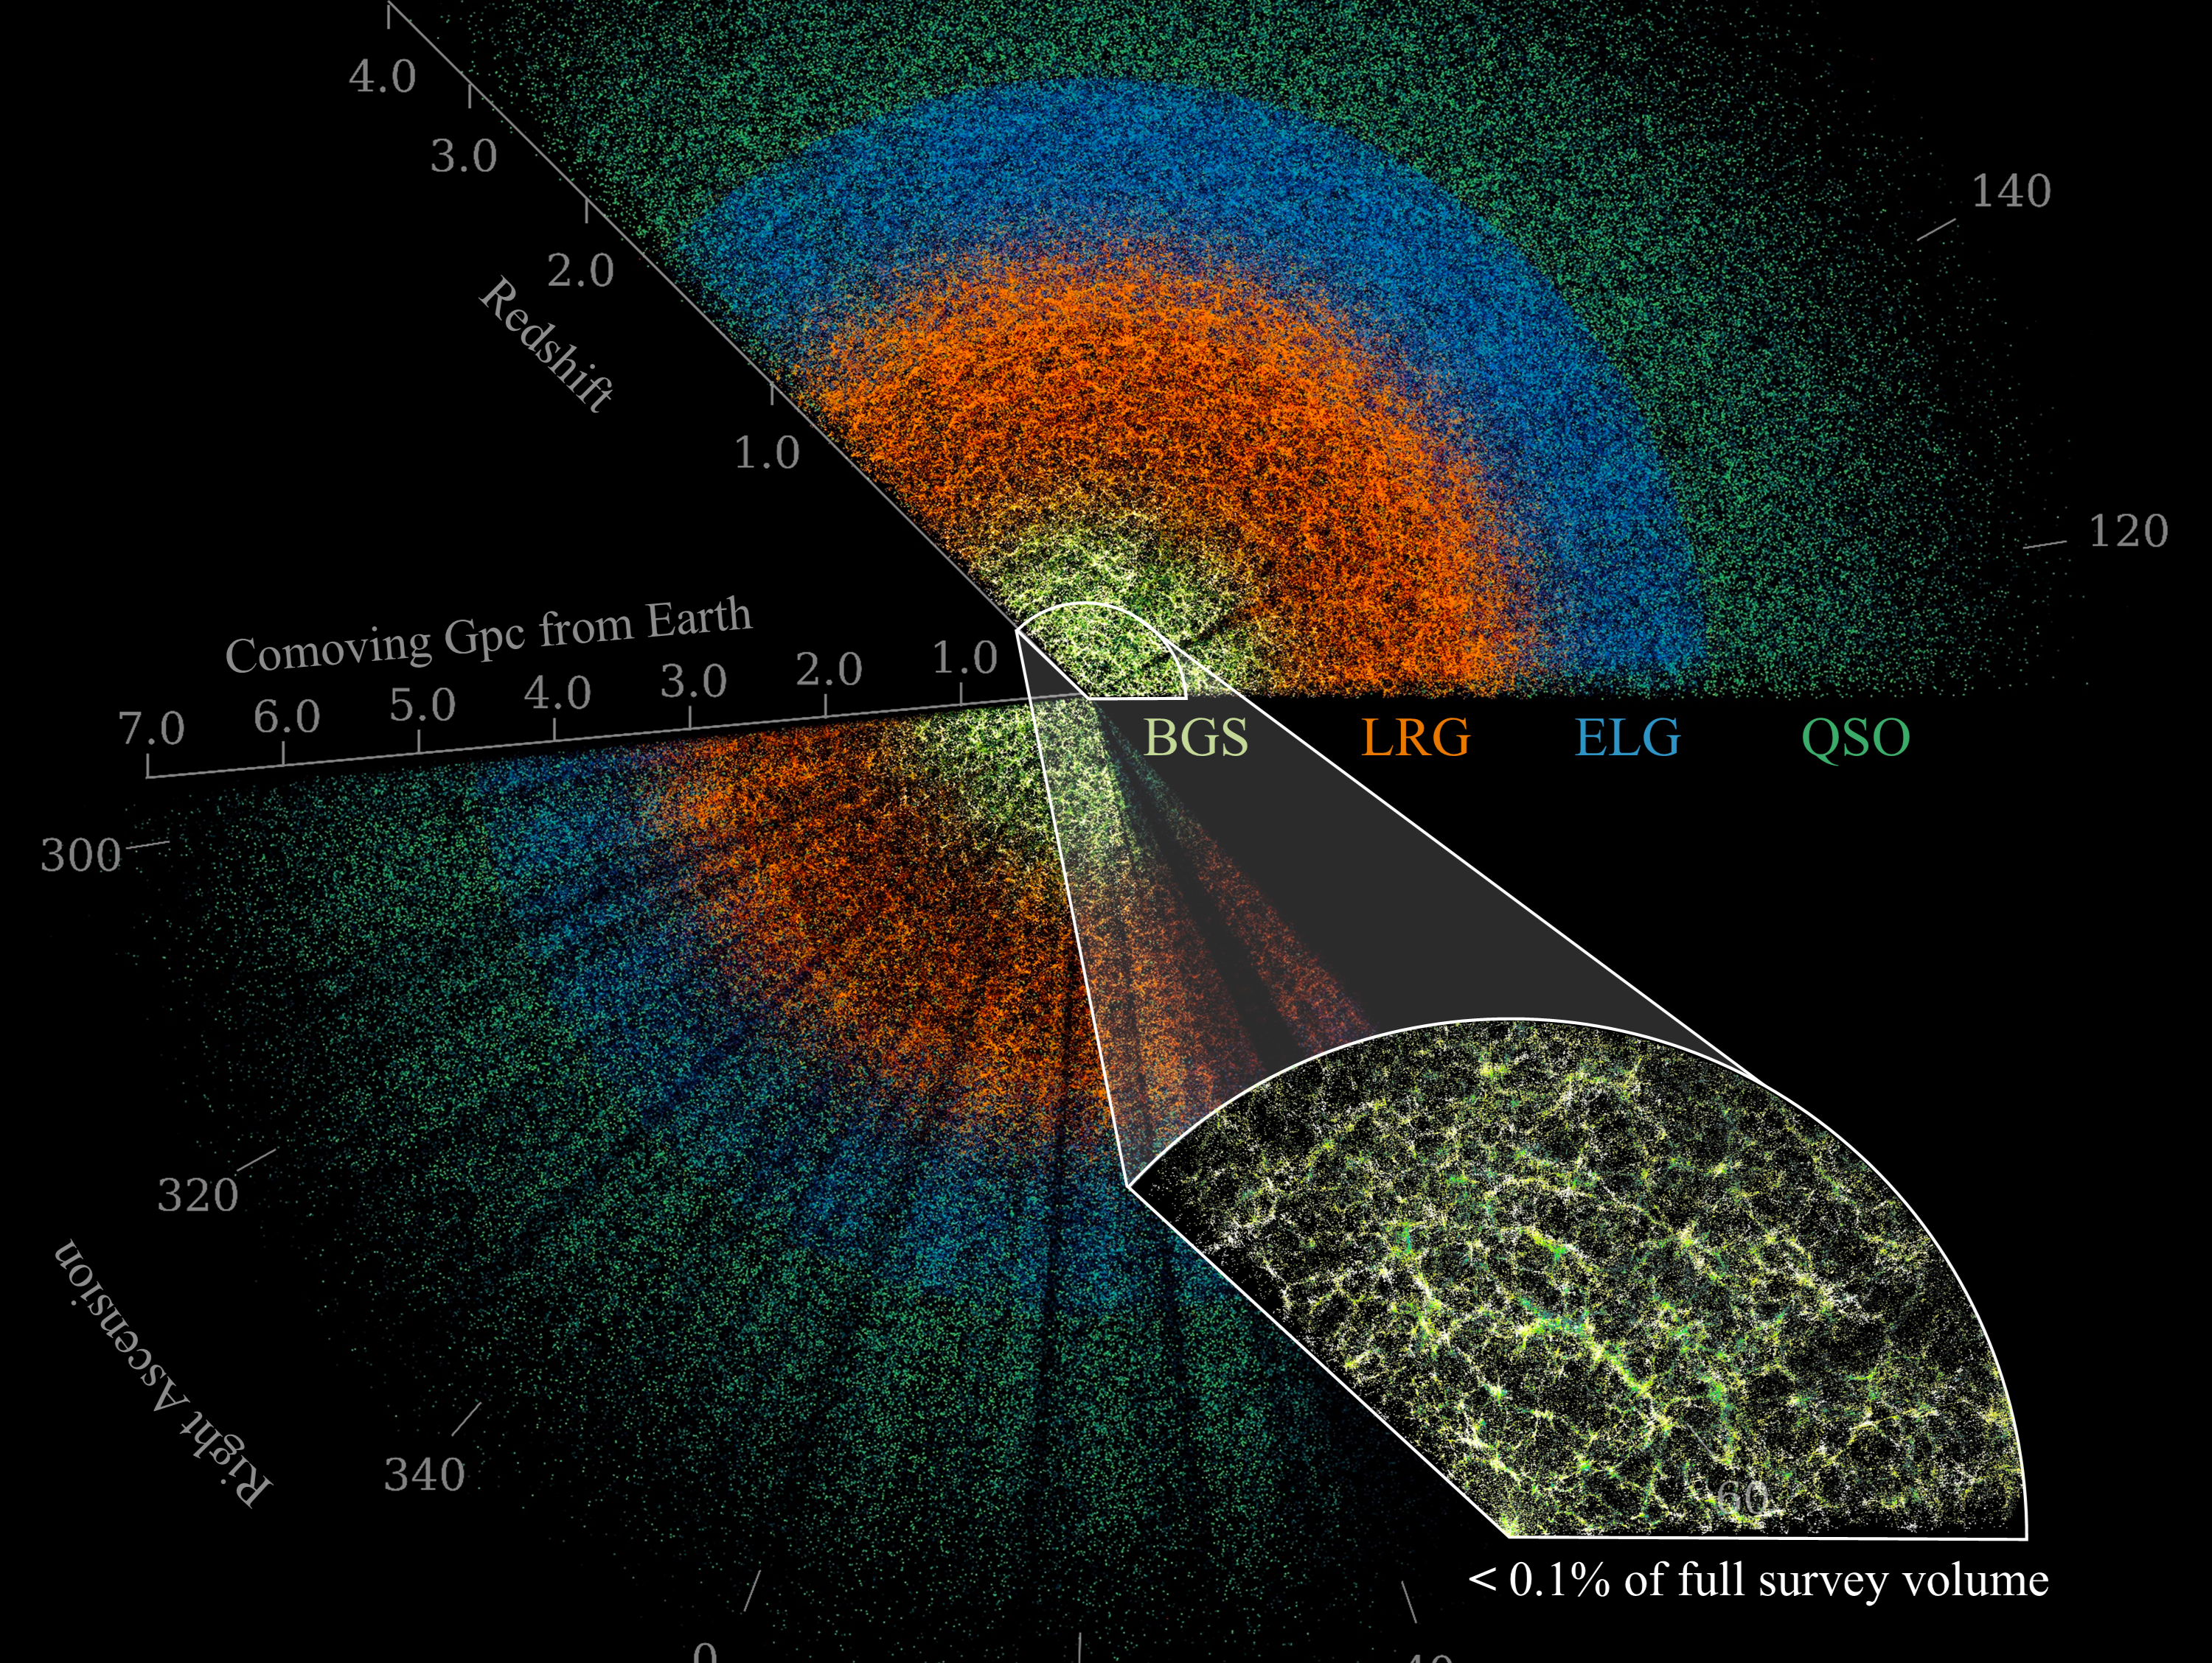


Cosmological implication of DESI DR1 and DR2
Credit : DESI collaboration/Claire Lamman

Slide 25
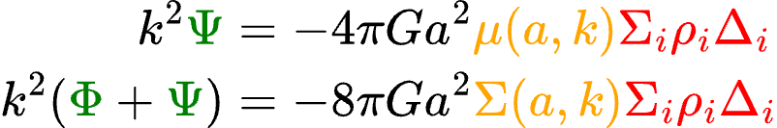

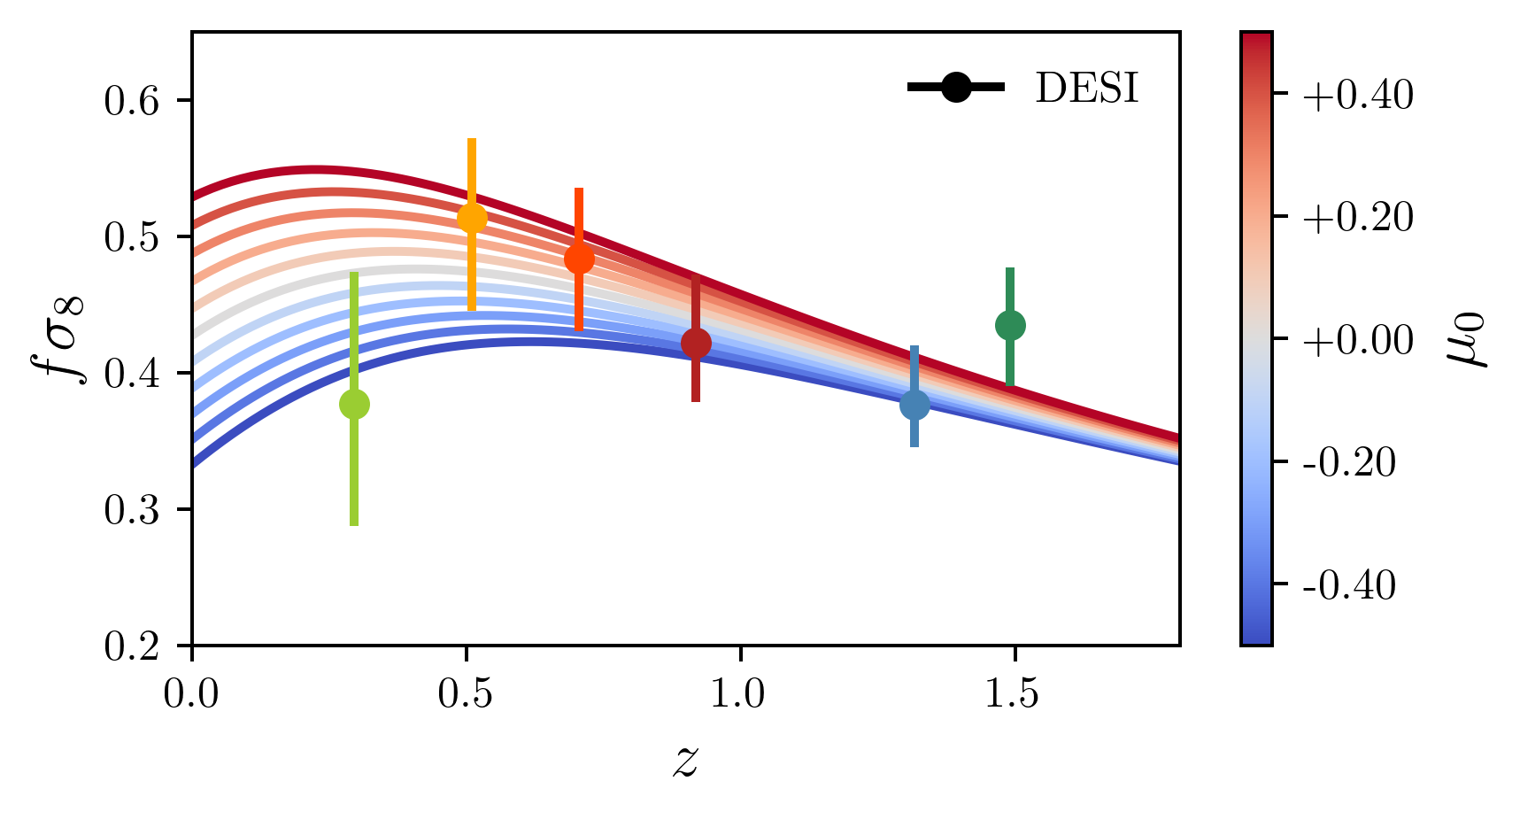
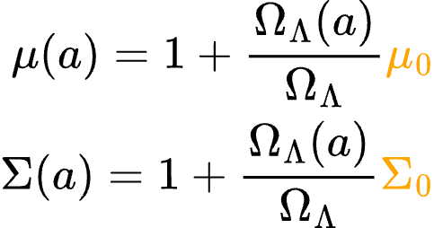
Full-shape DR1: Modified Gravity
FLRW:
At late times:
In GR:
Choose the following time dependence:
Growth rate of structure

Slide 26
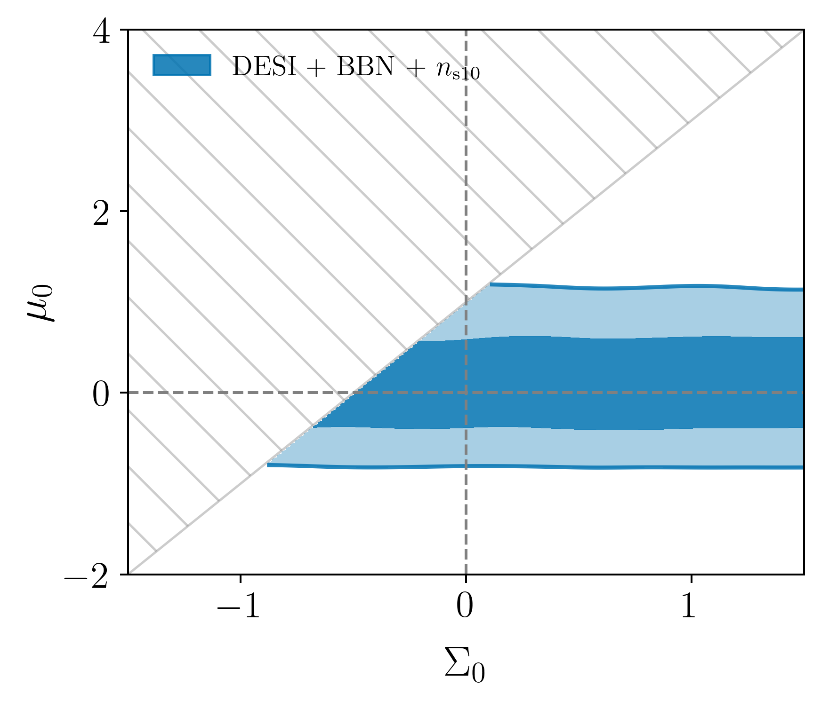

Full-shape DR1: Modified Gravity
Describes the motion of massive particles in a gravitational field:
→ can be directly constrained by DESI
GR
Area where we don’t trust our theory predictions

Slide 27


Full-shape DR1: Modified Gravity
Describes the motion of massive particles in a gravitational field:
→ can be constrained by lensing and ISW
Slight departure from GR related to CMB lensing anomaly​
GR
Area where we don’t trust our theory predictions

Slide 28


Full-shape DR1: Modified Gravity
Combination of clustering and lensing:
DESI +CMB-nl+DESY3
Suggest consistency with GR
GR
Area where we don’t trust our theory predictions

Slide 29


BAO: From DR1 to DR2
Only isotropic
BAO fit
bf: DESI + CMB + DESY5

Slide 30


BAO: From DR1 to DR2
bf: DESI + CMB + DESY5

Slide 31


BAO: From DR1 to DR2
Tension with SDSS is reduced to 2.6σ
bf: DESI + CMB + DESY5

Slide 32


BAO: From DR1 to DR2
Combination of
LRG3 and ELG,
yielding our tightest BAO measurement (15σ)
bf: DESI + CMB + DESY5

Slide 33


BAO: From DR1 to DR2
Error bars are reduced by a factor of two
bf: DESI + CMB + DESY5

Slide 34


BAO: From DR1 to DR2
New 2D BAO fits for QSO
bf: DESI + CMB + DESY5

Slide 35


BAO: From DR1 to DR2
Agreement & complementarity
between tracers
bf: DESI + CMB + DESY5

Slide 36


BAO: From DR1 to DR2
DR1 → DR2: 40% improvement in precision on Ω_{m} and hr_{d}
On the consistency between CMB
(including the new ACT results) and DESI, see arXiv:2504.18464

Slide 37

BAO: From DR1 to DR2
BBN prior on 𝜔_{b} :
DR1 → DR2: 40% improvement in precision on Ω_{m} and hr_{d}
Adding prior on angular acoustic scale 𝜃* :
On the consistency between CMB
(including the new ACT results) and DESI, see arXiv:2504.18464

Slide 38


Dark Energy Equation of State
We model a varying
DE equation of state through:
𝚲

Slide 39

Dark Energy Equation of State
We model a varying
DE equation of state through:
𝚲
DR1: DESI + CMB ⇒ 2.6σ

Slide 40

Dark Energy Equation of State
We model a varying
DE equation of state through:
𝚲
DR1: DESI + CMB ⇒ 2.6σ
DR2: DESI + CMB ⇒ 3.1σ

Slide 41

Dark Energy Equation of State
In 𝚲CDM:
→ DESI BAO predicts slightly
lower values of 𝛀_{m} than Planck
→ SN data sets predict
higher values of 𝛀_{m} than Planck

Slide 42

Dark Energy Equation of State
In 𝚲CDM:
→ DESI BAO predicts slightly
lower values of 𝛀_{m} than Planck
→ SN data sets predict
higher values of 𝛀_{m} than Planck
In w0waCDM:
→ Prediction of 𝛀_{m} from DESI BAO
consistent with SNe Ia data sets

Slide 43

Dark Energy Equation of State
𝚲
Combining DESI + CMB + SN:
DR1: DESI + CMB + Pantheon+ ⇒ 2.5σ
DR1: DESI + CMB + Union3 ⇒ 3.5σ
DR1: DESI + CMB + DESY5 ⇒ 3.9σ

Slide 44

Dark Energy Equation of State
𝚲
Combining DESI + CMB + SN:
DR1: DESI + CMB + Pantheon+ ⇒ 2.8σ
DR1: DESI + CMB + Union3 ⇒ 3.8σ
DR1: DESI + CMB + DESY5 ⇒ 4.2σ

Slide 45




Extended DE Study
Non-parametric way of determining w(z) through binning:
→ comparison of different redshift intervals without the assumption of a specific functional form
Chebyshev Polynomial
Testing different parameterisation
of either w(z) or ⍴_{DE}(z):
→ alternative 2 parameter models with different functional forms
→ introduction of additional degree of freedom
For more details, see arXiv:2503.14743

Slide 46
Futur prospects
Credit : DESI collaboration

Slide 47



DESI survey status
Main Survey almost finished after 4 years of observations !

Slide 48
DESI Timeline
DR3 collection final main survey
DR2
3 years extension​
DR1
Full shape results
DR2
BAO results
DR1
BAO results

Slide 49

DESI Extension
5 => 8 year survey (until 2029)
3M 3.6M Quasars (QSOs)
0.8<z<2.6
+ Ly-α z > 2.1
17M 21M Emission line galaxies (ELGs)
0.6<z<1.6
8M 10M Luminous red galaxies (LRGs)
0.4<z<1.1
13.5M 16M Bright galaxies
0<z<0.5
+ ~5M New sample of LRGs Luminous Galaxies Extension (LGE)
Increased density (+50%)
0.4<z<1.1
Increase sky area 14'000 => 17'000 deg²
Bigger Overlap with LSST
Expected ~60M extragalactic redshifts

Slide 50

Lots of new science to discover with DESI !
Full-shape MG constraints compatible with GR
​DR2 is fully consistent with DR1 with error bar smaller by almost ~2x​
DESI + CMB prefer dynamical DE at 3.1σ
Including SN data strengthens this to 2.8σ - 4.2σ

Slide 51
APPENDIX

Slide 52


Redshifts for the BAO analysis

Slide 53

Consistency with SDSS

Slide 54


DR2:
Level of Significance for the different data sets

Slide 55

Robustness of the Dark Energy results
Different level of CMB information:
→ CMB-derived priors
(late-time dark energy independent)
→ full CMB information (with or without lensing)
→ tighten constraints on w0wa through fixing 𝛀_{m}
DESY5 calibration:
→ remove samples for z > 0.1
→ best fit still lies in the lower quadrant
Replacing the CMB with DESY3:
→ constraints on w0wa purely depending on low-z probes

Slide 56


Robustness of the Dark Energy results
Results are robust to different CMB likelihoods

Slide 57

Robustness of the Dark Energy results
For supernovae at z > 0.1, which partially overlap the redshift range of DESI, the ΛCDM model that best fits the DESI data is also a good fit to the SNe data
(blue line)

Slide 58

Evolving DE: Adding Full-shape to the mix
For DR1:
2.5σ ⇒ 2.5σ
3.5σ ⇒ 3.4σ
3.9σ ⇒ 3.8σ

Slide 59




Full-shape DR1: Modified Gravity
Area where we don’t trust our theory predictions
Combination of clustering and lensing:
DESI +CMB
DESI +CMB-nl+
DESY3
GR

Slide 60

DESI Imaging systematics: QSO case
TS use Legacy survey DR9:
Trends in the number density of QSO vs imaging features (north region)
Relation QSO target density -1
Systematics need to be estimated for each photometric regions
Trends are corrected using different regression techniques:
  Linear
  Neural network (NN)
  Random forets
Chaussidon et al. 2022

Slide 61


Spectroscopic systematics: ELG case
Trends in the spectroscopic sucess rate vs spectroscopic features
Redshift catastrophics failure with sky-residual lines confusion
[OII] line confusion
z estimated
Across the focal plane
Vs the SNR
z true
+ lots of other features...
Yu et al. 2024
Krolewski et al. 2024
=> We observed only small trends according to spectroscopic features
Trends with spectroscopy are minors and have < 0.2σ impact on clustering measurements

Slide 62


Fiber assignment (FA)
Fiber patrol radius
Y1 FA mocks
Tests on ELG Y1 DESI mocks
Missing pairs at small separations!
Cut pair separation < 0.05 deg (~ size of the patrol radius) leads to unbiased measurement with FA
Pinon et al. in 2024

Slide 63


Fiber assignment:
Pairwise-Inverse-Probability (PIP) weighting scheme
Fiber patrol radius
Bianchi & Percival 2017
Mohammad et al. 2020
Statistical estimation to observe a galaxy pair:
Angular up-weight (ANG)
Number of FA runs
w_{ij} =
Number of time the galaxy pair has been observed
= 0 for galaxy inside the same patrol radius
The pairs DD and DR at a given separation angle θ are up-weighted

